Slide 1

Measuring the Magnetic and Density Structure of Near-Sun Coronal Mass Ejections
Greg Taylor, Tim Howard, Kevin Stovall, Jayce
Dowell, & Stephen White
December 9, 2016
SLF III, Pasadena, CA

Slide 2
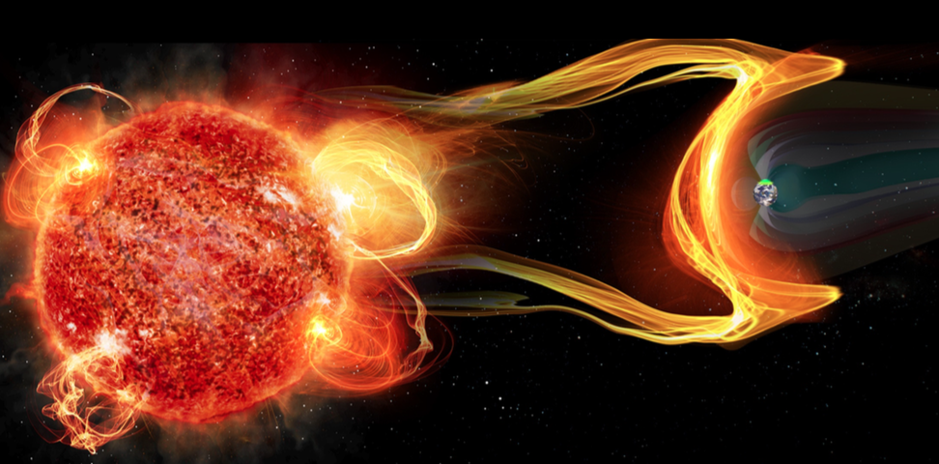
Coronal Mass Ejection

Slide 3
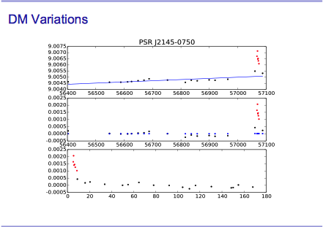

Slide 4
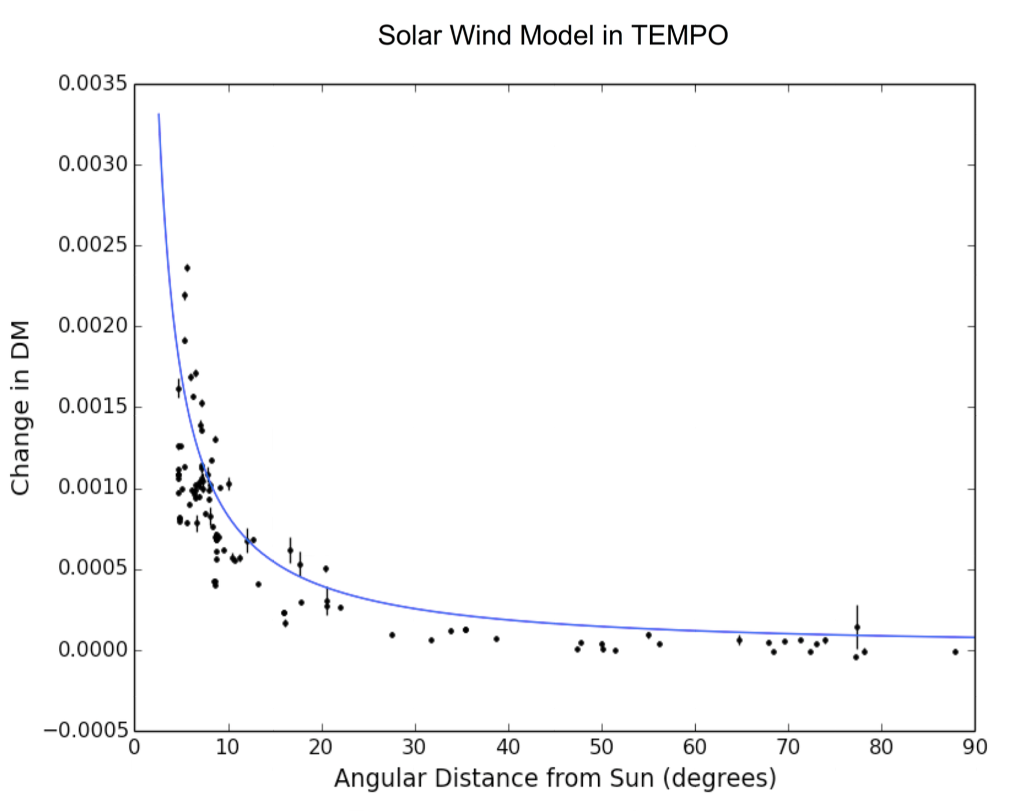
Solar System Electron Density

Slide 5
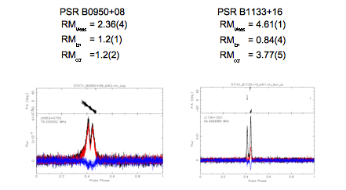
Rotation Measure Fitting
See poster by Veronica Dike et al., and talk by Joe Malins in this session

Slide 6
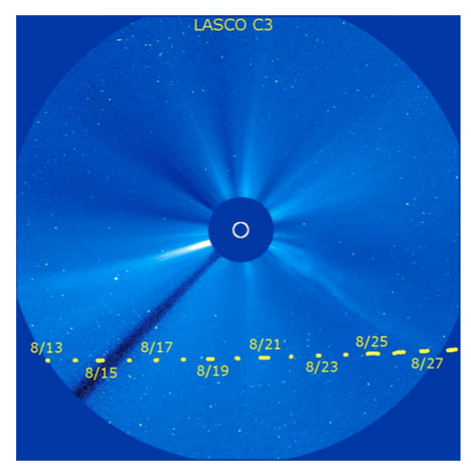
Catching a Coronal Mass Ejection
Howard et al 2016
and
AAS NOVA Research
Highlights on Dec 5
2016
B0950+08 passage
August 2015

Slide 7
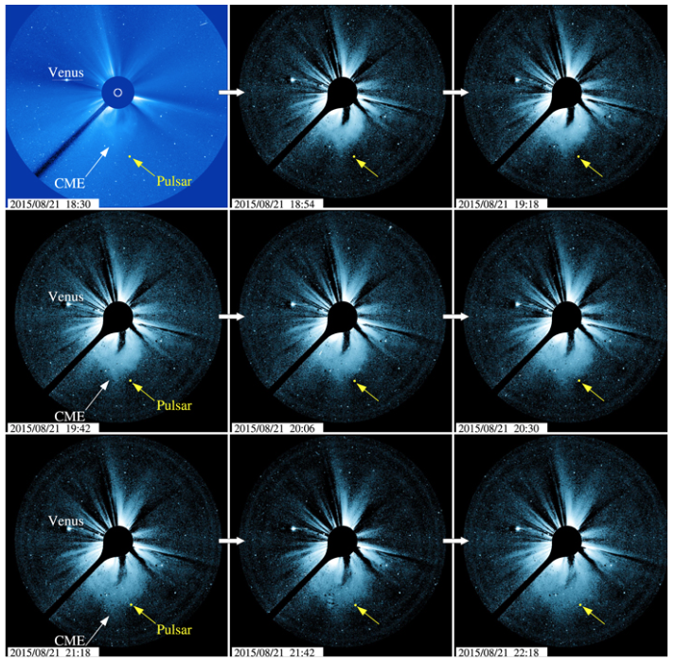

Slide 8
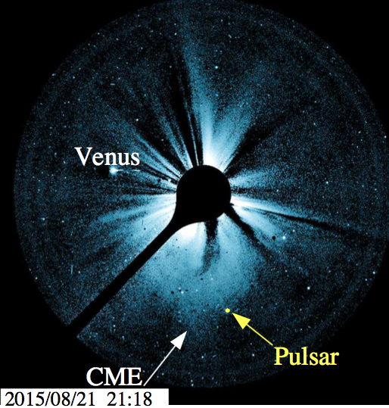
Catching a Coronal Mass Ejection

Slide 9

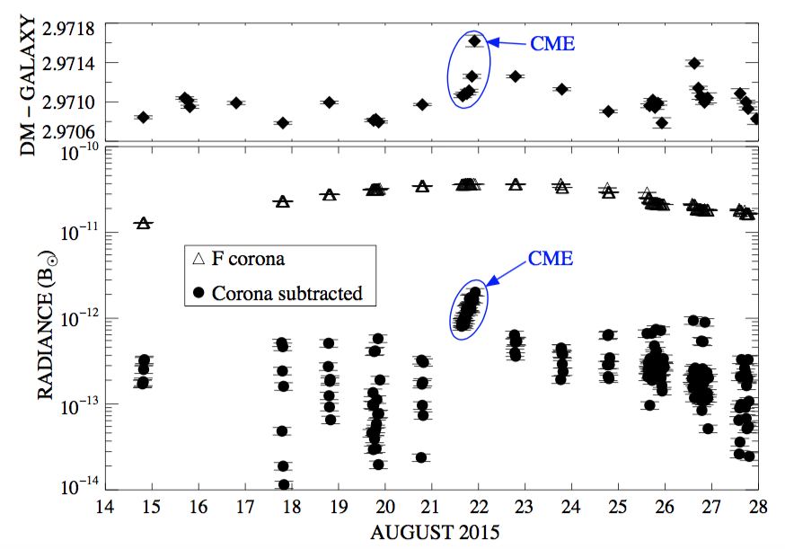
Catching a Coronal Mass Ejection

Slide 10

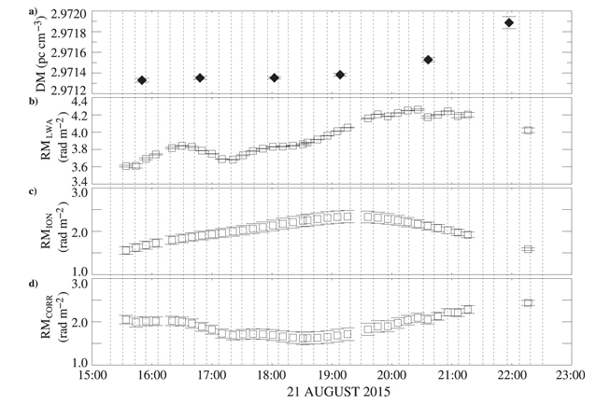
Catching a Coronal Mass Ejection
Results:
CME density of
3.5 x 10⁻¹⁸ kg/m³
from DM and
LASCO images
CME magnetic field
< 80 nT

Slide 11
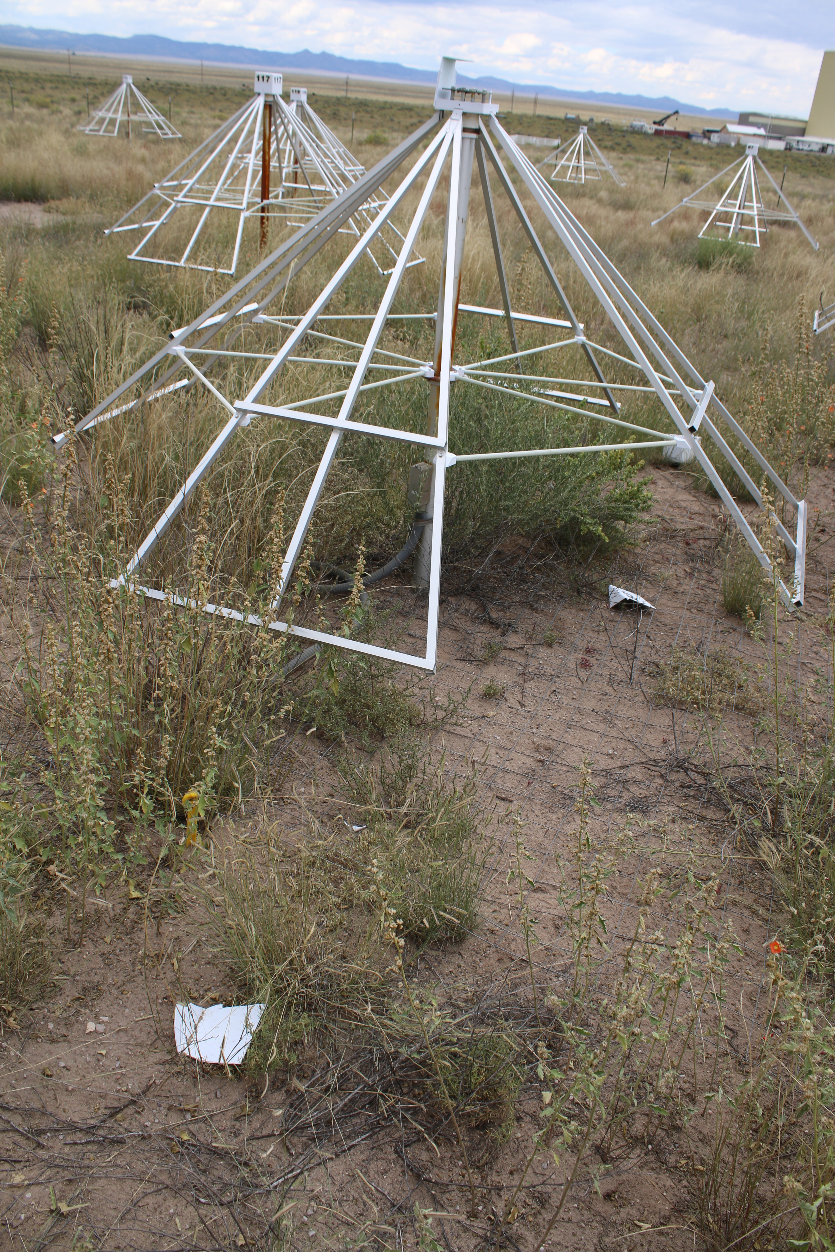
Natural Hazards
Lightning Strike on 9/21/15:
70 FEEs damaged
25 ARX boards damaged
2 cables damaged
1 antenna cap destroyed
Weather station destroyed

Slide 12
Catching a Coronal Mass Ejection
Results:
CME density of
3.5 x 10⁻¹⁸ kg/m³
from DM and
LASCO images
CME magnetic field
< 80 nT

Slide 13
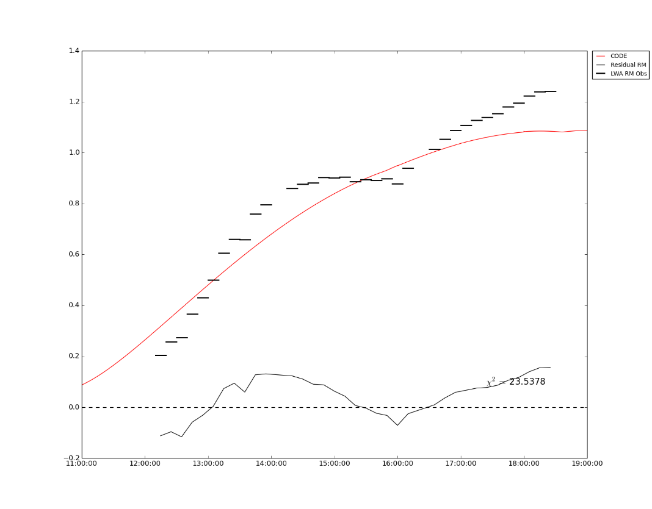
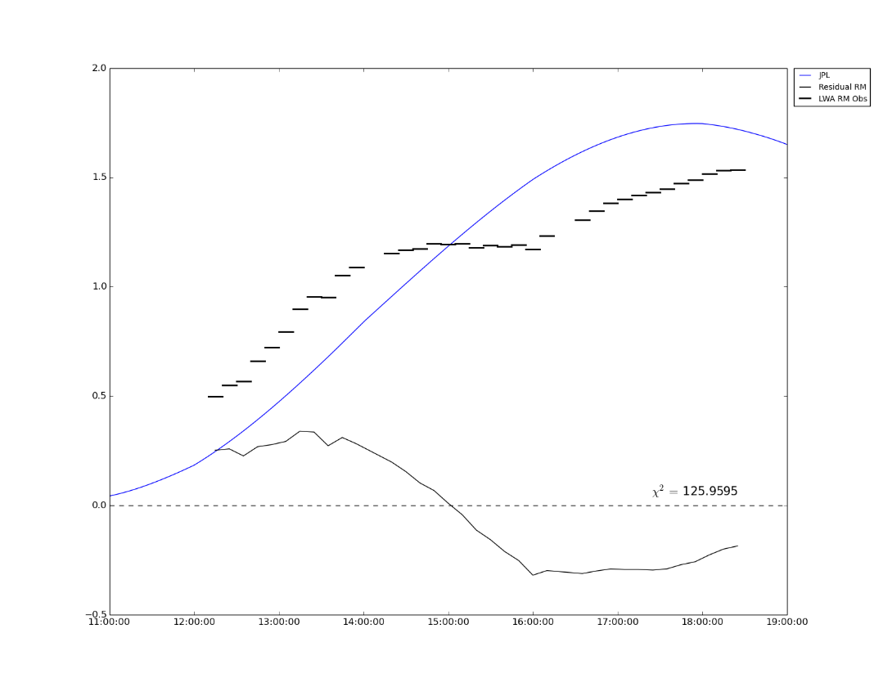
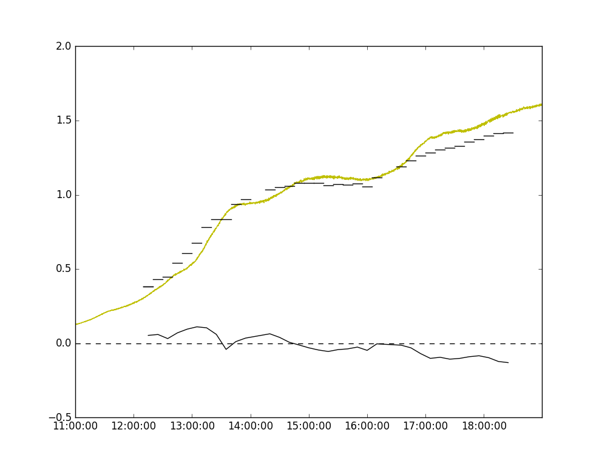



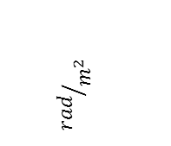
CODE Model
JPL Model
1.4
2.0
1.0
0.6
$${rad}/{m^{2}}$$
$$χ^{2}=0.6725$$
$$χ^{2}=3.5999$$
RM:
GPS Observation
Pulsar: B0950+08
3x 2Hour Observations
(Black Dashed Lines)
Date: 2016/09/23
2.0
See talk later
by Joe Malins
1.0
$$χ^{2}=0.3061$$

Slide 14
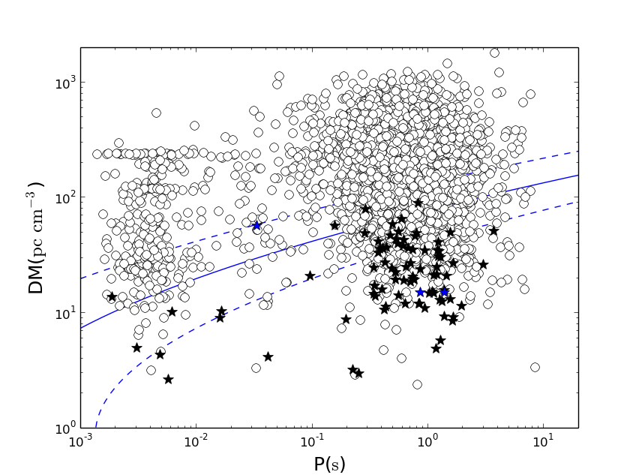
LWA1 Pulsar Detections
J0030+0451
B0031-07
J0034-0534
B0138+59
J0203+70
B0320+39
B0329+54
B0355+54
B0450+55
B0525+21
B0531+21*
B0628-28
B0655+64
B0809+74
B0818-13
B0823+26
B0834+06
B0919+06
B0943+10
B0950+08
B1112+50
B1133+16
B1237+25
J1327+34
B1508+55
B1540-06
B1541+09
B1604-00
B1612+07
B1642-03
B1706-16
B1749-28
B1822-09
B1839+56
B1842+14
B1919+21
B1929+10
B2020+28
B2110+27
J2145-0750
B2217+47
J2324-05
87 Pulsars detected (84 through pulsations, 3 through single pulses)
7 MSPs detected
Periods from 1.9ms to 3.7s
Stovall et al. (2014)

Slide 15
Adding LWA-SV
• Improved monitoring
• Resilience to thunderstorms

Slide 16
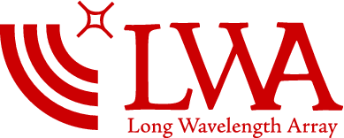
Summary
LWA1 measurements of the density of a CME is in good agreement with in-situ spacecraft measurements (from Helios)
Pulsars at low frequencies offer a high precision measurement of DM and RM which can provide the density and magnetic field strength
Ionospheric Faraday correction is the current limiting factor
Additional stations and pulsars will be of great value to improve monitoring opportunities
3C196

Slide 17
Extra Slides
3C196

