Slide 1
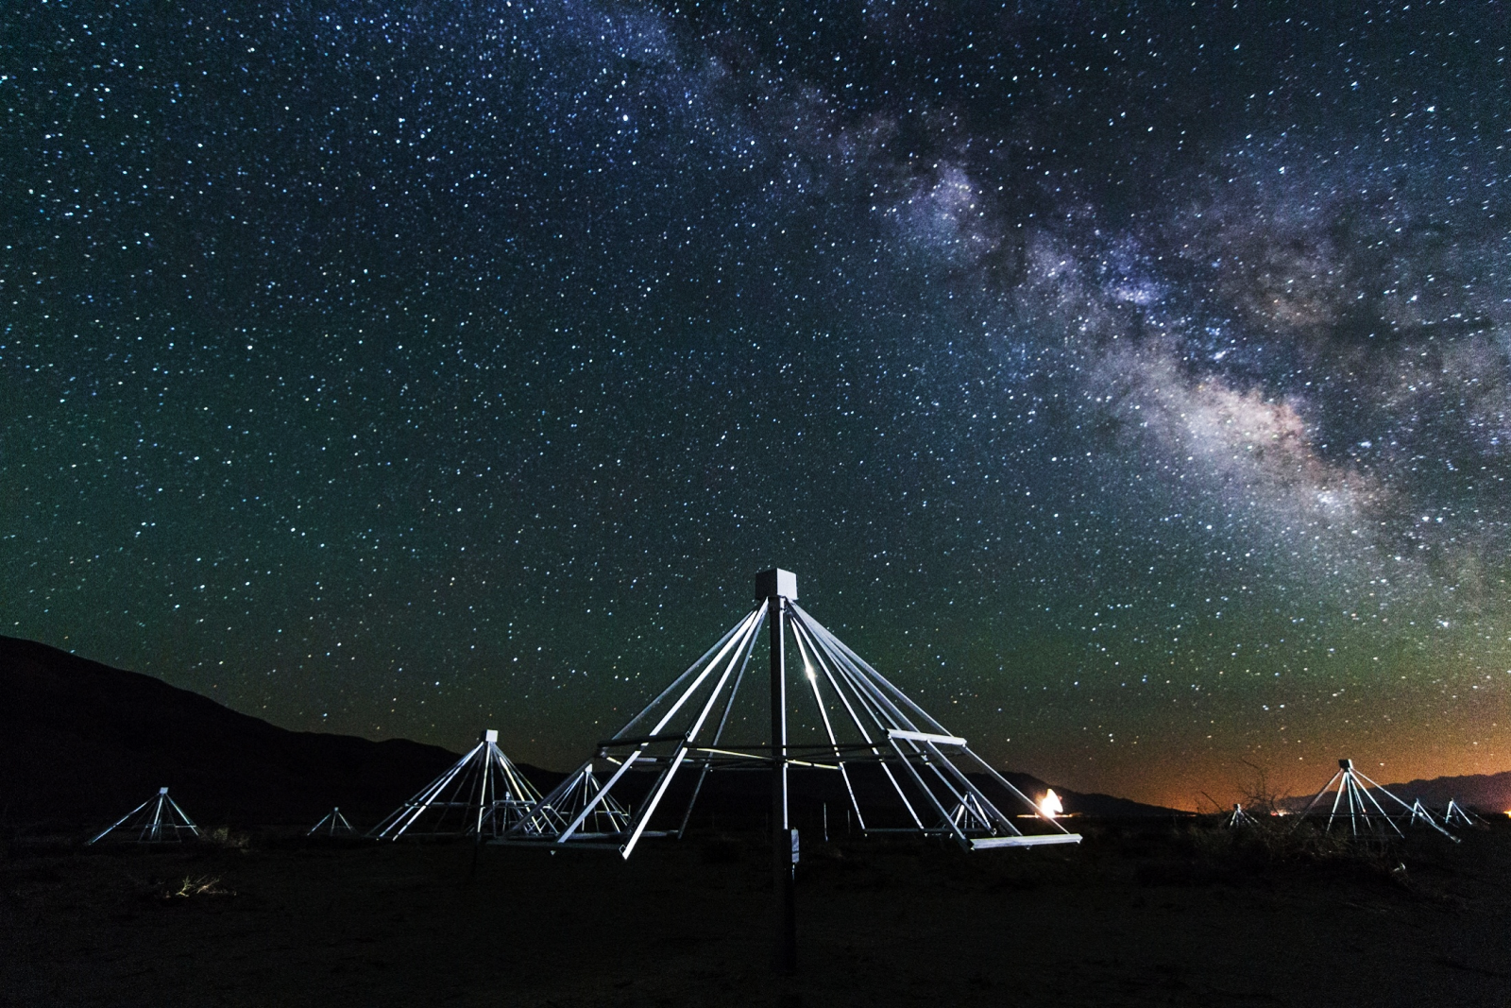
Imaging Spectroscopy of CME-associated Radio Bursts with
OVRO - LWA
Sherry Chhabra
Supervisor: Dr Dale Gary
Centre for Solar and Terrestrial Research
New Jersey Institute of Technology
Science at Low Frequencies III December 9th, 2016

Slide 2
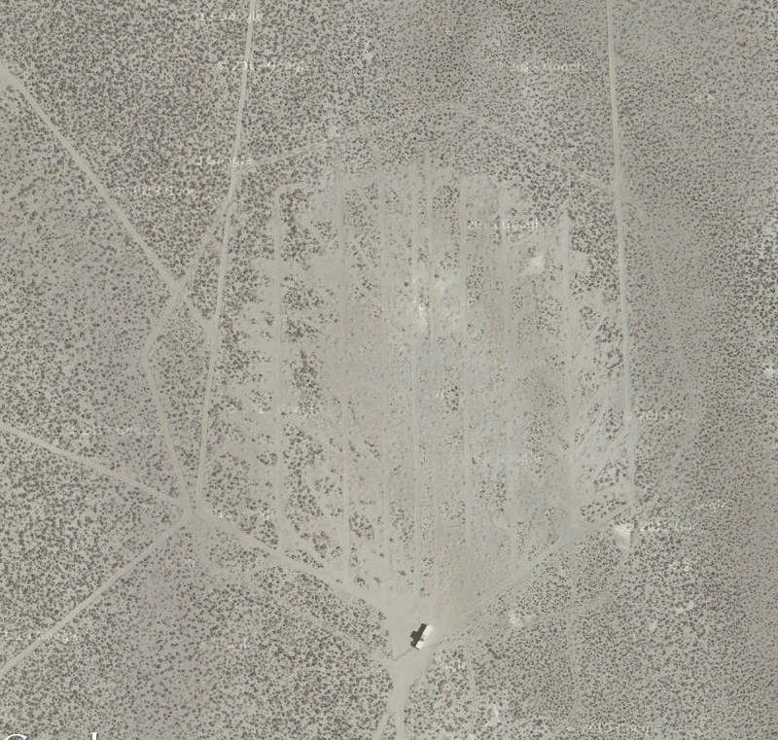
OVRO-LWA
Low frequency Radio interferometer with 252 antennas over a ~ 1.6 km region
Nominally observes 25 – 85 MHz (41-69 MHz for these observations, spatial resolution 0.26 – 0.16 degrees)
Optimized to minimize side-lobes
Images the full sky as frequently as every one second (9 s for these observations).

Slide 3
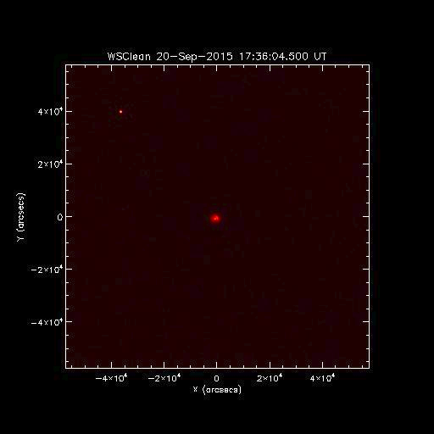
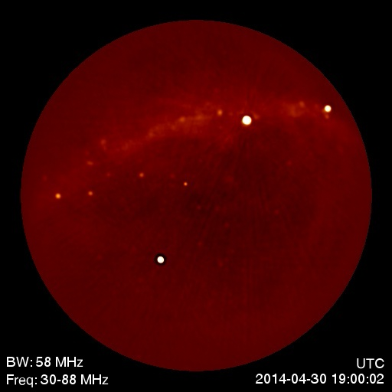
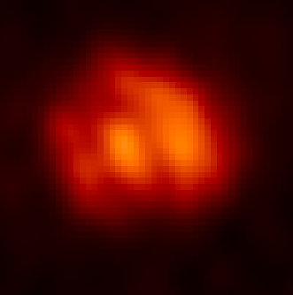
Image Processing for Solar Data from LWA
Step 1: All Sky image: Centring the Sun + Cleaning

Slide 4
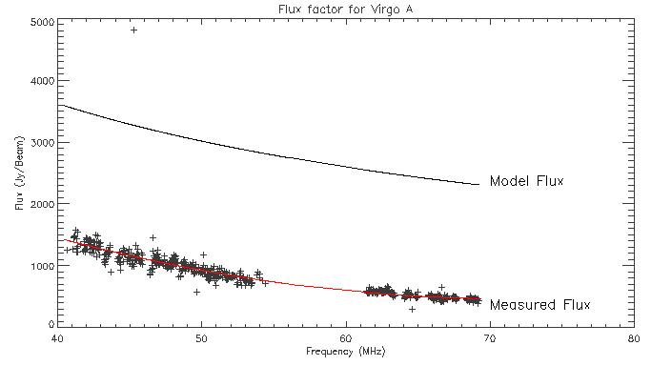
Step 2: Flux and Position calibration using a strong source (Virgo A)
Virgo A flux density spectrum from
Vinyaikin, E.N. Astron. Rep. (2016) 60: 744. doi:10.1134/S1063772916080084
Virgo A
Notes:
This is a We use the fit flux factor and enhance the solar flux by the same. And finally our images are ready for analysis.

Slide 5
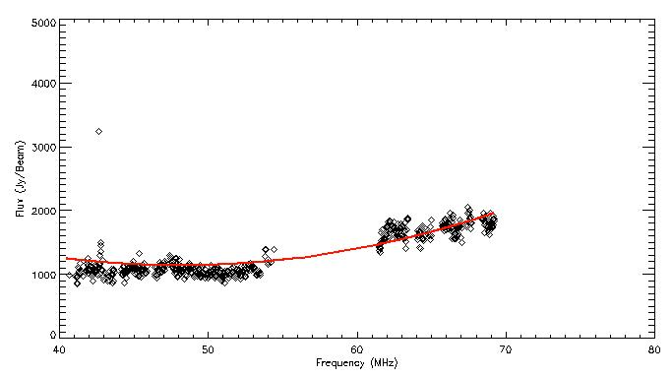
What about Data Quality?
Solar flux density at a quiet time before the burst began, after applying the Virgo A calibration factor
Notes:
We measure the flux for quiet sun over the observed range of frequencies and get a rough measure of the opacity. Show measured and modelled quiet sun flux plot here and talk about what the comparison tells us in terms of opacity

Slide 6
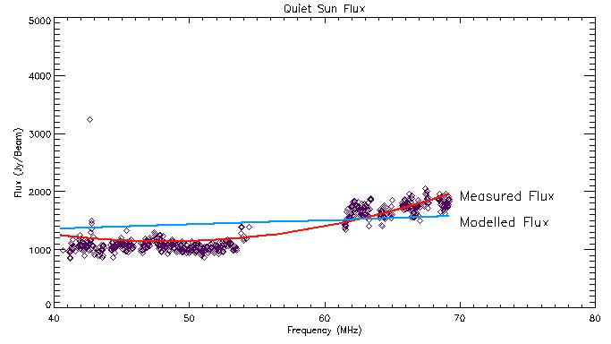
Measured QS flux density matches expectations
Measured solar flux density (red) compared to a model corona (blue) assuming a temperature T = 10⁶ K
Where the data fall below the model, this is a possible indication that the quiet Sun emission is becoming optically thin (optical-depth-unity surface falls below plasma level.
Notes:
Quality of the LWA data with respect to the optical depth

Slide 7
Observed CME: September 20th 2015 AIA 171
Notes:
SXR M2.1 class flare which was observed at the southwest corner on the solar disk
AIA 171 showing the event occurring at 18:30 UT (around 6-7 sec into the movie)
We Observed the Sun for approximately 100 minutes (Pre-event, during the event and post-event data was analysed)

Slide 8
LASCO C2 view

Slide 9
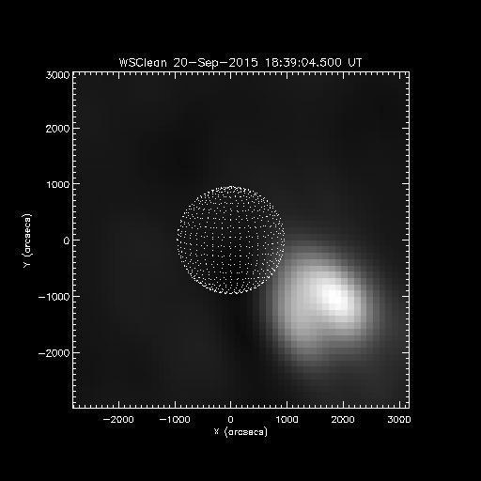
Notes:
Event at both low and high frequencies

Slide 10
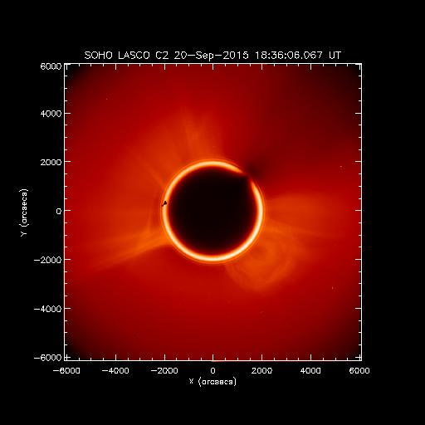
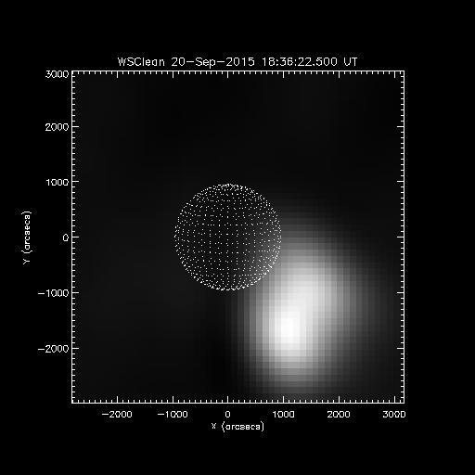
Notes:
Band 08

Slide 11
LASCO Co- Alignment
Notes:
So our basic aim is to understand the structural evolution of the event \
We get a spatial and temporal comparison with LASCO and SWAP (WL and EUV)

Slide 12
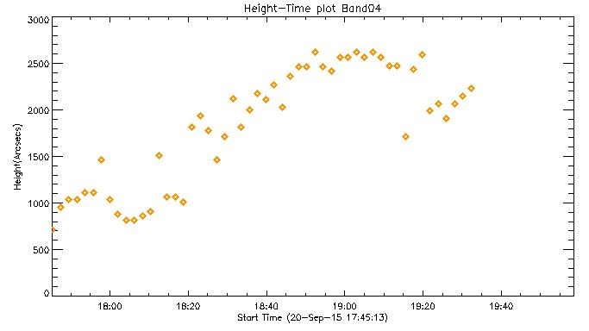
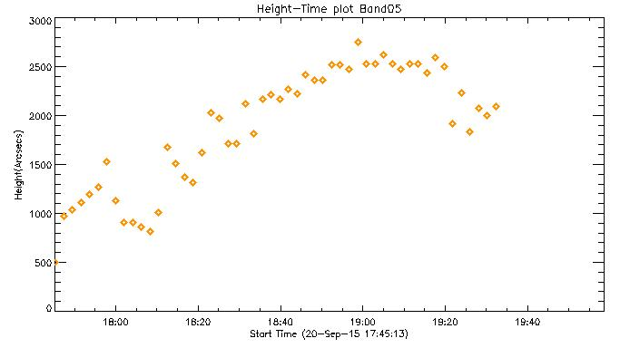
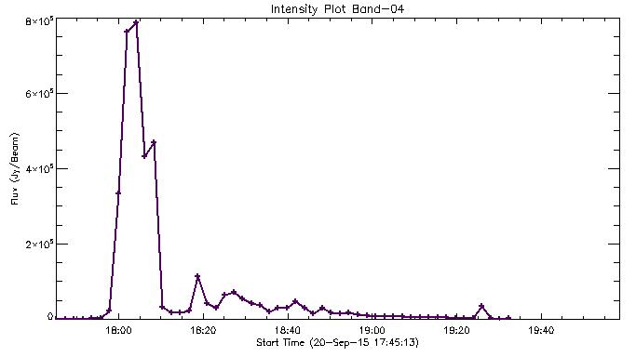
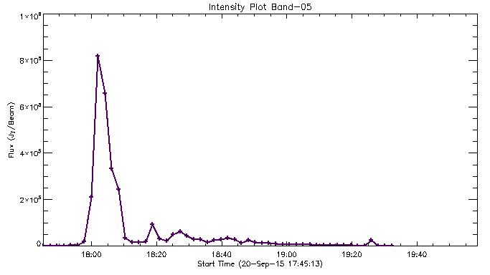
Height-Time Evolution
Notes:
Talk about the velocity trend

Slide 13
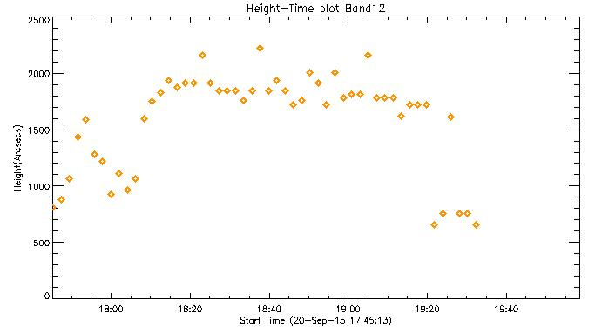
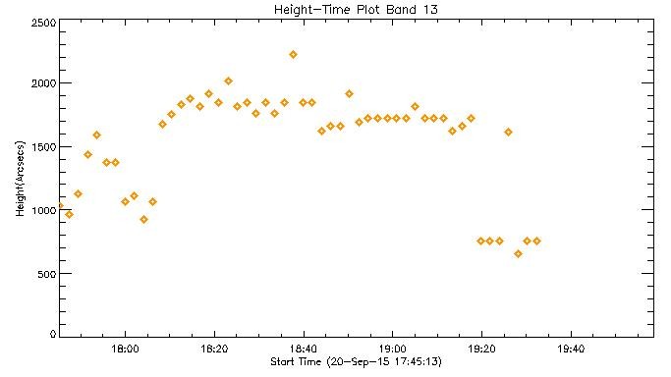
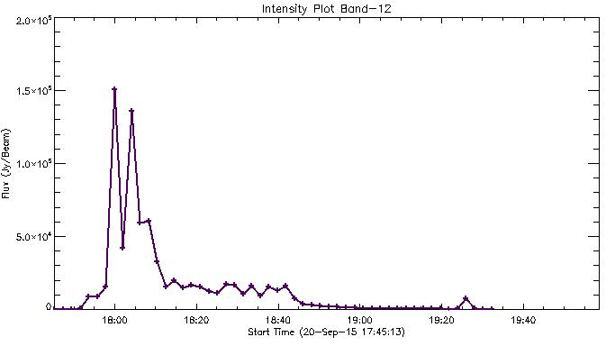
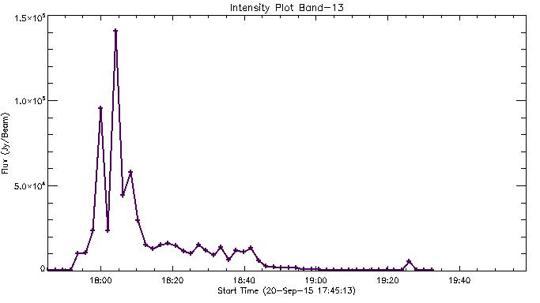

Slide 14
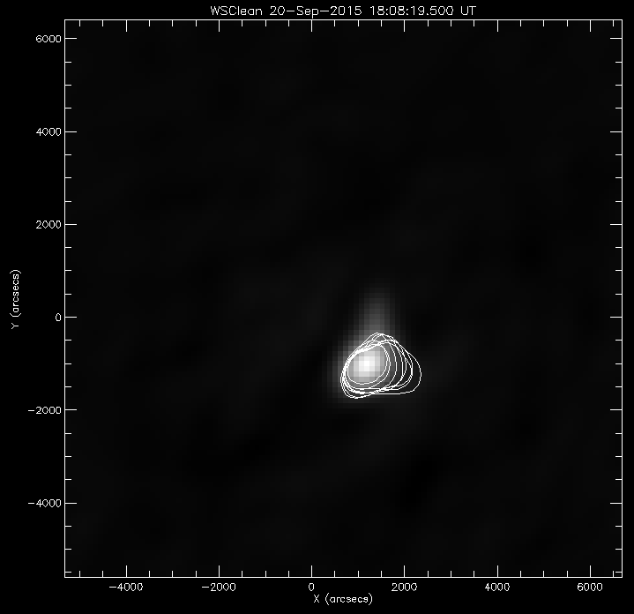
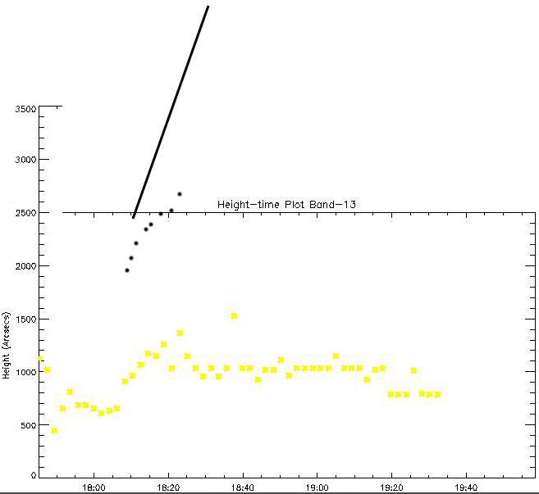

Slide 15
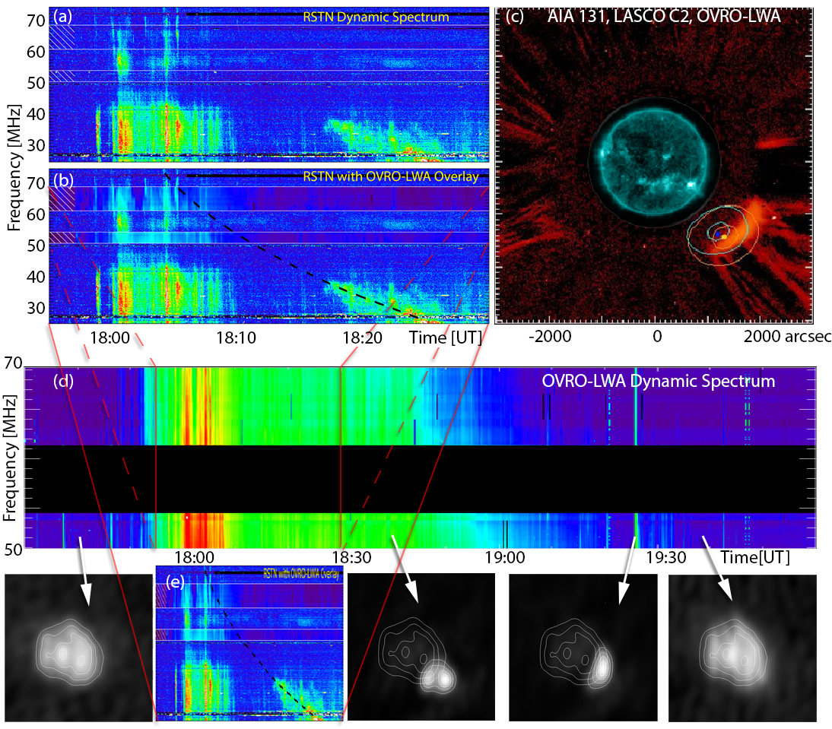
Notes:
Overview of the event: Backward Extrapolation of the type II and the emission observed in LWA (18:10)at the same time
high resolution of LWA
Emission at ~ 19:20 ??

Slide 16
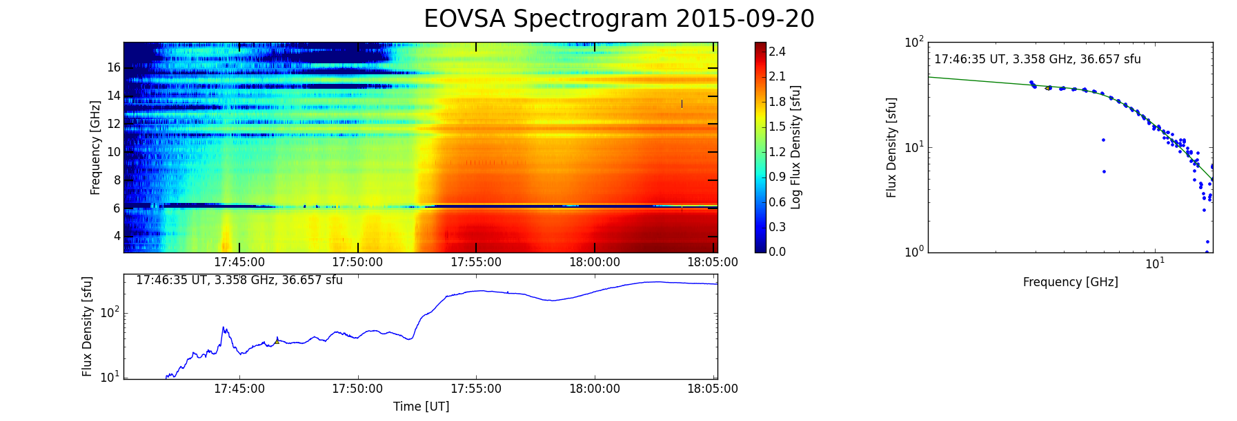

Slide 17
Summary
We have an almost perfect flux calibration
Position calibration still needs to be worked (Correlator output offset which causes and offset in the sun’s position)
Looking at ~1 optical depth (very good quality data)
Height-time plots show clear outward motion and their correlation with other wavelengths
More to do:
Get a better estimate for the outward velocities
Analyze all available frequencies at all times
Spatial and Temporal correlation with AIA , SWAP.

Slide 18
Thank you

