Slide 1
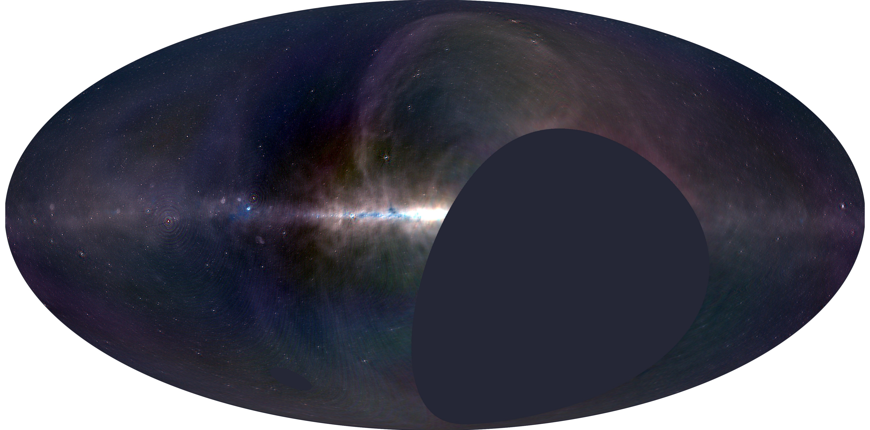
Science at Low Frequencies III
Pasadena
Dec 7th - 9th, 2016

Slide 2
Scientific Organizing Committee
Gregg Hallinan - Caltech
Melanie Johnston-Hollitt - Victoria University of Wellington
Greg Taylor - University of New Mexico
David Kaplan - University of Wisconsin-Milwaukee
Cath Trott - ICRAR/Curtin
George Heald - CSIRO
Rene Vermeulen - ASTRON
Tracy Clarke - Naval Research Laboratory
Jason Hessels - University of Amsterdam / ASTRON
Danny Jacobs - Arizona State University
Yashwant Gupta - NCRA-TIFR
Local Organizing Committee
Marin Anderson - Caltech
Michael Eastwood - Caltech
Ryan Monroe - Caltech
Harish Vedantham - Caltech
Joseph Lazio - JPL
Gregg Hallinan - Caltech

Slide 3
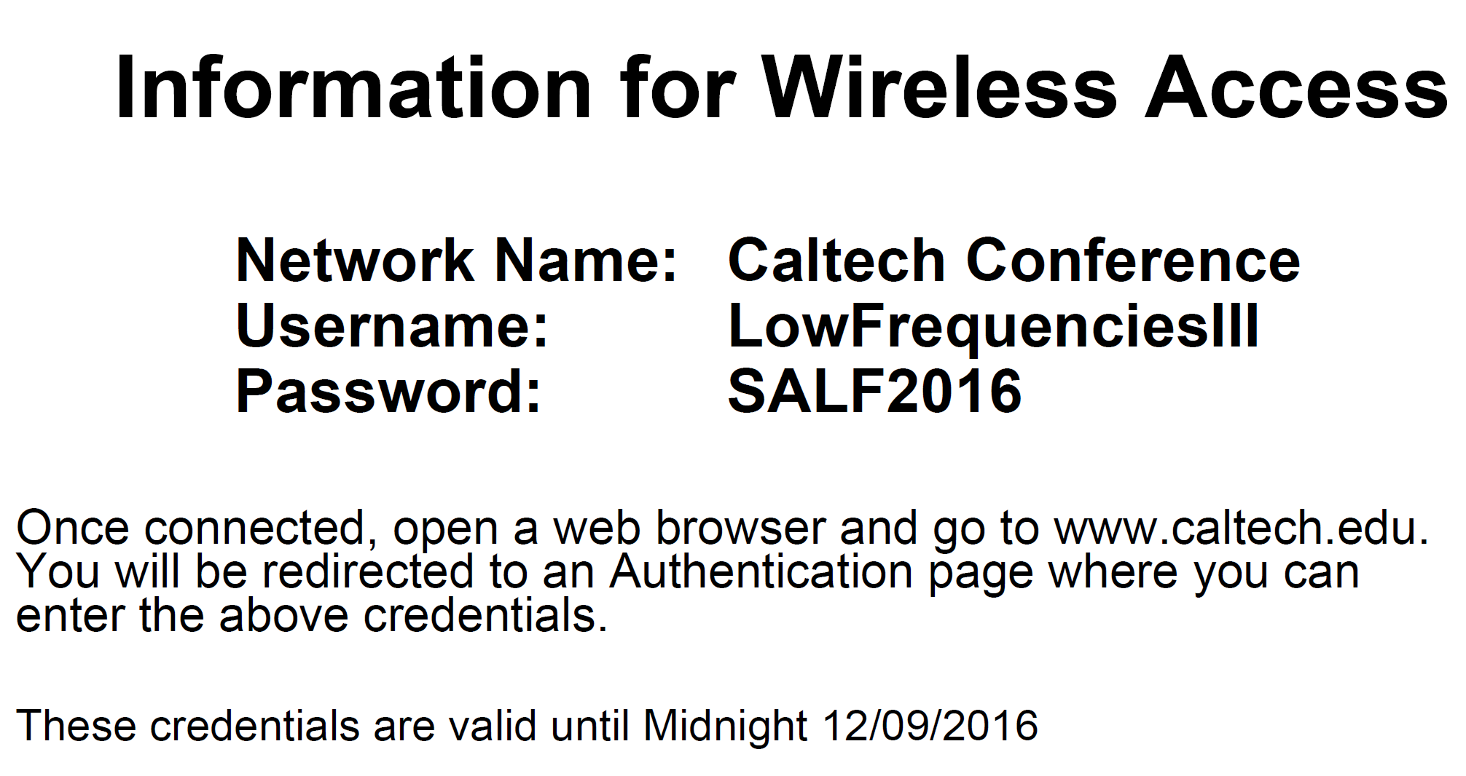

Slide 4
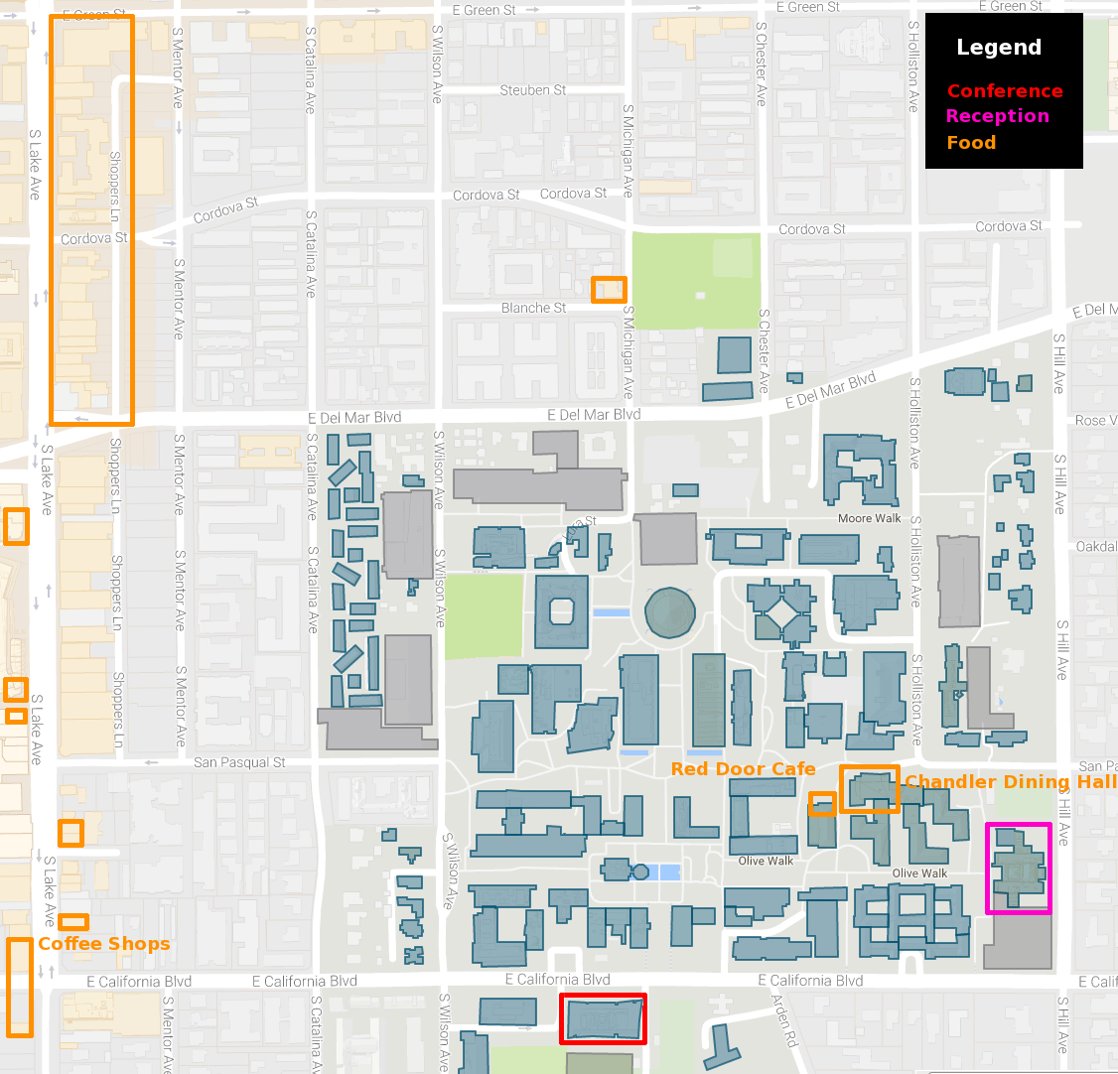
Breakfast served each morning at 7.45am
Coffee breaks on the patio
Reception at the Athenaeum

Slide 5
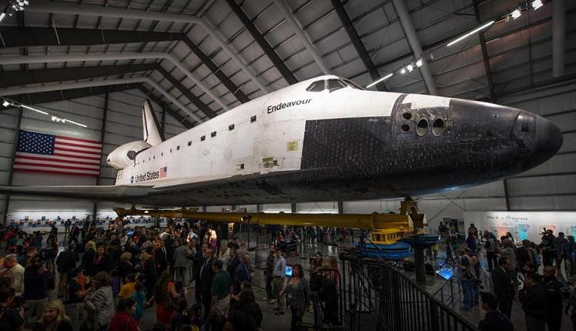
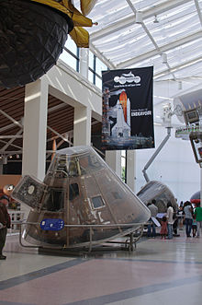
There are spaces still available on the conference excursion to the California Science Center on Saturday, Dec 10
Contact Harish Vedantham - harish.ved@gmail.com

Slide 6
Presentation Guidelines
Please allow 3 minutes questions for an invited talk; 2 minutes for contributed talk
Please come to the front to have your mic installed during question time of the previous talk
Your presentation slides will load 1 minute before the allocated slot time

