Slide 1
Presentations On-line
All presentations will be on-line next week
Please contact lowfrequencies3@gmail.com if you want to modify your slides
Photos from the conference? Please share!

Slide 2
Scientific Organizing Committee
Gregg Hallinan - Caltech
Melanie Johnston-Hollitt - Victoria University of Wellington
Greg Taylor - University of New Mexico
David Kaplan - University of Wisconsin-Milwaukee
Cath Trott - ICRAR/Curtin
George Heald - CSIRO
Rene Vermeulen - ASTRON
Tracy Clarke - Naval Research Laboratory
Jason Hessels - University of Amsterdam / ASTRON
Danny Jacobs - Arizona State University
Yashwant Gupta - NCRA-TIFR
Local Organizing Committee
Marin Anderson - Caltech
Michael Eastwood - Caltech
Ryan Monroe - Caltech
Harish Vedantham - Caltech
Joseph Lazio - JPL
Gregg Hallinan - Caltech

Slide 3
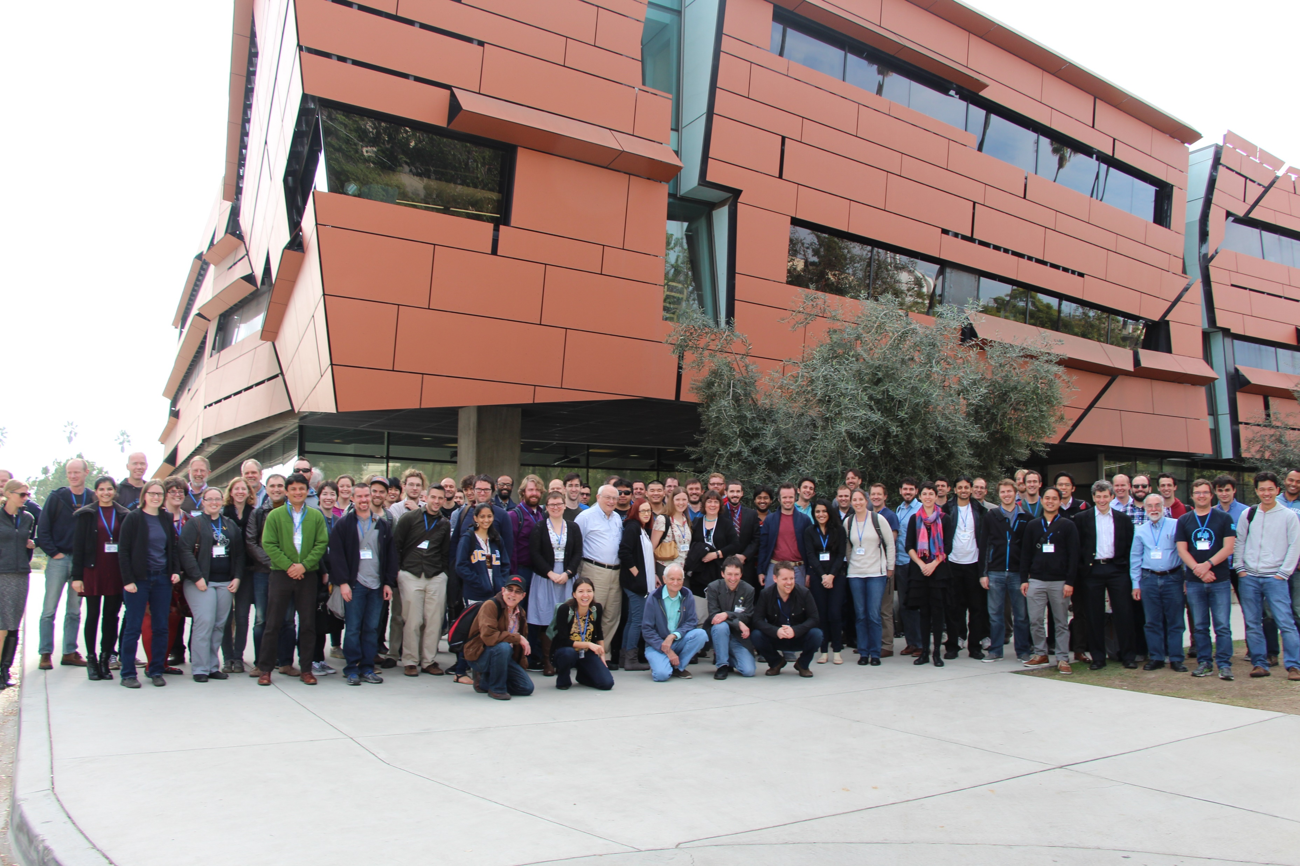
Thank you!

Slide 4
Science at Low Frequencies IV
University of Sydney, Australia
Main conference: 13th – 15th December 2017
Workshops: 12th December 2017

