Slide 1
Observations of pulsar microstructure with the GMRT
Kishalay De (Caltech / IISc)
Yashwant Gupta (NCRA-TIFR), Prateek Sharma (IISc)
Science at Low Frequencies 2016

Slide 2
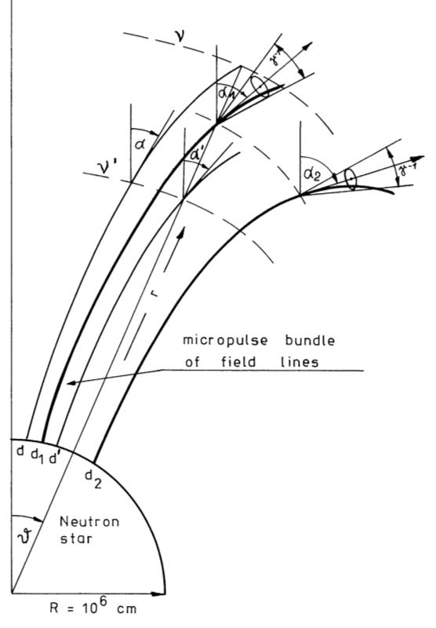
Microstructure emission
Gil 1982
Milli-period timescale (often quasi-periodic) intensity fluctuation in sub-pulse emission.
Autocorrelation function (ACF) of single pulses show periodic maxima.
Timescales increase with rotation period.
Geometric sweeping of micro-beams or temporal modulation of emission?
Cordes et al. 1990

Slide 3
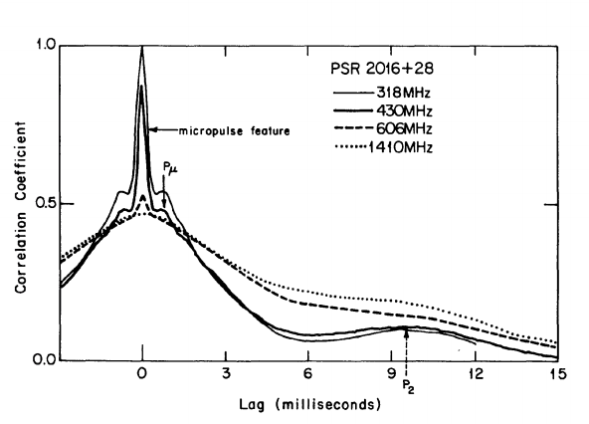
Probing microstructure with GMRT
Observations limited to brightest pulsars.
Few studies of microstructure polarization and frequency evolution.
Previously undetected in millisecond pulsars.
GMRT well placed to explore new parameter spaces in the field.
Cordes et al. 1990
This campaign:
Single frequency full Stokes observations at 325 and 610 MHz (BW 32 MHz)
Simultaneous dual frequency total intensity observations at 325 (BW 32 MHz) and 650 MHz (BW 100 MHz)
Coherently dedispersed with recently developed real-time pipeline (De & Gupta 2016)

Slide 4
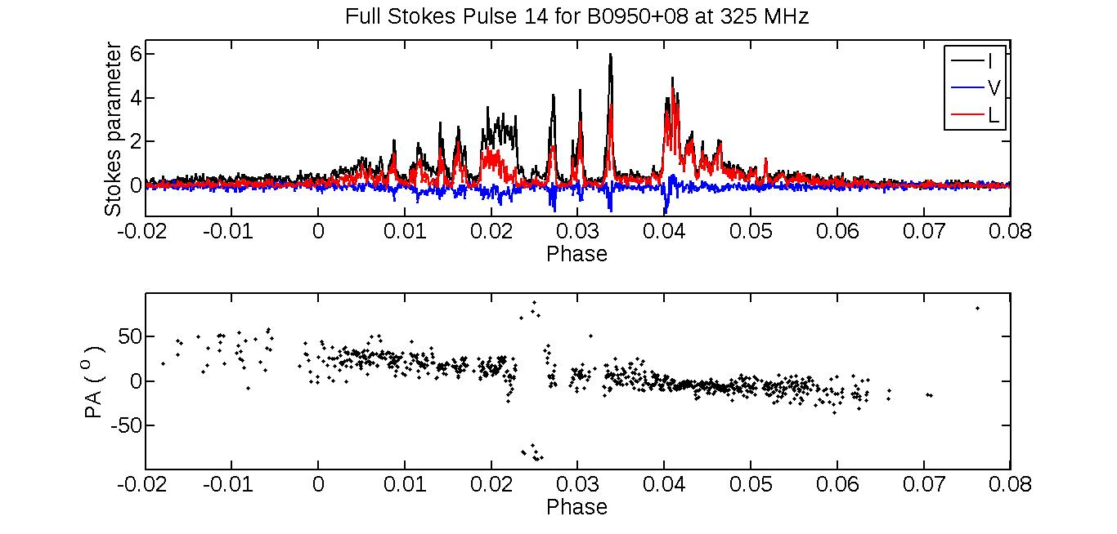
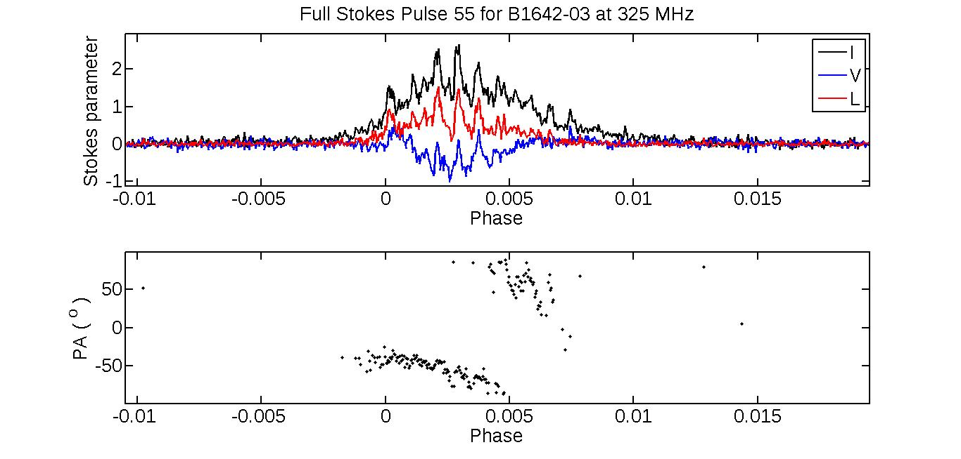
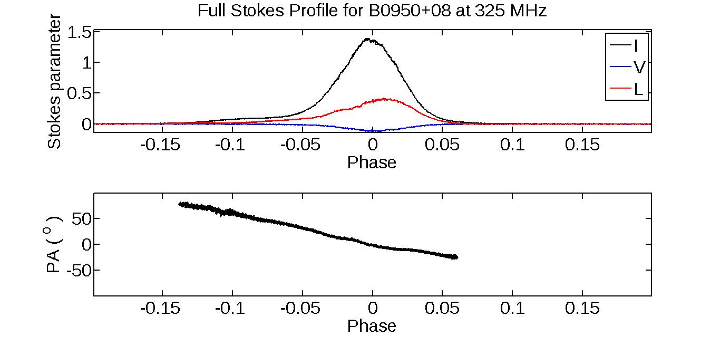
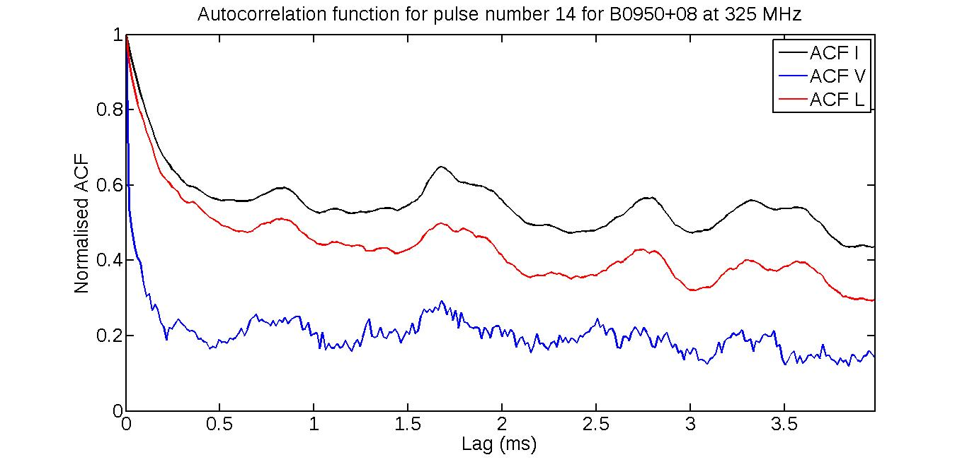
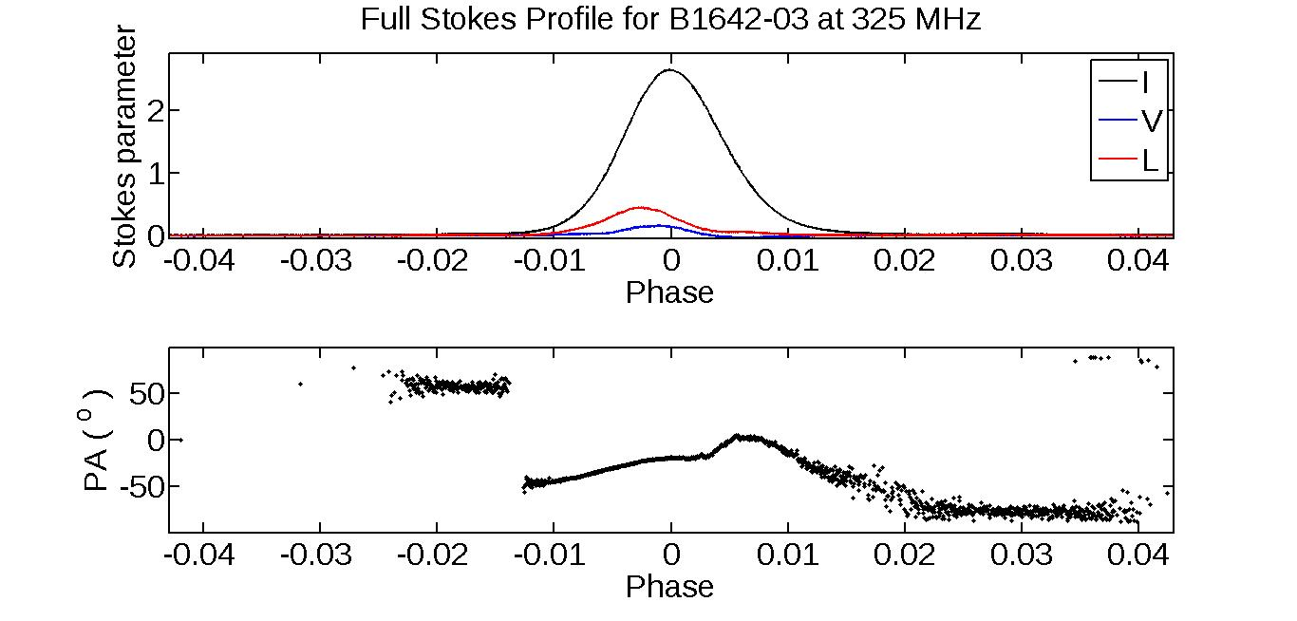
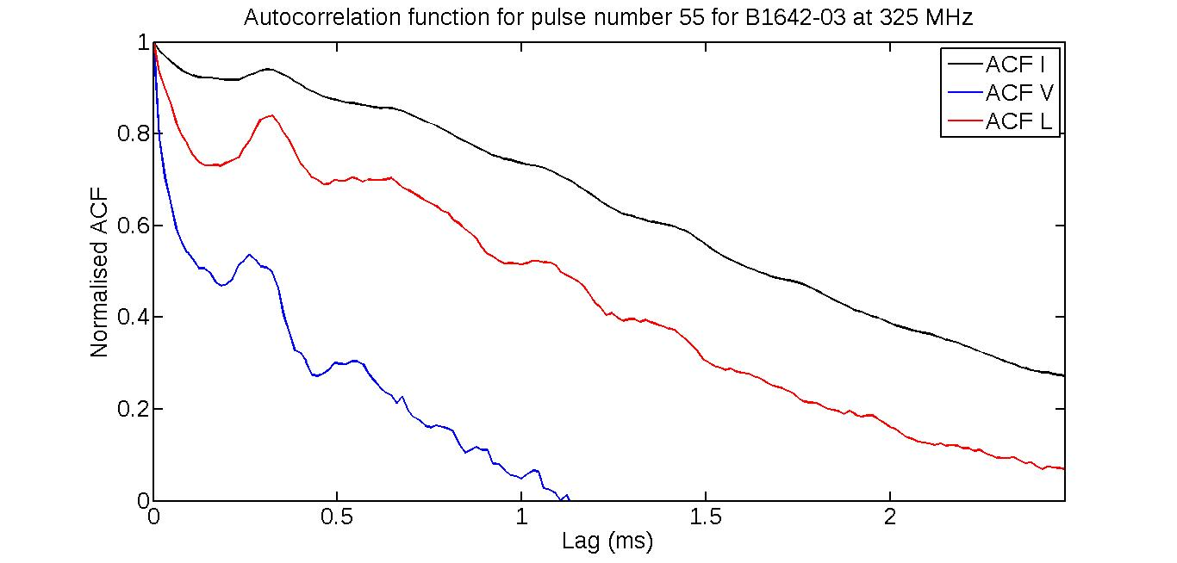
Initial results: GMRT observations at 325 MHz
B0950+08
B1642-03
De, Gupta & Sharma, in prep.

Slide 5
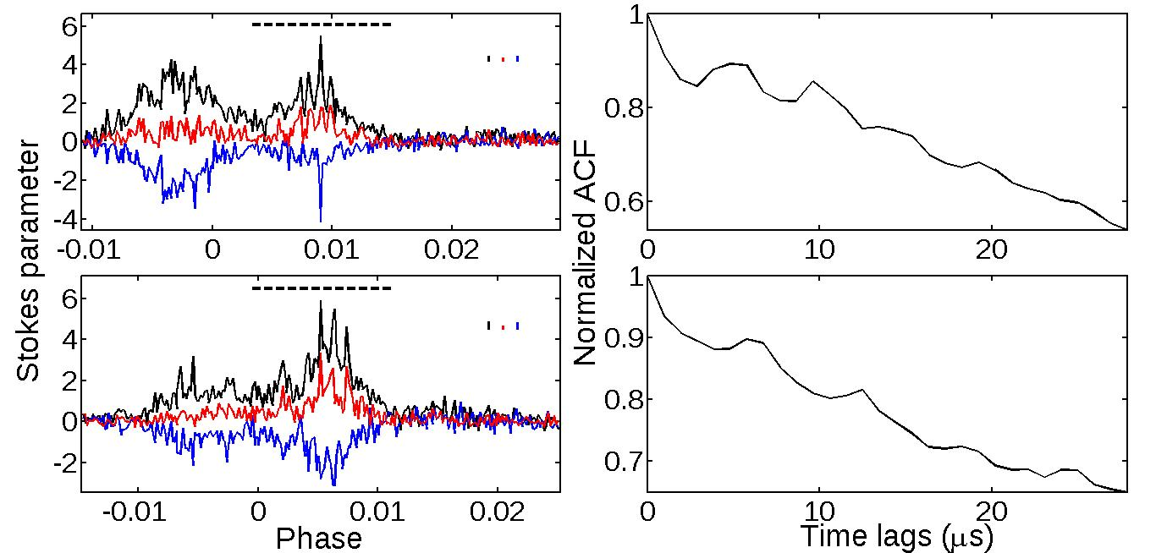
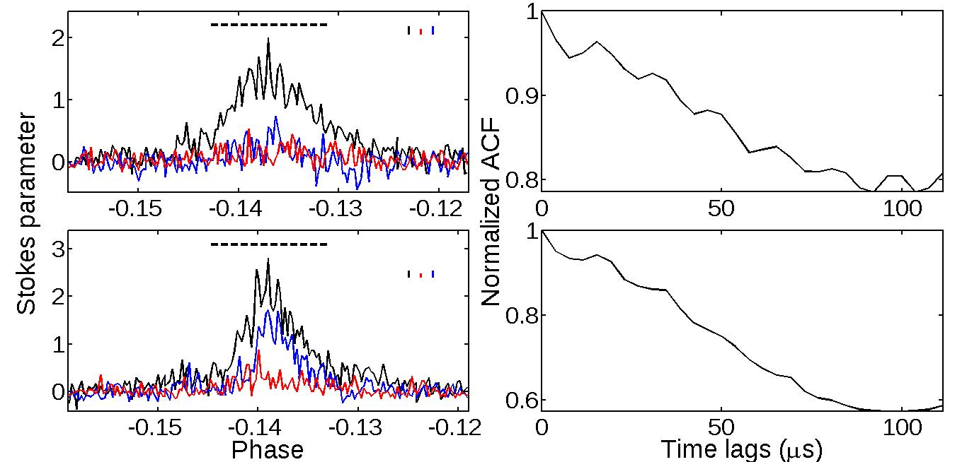
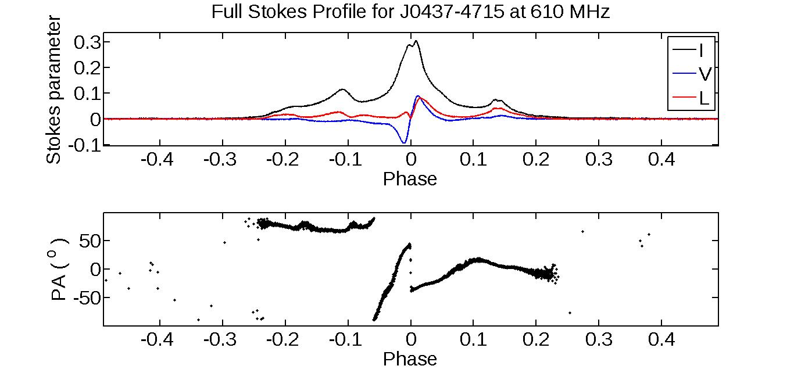
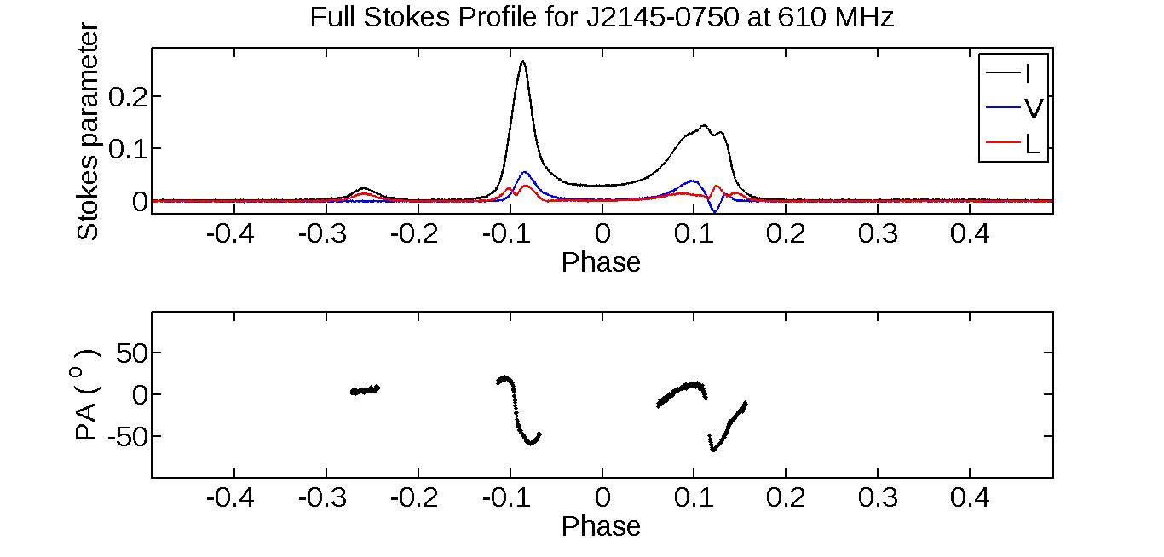
Millisecond pulsars
De, Gupta & Sharma, 2016
PSR J0437-4715 at 610 MHz
PSR J2145-0750 at 610 MHz

Slide 6
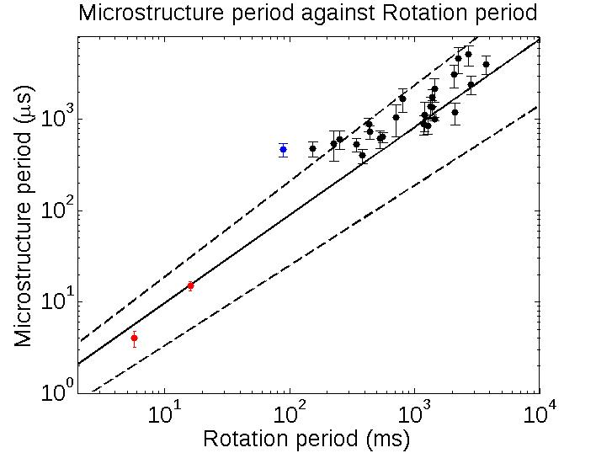
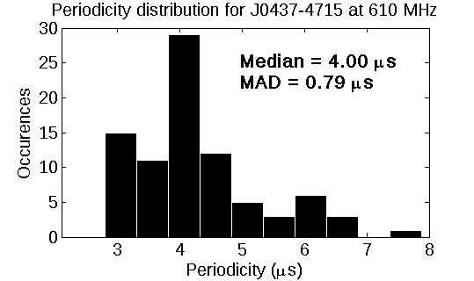
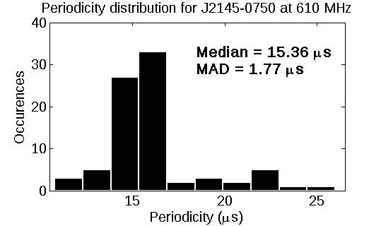
Millisecond pulsars
De, Gupta & Sharma, 2016
Micro-beams have constant angular widths.
Temporal modulation directly dependent on rotation period.

Slide 7
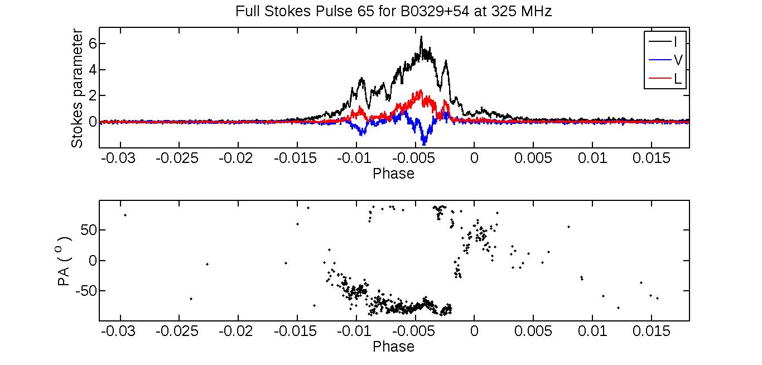
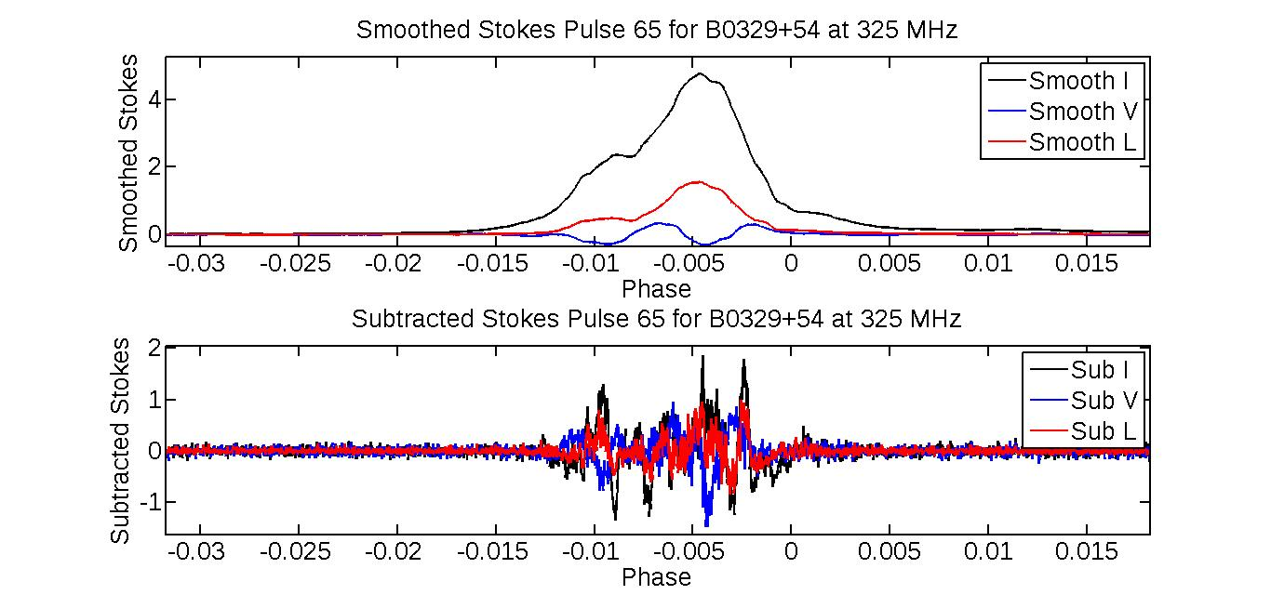
Automated characterization
Subtract underlying sub-pulse emission from single pulses.
Measure widths from ACF of microstructure features.
Measure periodicities from power spectrum of microstructure features.
B0329+54
De, Gupta & Sharma, in prep.

Slide 8
Automated characterization
De, Gupta & Sharma, in prep.
B0950+08 widths
B0950+08 periods
B1642-03 widths
B1642-03 periods

Slide 9
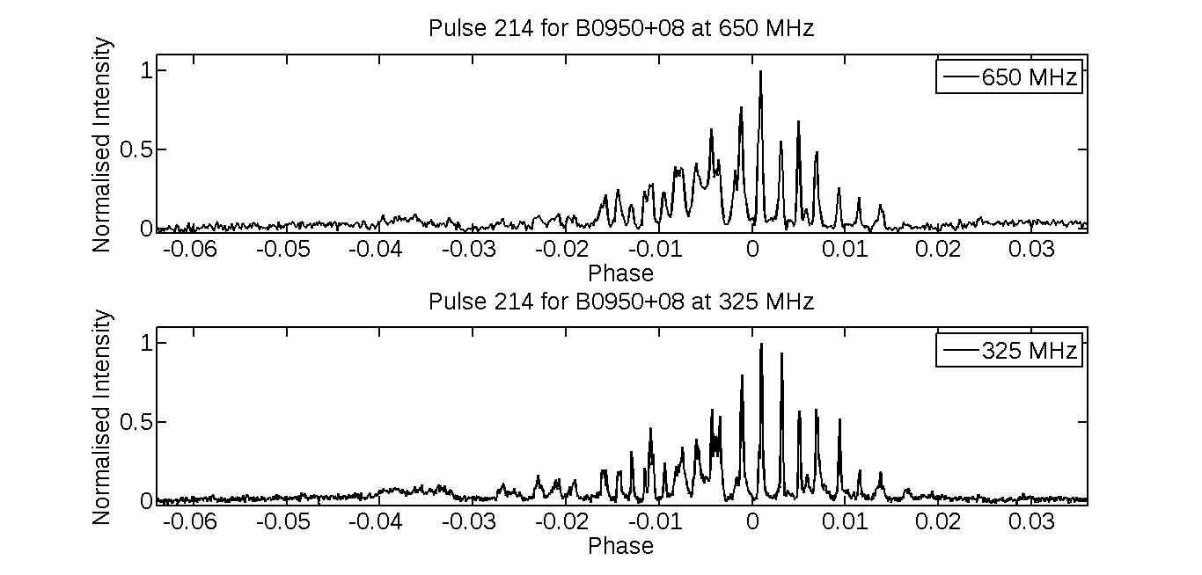
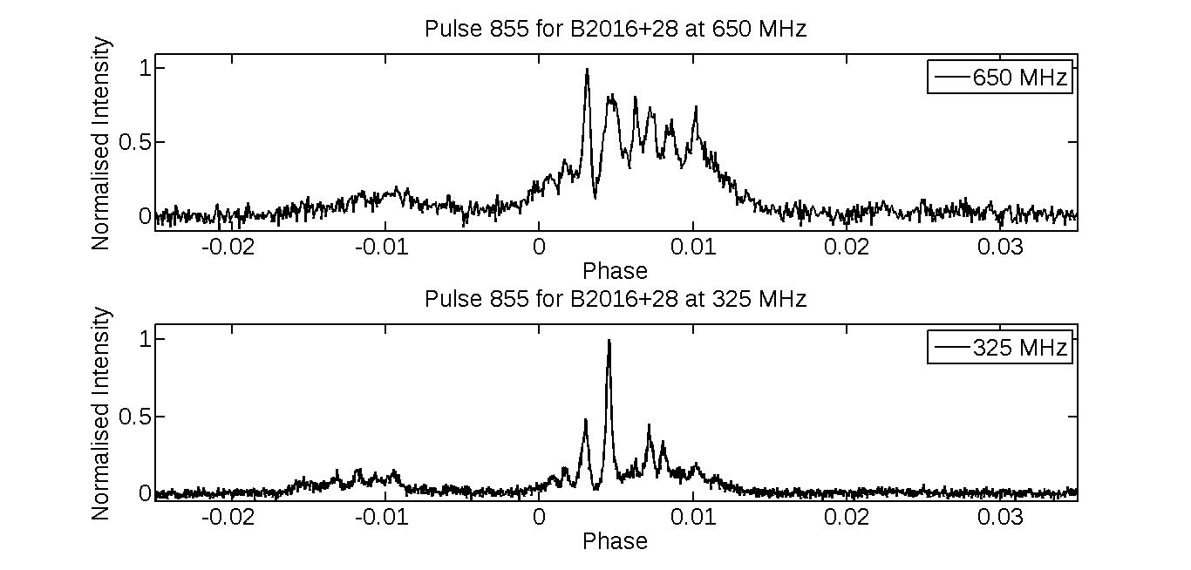
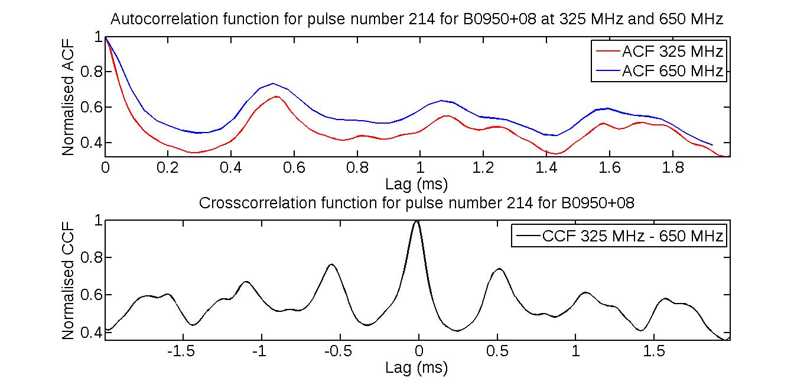
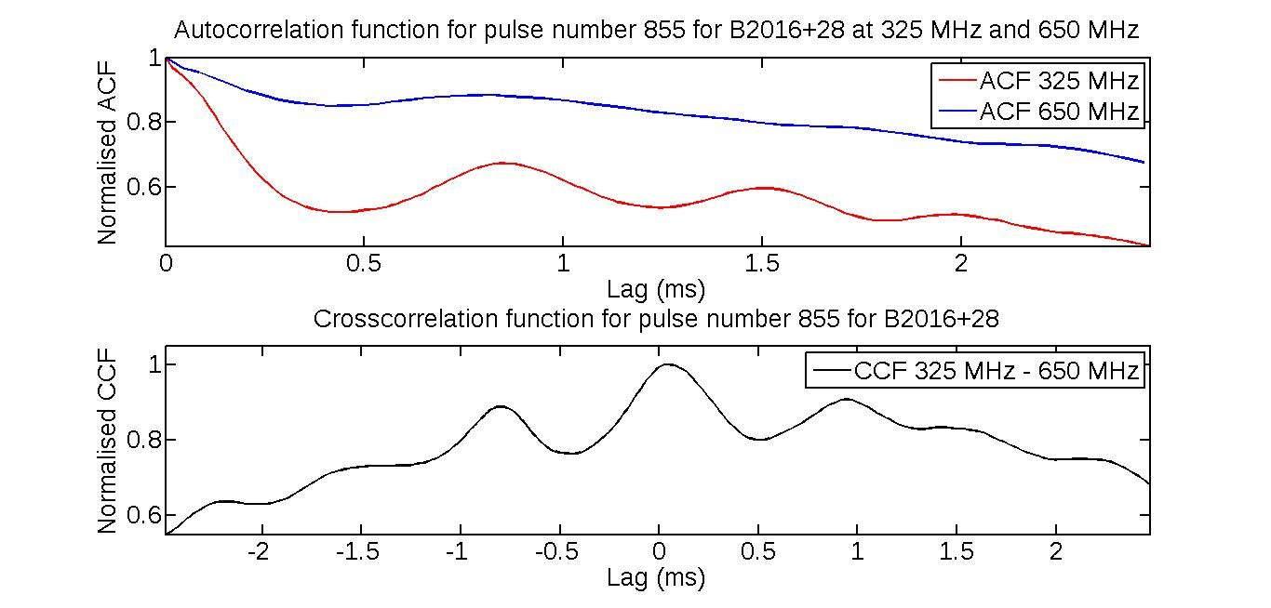
Simultaneous dual-frequency observations
B0950+08
B2016+28

Slide 10
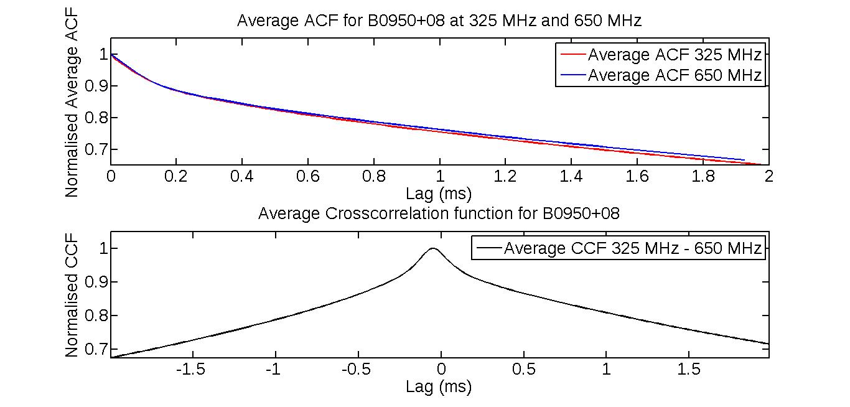
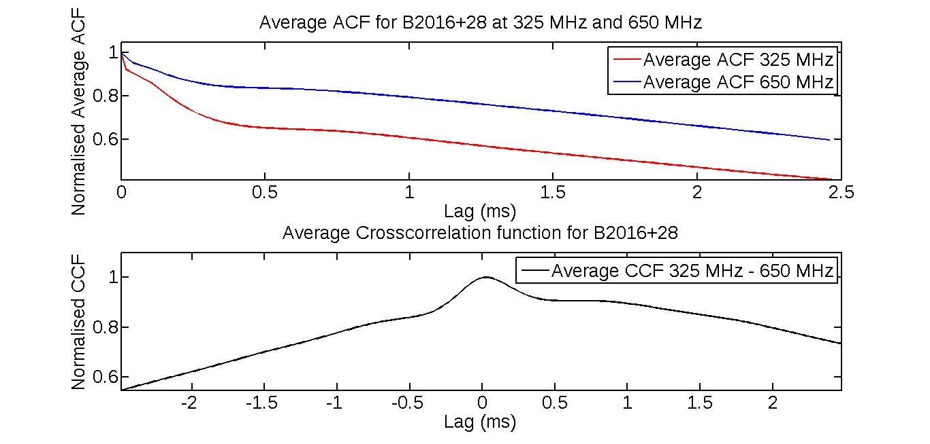
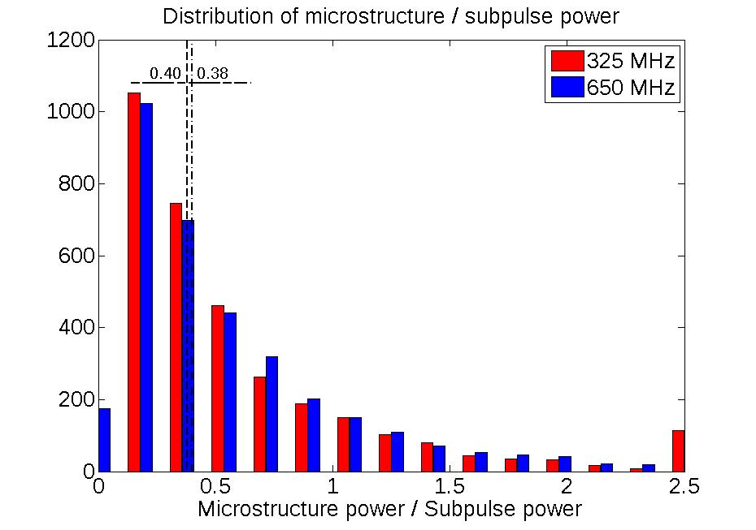
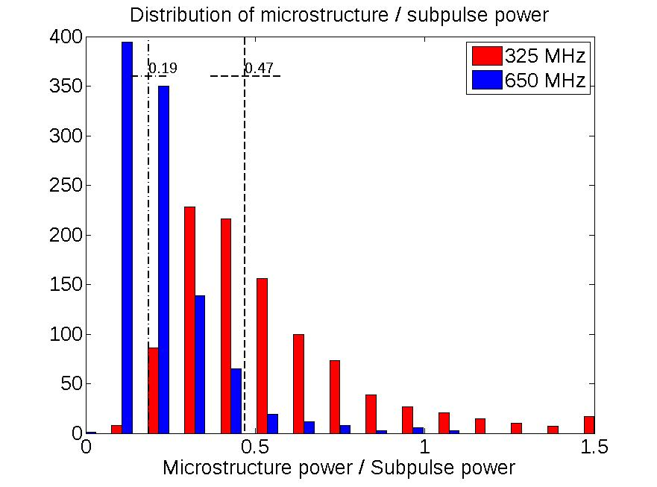
The spectrum of microstructure emission
B0950+08
B2016+28

Slide 11
Summary
High sensitivity of GMRT well suited to low frequency, high time resolution observations of pulsar microstructure.
First detection of quasi-periodic microstructure in MSPs.
Automated characterization of microstructure timescales possible by separation of sub-pulse and microstructure components.
Steeper spectrum of microstructure compared to subpulse emission.
The upgraded GMRT will be a powerful instrument for such studies
200 MHz bandwidth at 400 and 700 MHz (+ dual band observations)
Capability for real time coherent dedispersion
Thank you!

Slide 12
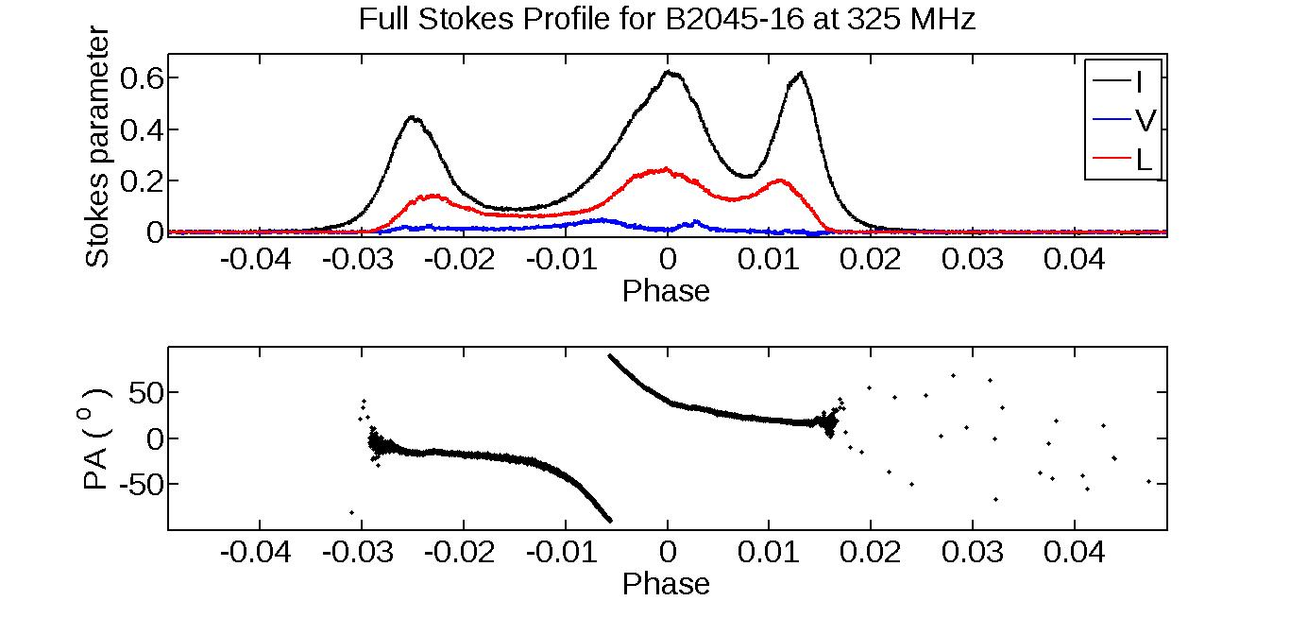
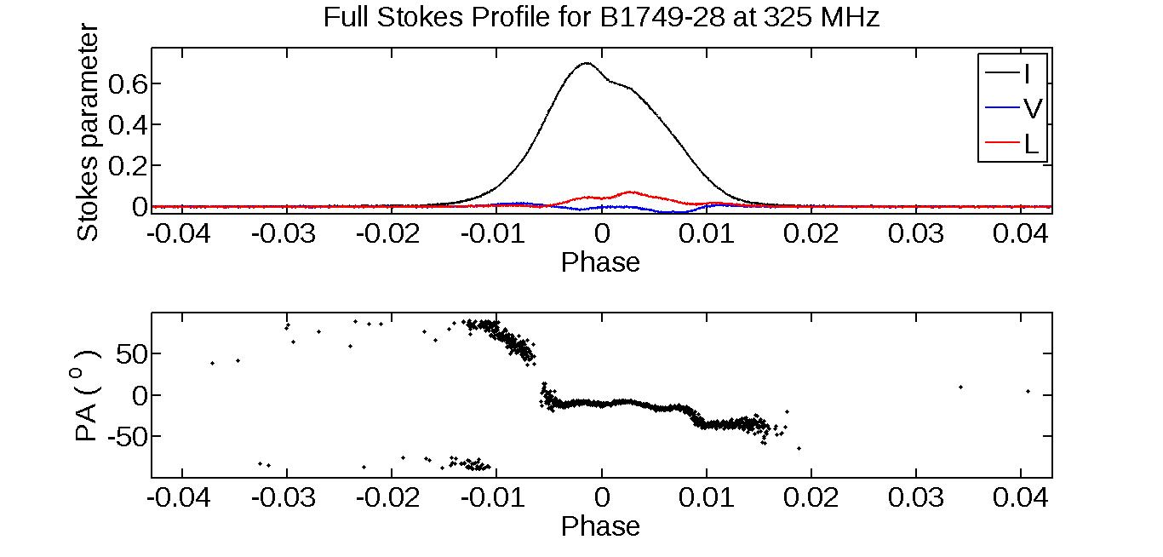
Example polarization profiles

Slide 13
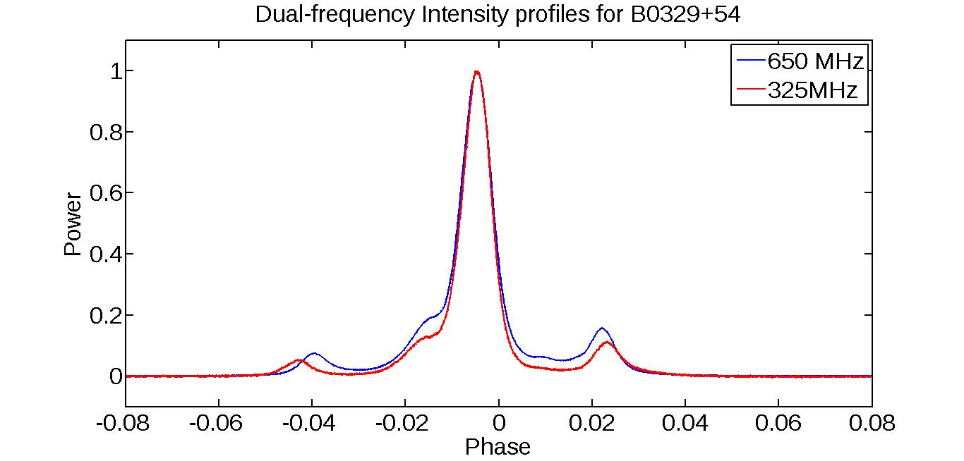
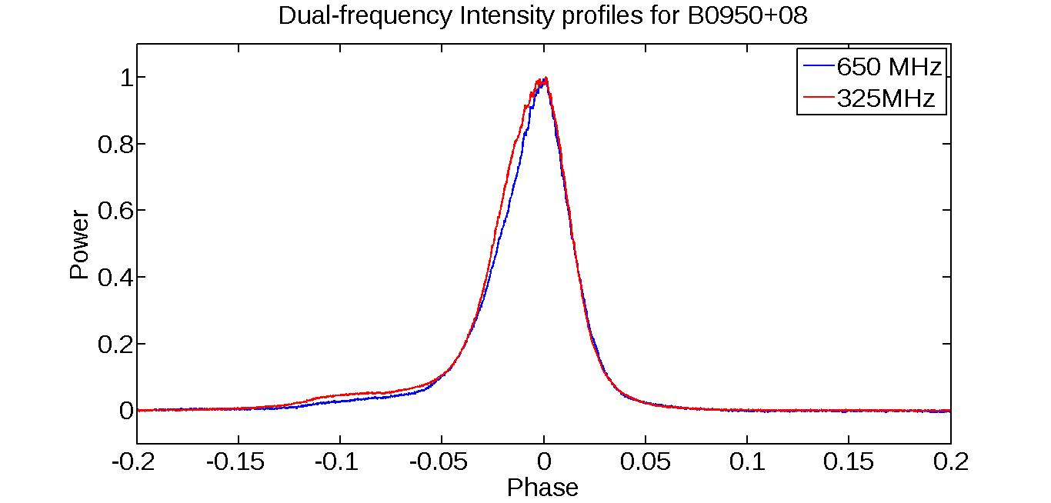
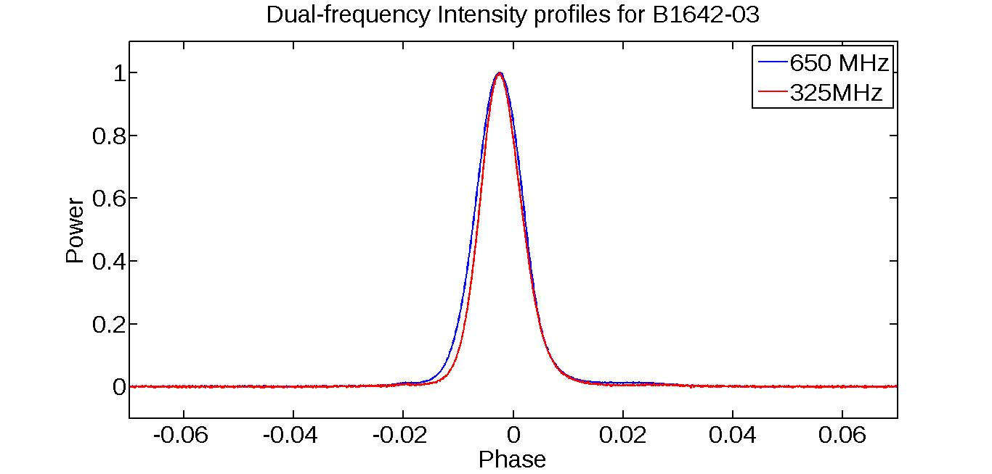
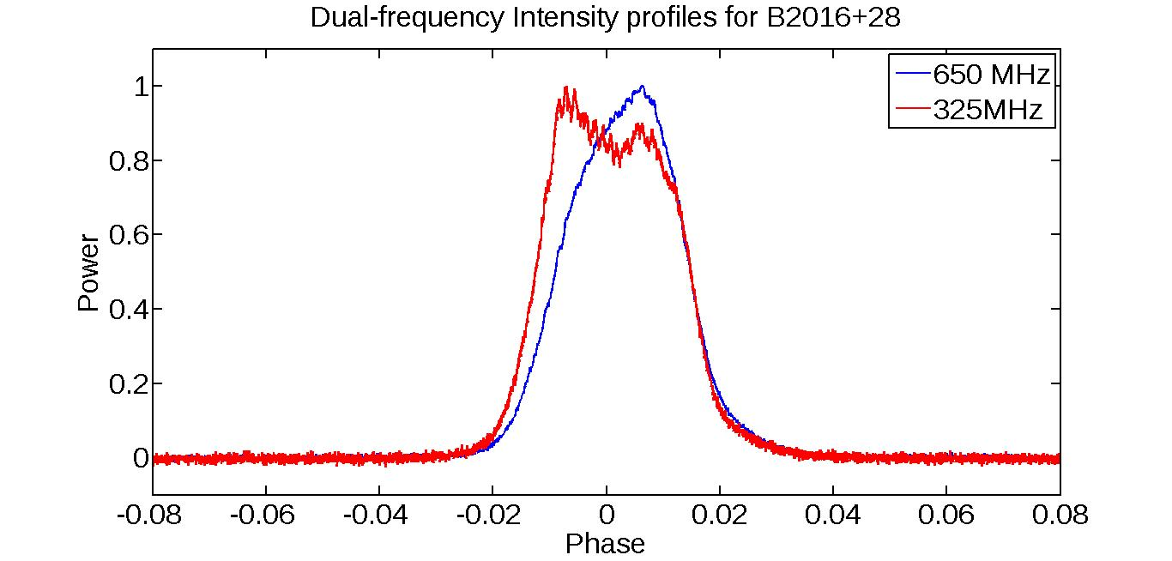
Example dual-frequency profiles

Slide 14
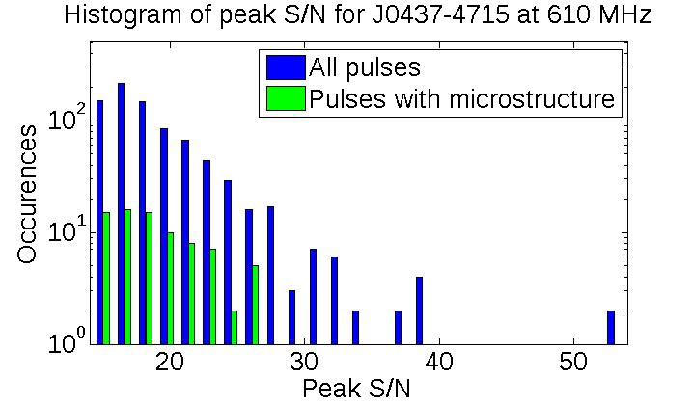
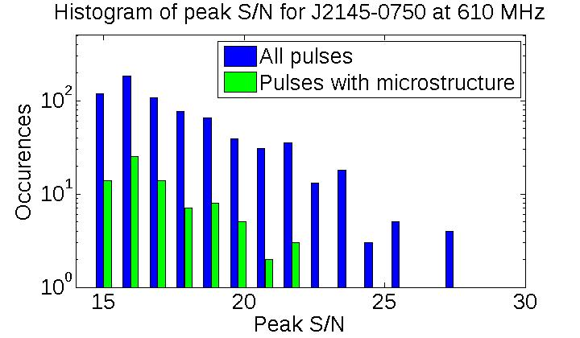
S/N distribution of pulses

Slide 15
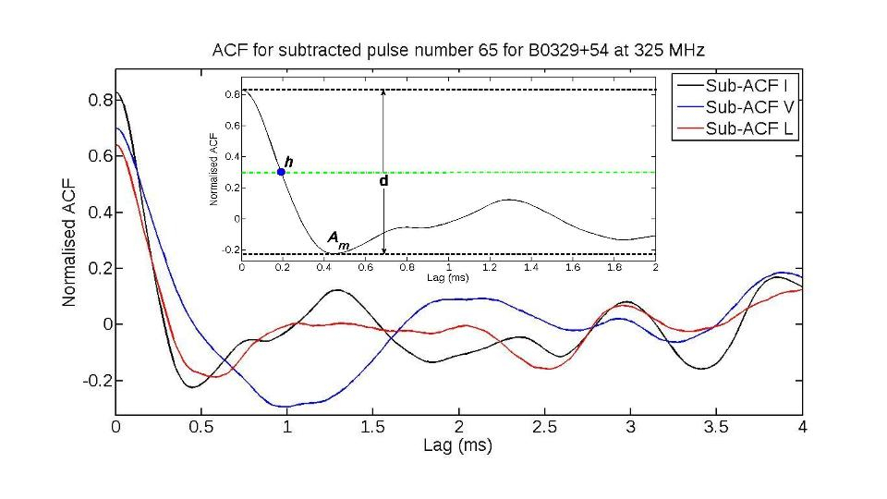
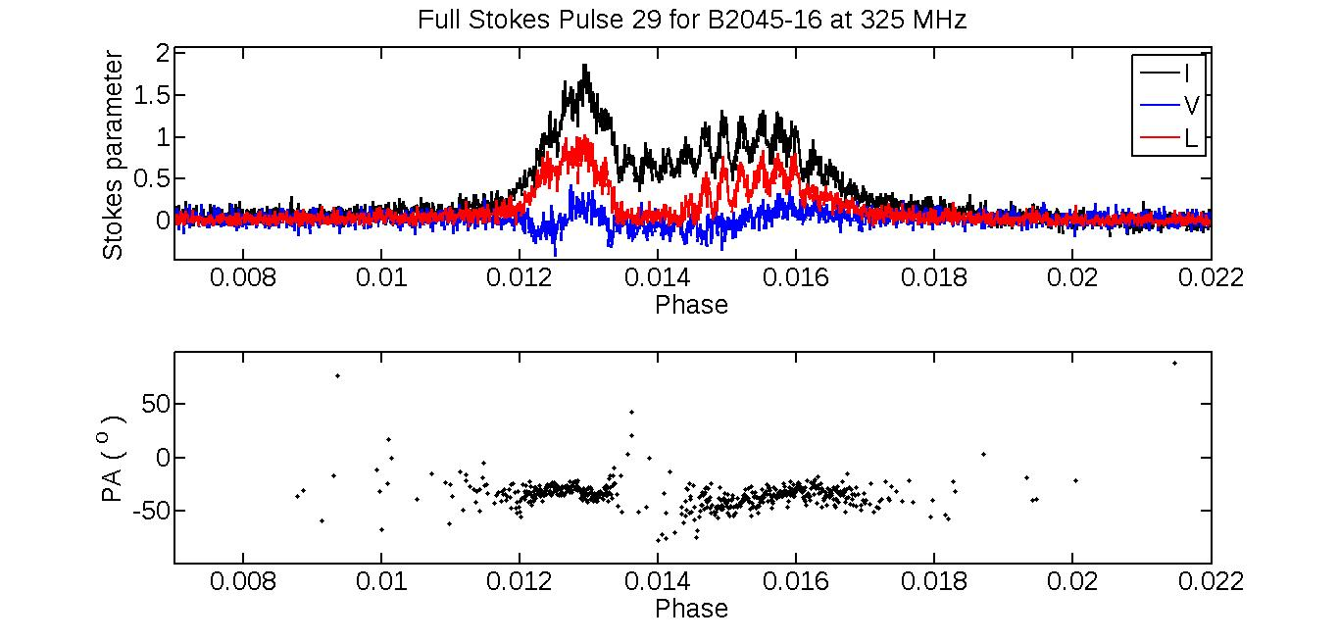
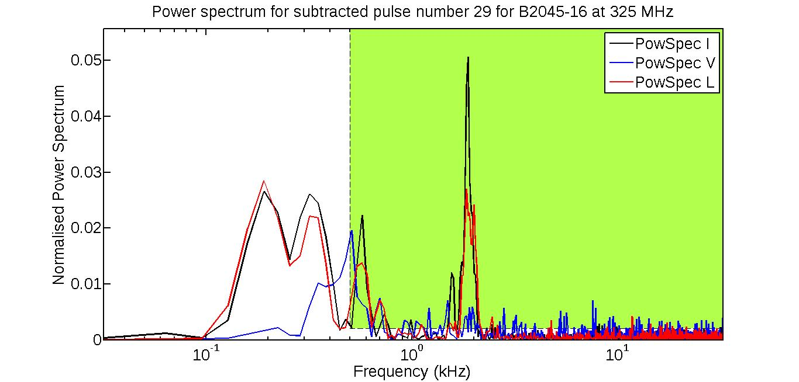
Automated characterization
De, Gupta & Sharma, in prep.

