Slide 1
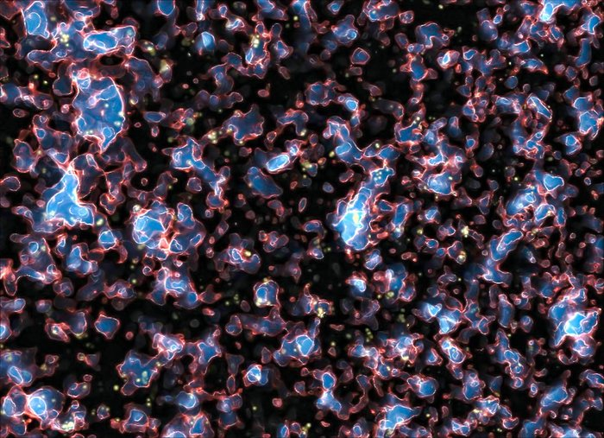
Joint 21cm
Parameter Constraints
with Emulators
Nick Kern
UC Berkeley
with Adrian Liu, Aaron Parsons, Andrei Mesinger and Bradley Greig
Science at Low Frequencies III
December 9th, 2016
Image: Alvarez et al. 2009

Slide 2
How do we interpret a 21cm power spectrum detection?
𝒛 =
Notes:
• we use CMB as a backlight and see the intervening neutral hydrogen either in absorption or emission depending on its thermal state
• it is in some way both a probe of the density field, and therefore cosmological parameters, and of the astrophysics governing the formation of the first stars and galaxies and how they
Injected ionizing photons into the IGM

Slide 3

How do we interpret a 21cm power spectrum detection?
Start with a three parameter model for reionization
𝒛 =
Greig et al. 2016
Notes:
• we use CMB as a backlight and see the intervening neutral hydrogen either in absorption or emission depending on its thermal state
• it is in some way both a probe of the density field, and therefore cosmological parameters, and of the astrophysics governing the formation of the first stars and galaxies and how they
Injected ionizing photons into the IGM

Slide 4
How do we interpret a 21cm power spectrum detection?
Cannot ignore cosmology
𝒛 =
Liu et al. 2016
Notes:
• we use CMB as a backlight and see the intervening neutral hydrogen either in absorption or emission depending on its thermal state
• it is in some way both a probe of the density field, and therefore cosmological parameters, and of the astrophysics governing the formation of the first stars and galaxies and how they
Injected ionizing photons into the IGM

Slide 5
How do we interpret a 21cm power spectrum detection?
Should not ignore IGM heating
𝒛 =
Ewall-Wice et al. 2016
Notes:
• we use CMB as a backlight and see the intervening neutral hydrogen either in absorption or emission depending on its thermal state
• it is in some way both a probe of the density field, and therefore cosmological parameters, and of the astrophysics governing the formation of the first stars and galaxies and how they
Injected ionizing photons into the IGM

Slide 6
Emulators Approximate the Likelihood
p
𝜃
Notes:
• Parameter constraints boil down to solving for the posterior distribution, which involves evaluating the likelihood
• In many cases the likelihood cannot be written analytically, so we must turn to sampling techniques like Markov Chain Monte Carlo
• A markov chain explores the parameter space and is probabalistically drawn to regions of higher posterior probability by a predefined acceptance-rejection agorithm

Slide 7

Emulators Approximate the Likelihood
p
𝜃
Notes:
• Parameter constraints boil down to solving for the posterior distribution, which involves evaluating the likelihood
• In many cases the likelihood cannot be written analytically, so we must turn to sampling techniques like Markov Chain Monte Carlo
• A markov chain explores the parameter space and is probabalistically drawn to regions of higher posterior probability by a predefined acceptance-rejection agorithm

Slide 8
Emulators Approximate the Likelihood
p
𝜃
Notes:
• Parameter constraints boil down to solving for the posterior distribution, which involves evaluating the likelihood
• In many cases the likelihood cannot be written analytically, so we must turn to sampling techniques like Markov Chain Monte Carlo
• A markov chain explores the parameter space and is probabalistically drawn to regions of higher posterior probability by a predefined acceptance-rejection agorithm

Slide 9
Emulators Approximate the Likelihood
Training Set
𝜃
Notes:
• Parameter constraints boil down to solving for the posterior distribution, which involves evaluating the likelihood
• In many cases the likelihood cannot be written analytically, so we must turn to sampling techniques like Markov Chain Monte Carlo
• A markov chain explores the parameter space and is probabalistically drawn to regions of higher posterior probability by a predefined acceptance-rejection agorithm

Slide 10
Emulators Approximate the Likelihood
m₁
Training Set
f₁
𝜃
Notes:
• Parameter constraints boil down to solving for the posterior distribution, which involves evaluating the likelihood
• In many cases the likelihood cannot be written analytically, so we must turn to sampling techniques like Markov Chain Monte Carlo
• A markov chain explores the parameter space and is probabalistically drawn to regions of higher posterior probability by a predefined acceptance-rejection agorithm

Slide 11
Emulators Approximate the Likelihood
m₂
Training Set
f₁
f₂
⫶
𝜃
Notes:
• Parameter constraints boil down to solving for the posterior distribution, which involves evaluating the likelihood
• In many cases the likelihood cannot be written analytically, so we must turn to sampling techniques like Markov Chain Monte Carlo
• A markov chain explores the parameter space and is probabalistically drawn to regions of higher posterior probability by a predefined acceptance-rejection agorithm

Slide 12

Emulators Approximate the Likelihood
m₂
Training Set
f₁
f₂
⫶
𝜃
Notes:
• Parameter constraints boil down to solving for the posterior distribution, which involves evaluating the likelihood
• In many cases the likelihood cannot be written analytically, so we must turn to sampling techniques like Markov Chain Monte Carlo
• A markov chain explores the parameter space and is probabalistically drawn to regions of higher posterior probability by a predefined acceptance-rejection agorithm

Slide 13
Emulators Approximate the Likelihood
m₂
Training Set
Cross
Validation
𝜃
Notes:
• Parameter constraints boil down to solving for the posterior distribution, which involves evaluating the likelihood
• In many cases the likelihood cannot be written analytically, so we must turn to sampling techniques like Markov Chain Monte Carlo
• A markov chain explores the parameter space and is probabalistically drawn to regions of higher posterior probability by a predefined acceptance-rejection agorithm

Slide 14
Emulators Approximate the Likelihood
m₂
Training Set
Python Toolbox or Cosmic Dawn
Parameter Estimation
Cross
Validation
-𝜎
0
𝜎
error
𝜃
Notes:
• Parameter constraints boil down to solving for the posterior distribution, which involves evaluating the likelihood
• In many cases the likelihood cannot be written analytically, so we must turn to sampling techniques like Markov Chain Monte Carlo
• A markov chain explores the parameter space and is probabalistically drawn to regions of higher posterior probability by a predefined acceptance-rejection agorithm

Slide 15
Power Spectrum
HERA Parameter Constraint Forecast via
Emulation of 21cmFAST
Notes:
• now I’ll talk about how we are applying these techniques to emulate simulations of reionization, in particular the popular semi-numerical simulation 21cmFAST
• I should emphasize, as I continually will, that an emulation model is not specific to any simulation—it is specific only to a training set, and any simulation can generate a training set

Slide 16
Training on EoR Simulations
L_{BOX} = 400 cMpc
L_{CELL} = 2 cMpc
Mesinger et al. 2011
Notes:
• 21cmFAST is a semi-numerical simulation of reionization
• It uses approximate physics to simulate the behavior of the 21cm signal across large volumes but with short runtimes compared to hydrodynamic, RT simulations.
• The following images are a 150 Mpc simulation. 21cmFAST uses 1st order perturbation theory (ZelDovic Approx) to evolve the DM density field into the quasi-nonlinear regime at redshifts 6-20.
• It then uses excursion set theory to identify ionized regions by filtering the density field from large to small scales and identifies ionized regions when the mass that has collapsed into virialized structures, f_collapse, exceeds the inverse of an ionizing efficiency parameter the region is ionized (conceptually this is just saying if there are more ionizing photons than neutral hydrogen the region is ionized)
• the center image shows the brightness temp field of a hydrodynamic RT simulation with the same IC and the right shows 21cmFAST
• 21cmFAST fails at small scales but gets the large scales roughly right (in the power spectra at our scales of interest, it is accurate at the 15-20% level)

Slide 17
Parameters of Interest
Astrophysics
• Ionization Efficiency: 𝛇
• Mean-free path of UV photons: R_{MFP}
• Min. Virial Temp. of SF Halos: T_{VIR}
Cosmology
• Clustering Amplitude: 𝜎₈
• Primordial PS Slope: 𝑛_{𝑠}
• CDM Fraction: 𝛺_{c}h²
• Baryon Fraction: 𝛺_{b}h²
• Hubble Constant: 𝐻₀
• X-ray Efficiency: 𝑓_{X}
• X-ray Spectral Index: 𝛼_{X}
• X-ray Cutoff Frequency: 𝜈_{min}
flat priors
planck priors
Notes:
• So what are the parameters we’d like to constrain?
• First we have our standard three parameter model, including the ionization efficiency, the mean free path of UV photons and the minimum temperature or mass of SF halos.
• These parameters are really all we need to describe a broad class late-reionization scenarios at z < 12
• In this regime, 21cmFAST can produce a realization in seconds
• However, HERA will hopefully probe reionization out to redshifts of z > 20, which as I mentioned will give us the most constraining power
• In order to model reionization at these redshifts we have to account for spin temperature fluctuations, which require more detailed modeling of the X-ray background

Slide 18
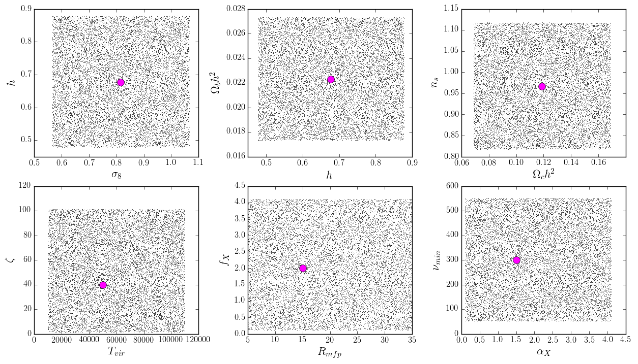
Emulation of Power Spectra at Percent-Level Accuracy

Slide 19
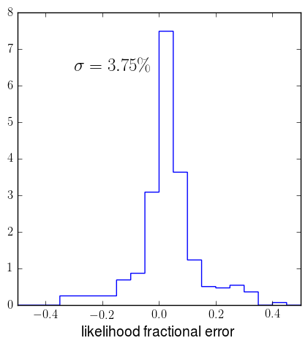
Emulation of Power Spectra at Percent-Level Accuracy

Slide 20
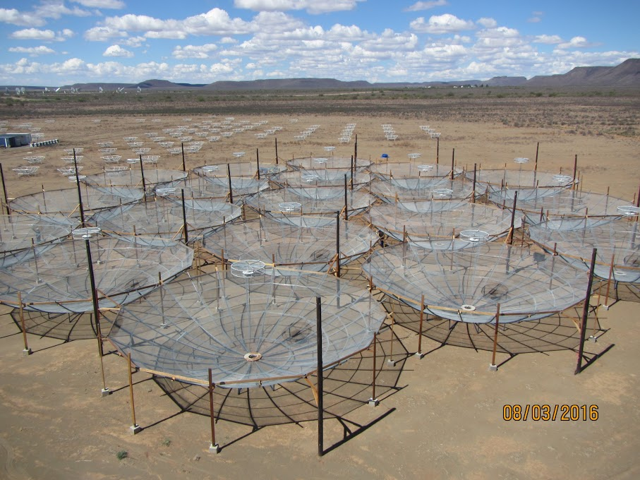
HERA331 Power Spectrum Mock Observation
• 1000 Hour Observation
• 331 antennas
• 7 < 𝑧 < 20 in 𝛥𝑧 = 0.5
• Foreground Avoidance

Slide 21
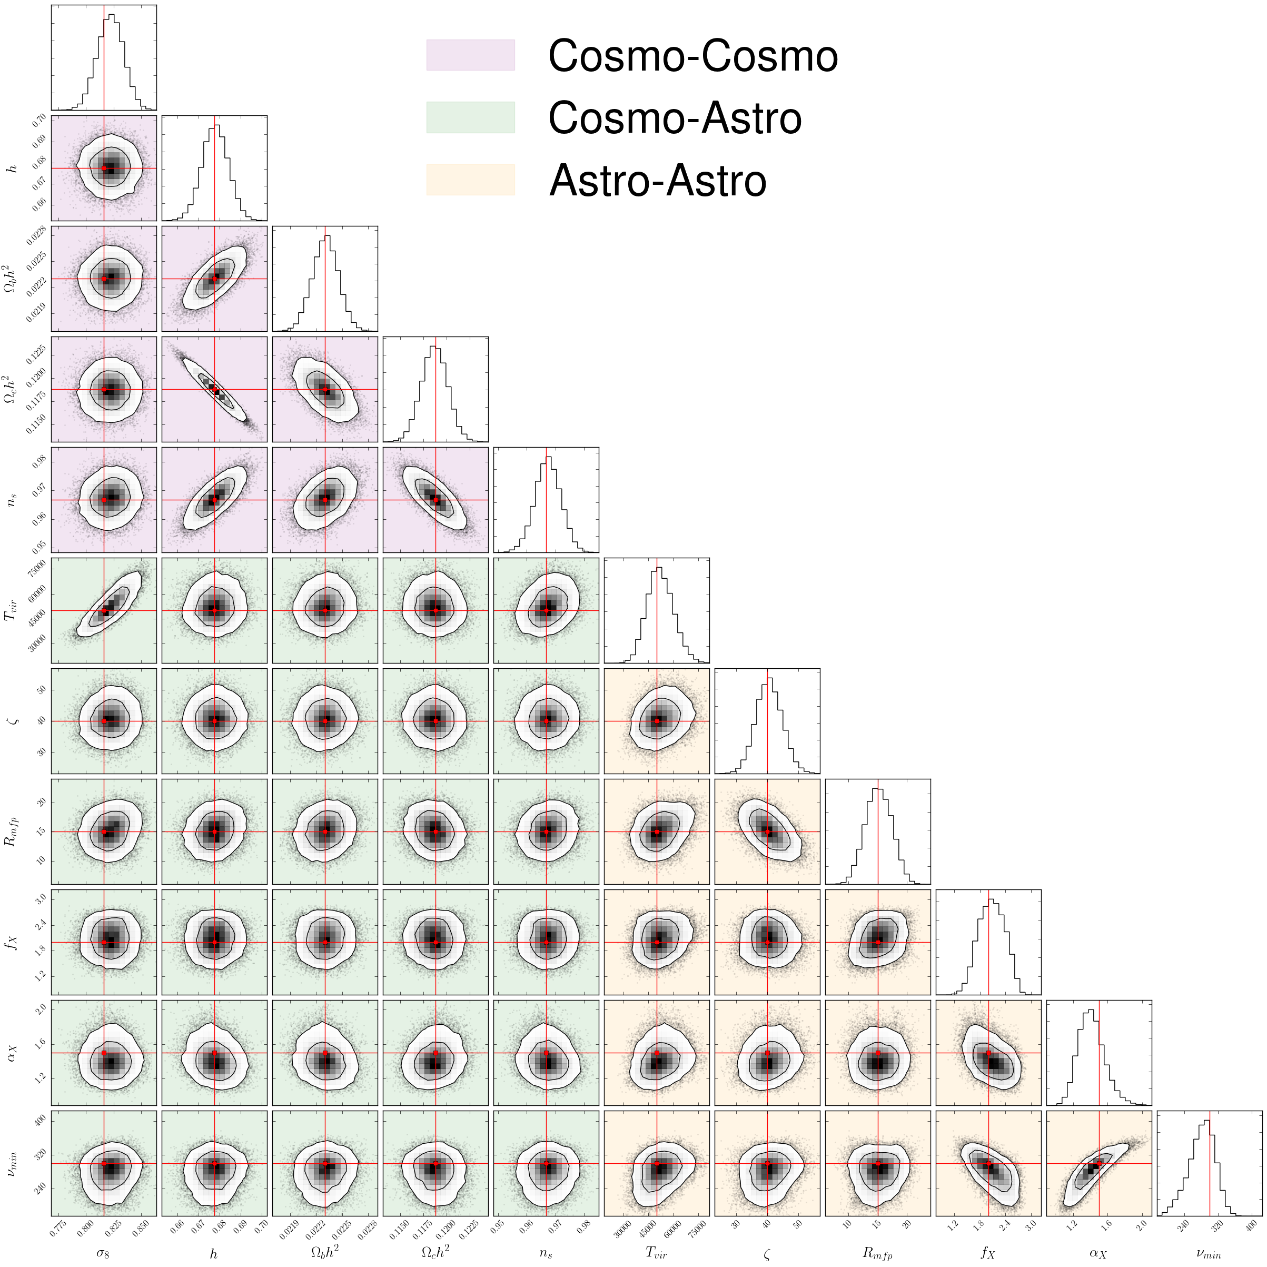
HERA Joint Posterior Distribution
Notes:
• Mock observation is twice as large (800 Mpc), same resolution (2 Mpc), with 180 days of observation, 6 hours a day, foreground avoidance

Slide 22



HERA Joint Posterior Distribution
Kern et al. in prep
Notes:
• Mock observation is twice as large (800 Mpc), same resolution (2 Mpc), with 180 days of observation, 6 hours a day, foreground avoidance

Slide 23
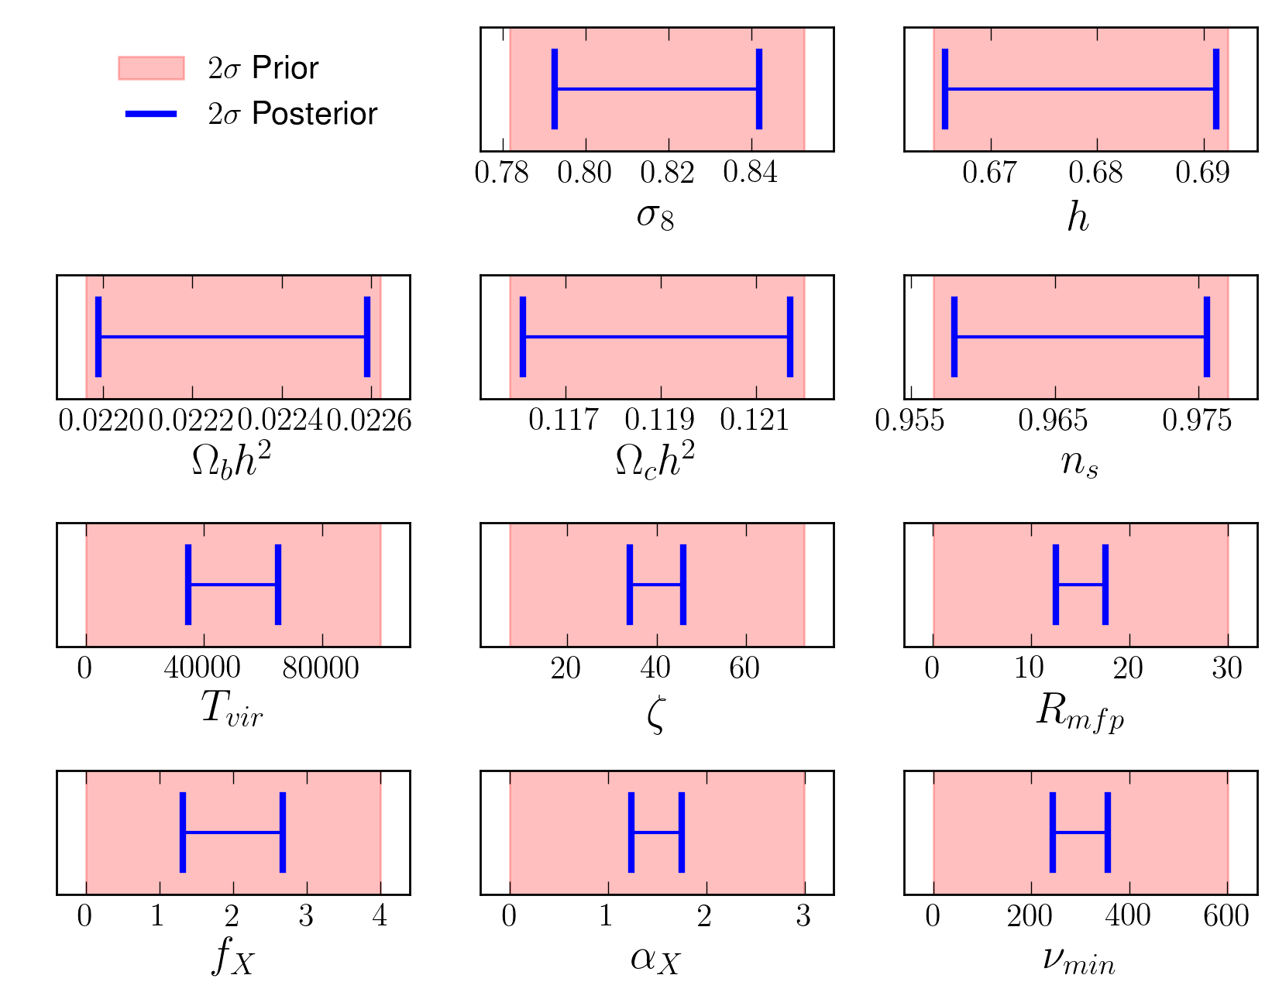
HERA Marginalized Posterior Widths
Kern et al. in prep

Slide 24
Take-Away Points
1 Emulators allow us to use more accurate simulations for
full MCMC sampling of the posterior distribution
2 Emulators are generalizable to any simulation
3 HERA is predicted to put significant constraints on astrophysical parameters governing reionization and the heating epoch
4 The Python Toolbox for Cosmic Dawn Parameter Estimation will soon be a publicly available package!

Slide 25
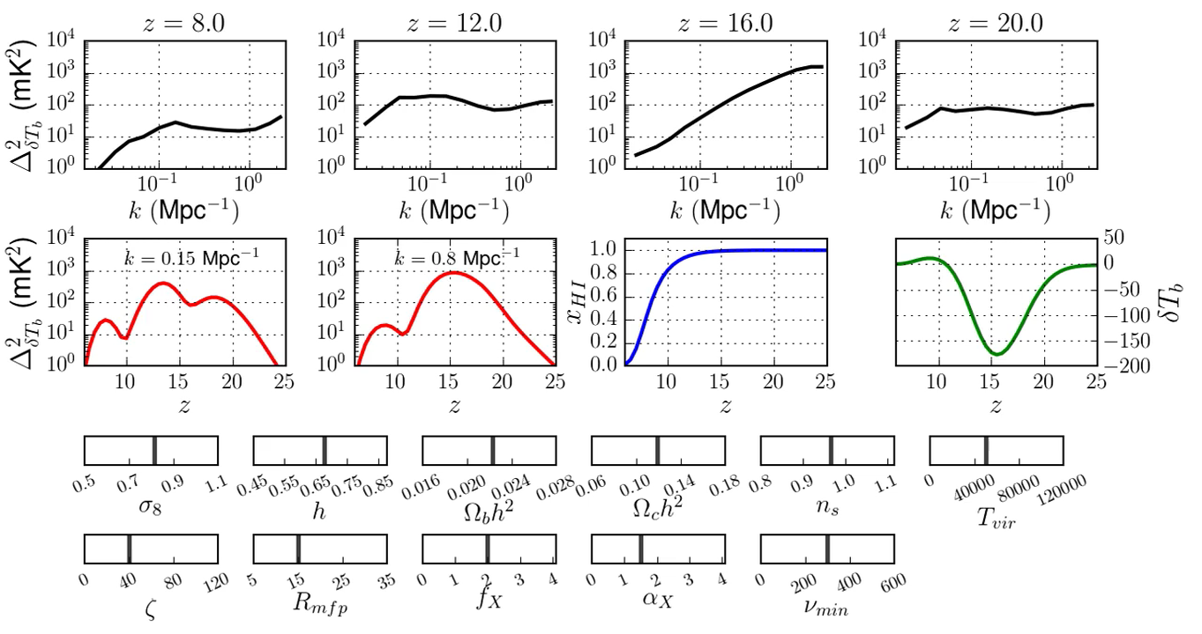
Gaining Intuition

Slide 26
Emulation of Power Spectra at Percent-Level Accuracy

Slide 27
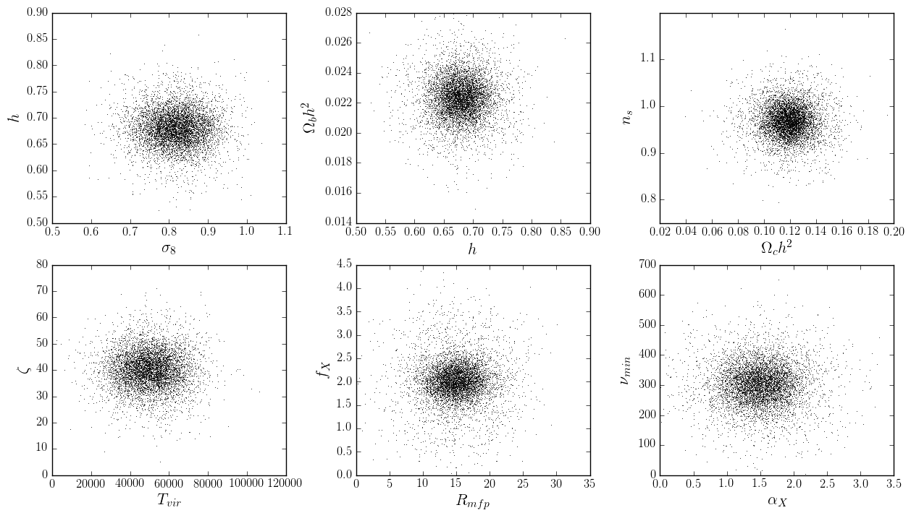
Emulation of Power Spectra at Percent-Level Accuracy

Slide 28
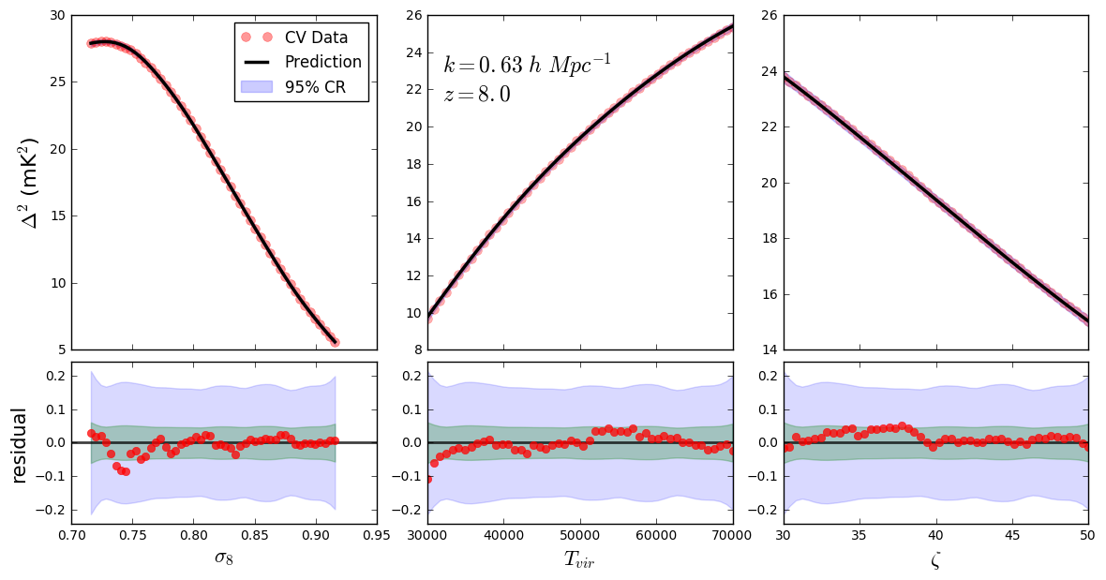
Emulation of Power Spectra at Percent-Level Accuracy

