Slide 1
Designing Next-Generation Instruments to Enable Detection of the Epoch of Reionization
Nithyanandan Thyagarajan
(Arizona State University)
HERA+, MWA+

Slide 2
HERA Collaboration

Slide 3
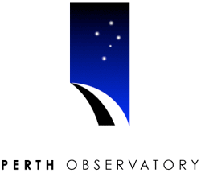
MWA Collaboration

Slide 4
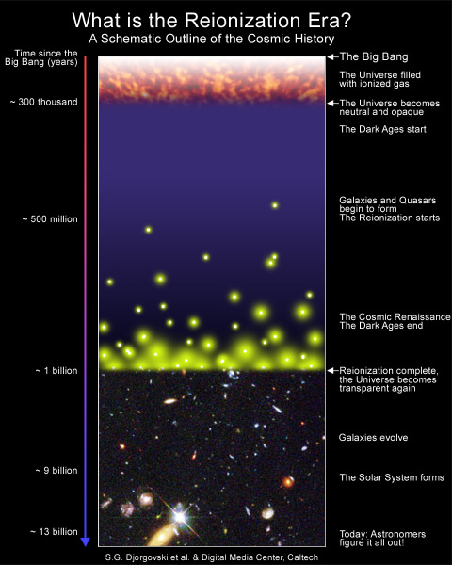
Why study the Epoch of Reionization?
Formation of large scale structures and evolution of astrophysical objects need to be probed
Neutral Hydrogen is a direct probe of the Reionization epoch
Current instruments have enough sensitivity for statistical detection of HI from the EoR

Slide 5
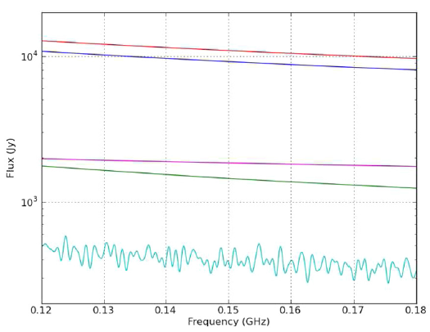
The Foreground Problem
Bright Foregrounds
(but smooth)
HI signal extremely faint
(but not smooth)
Parsons et al. (2012)

Slide 6
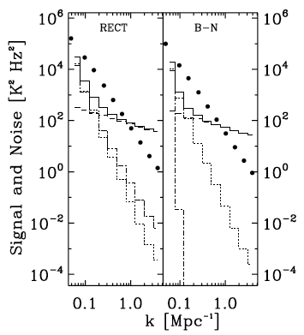
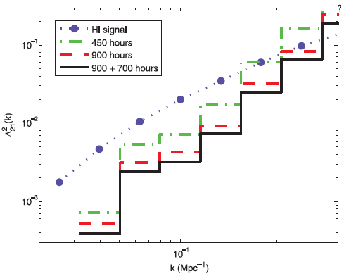
Motivation for High Precision Modeling
Thyagarajan et al. (2013)
Beardsley et al. (2013)
>10-sigma statistical detection expected with ~1000 hours data
Currently limited by foregrounds and instrument systematics (e.g. PAPER64 - Ali et al. 2015, Pober et al. 2015; MWA – Dillon et al. 2013, Beardsley et al. 2016)

Slide 7
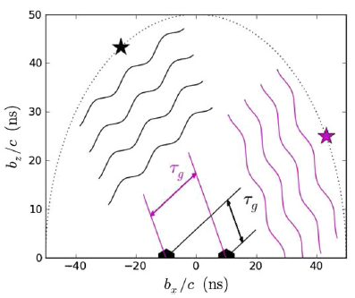
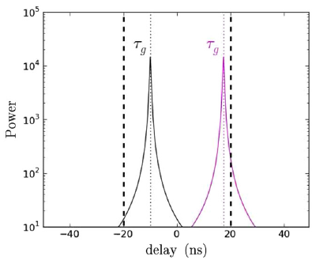
Fourier Space and Delay Spectrum
Parsons et al. (2012)

Slide 8
Foreground “Wedge” and EoR window

Slide 9
Precision Radio Interferometry Simulations (PRISim)
Objectives with PRISim:
Comprehensive all-sky simulations (with good match to data)
Role of Wide-field measurements
Role of compact, diffuse foregrounds
Role of instrument - antenna aperture, chromaticity
Antenna Position Errors
Post-processing solutions to mitigate systematics
On Github => https://github.com/nithyanandan/PRISim

Slide 10
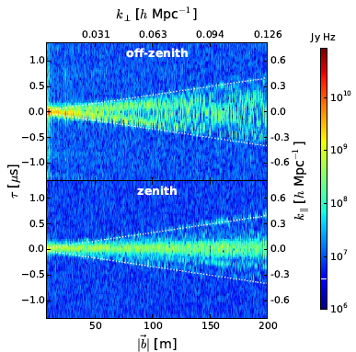
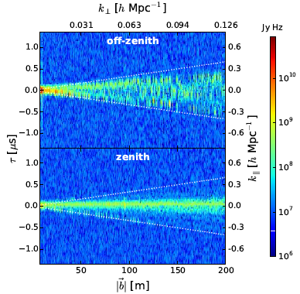
Model-Data Agree well
Thyagarajan et al. 2015b

Slide 11
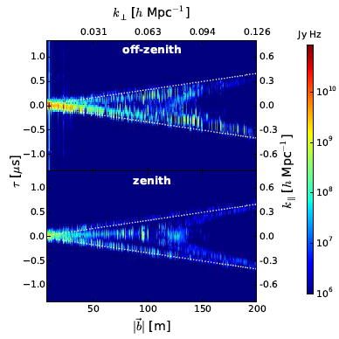
Impact of Wide-Field Foregrounds – “Pitchfork” effect
Diffuse Emission
Thyagarajan et al. (2015a)
Point sources

Slide 12
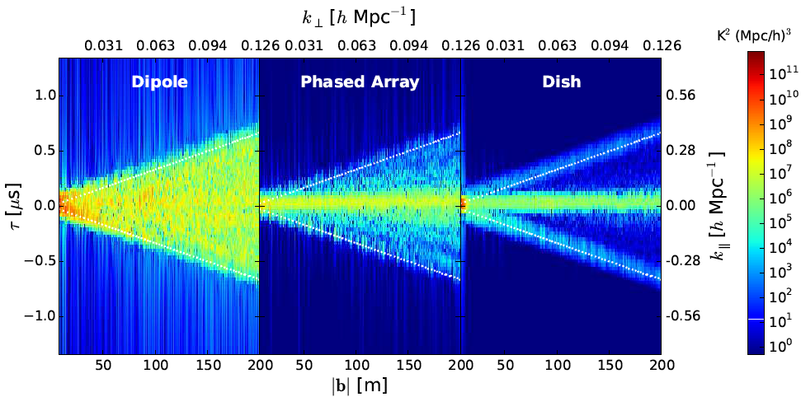
Mitigation of systematics via Antenna Geometry
(e.g. PAPER)
(e.g. MWA)
(e.g. HERA)
Foreground spillover from
Pitchfork drops significantly
Thyagarajan et al. (2015a)

Slide 13
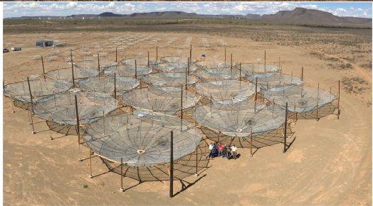
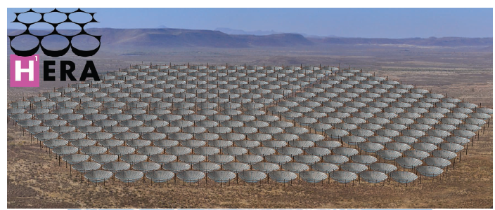
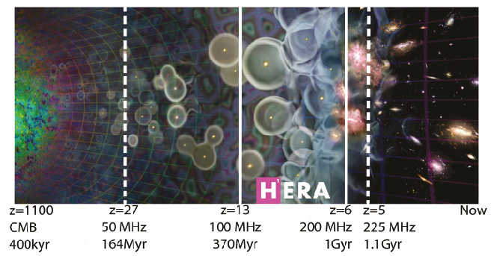
HERA Example
HERA (Hydrogen Epoch of Reionization Array)
B = 100MHz
1024 channels
~100 kHz channels
14m dishes
FoV ~ 10 deg. at 150 MHz
Compact hexagonal array

Slide 14
Effects of Beam Chromaticity
Thyagarajan et al. (2016)
Uniform Disk Airy Pattern
Simulated Chromatic HERA beam
Differences seen only due to spectral differences in Antenna beam
Beam chromaticity worsens foreground contamination
HERA aiming for such a robust element design

Slide 15
EoR Observing Window Efficiency
150 MHz subband (z=8.47)
170 MHz subband (z=7.36)
All HERA baselines sensitive to EoR for most of observing window
Robust to different models and redshifts
HERA will have good control over instrumental systematics and foreground contamination
Working on SKA point of view

Slide 16
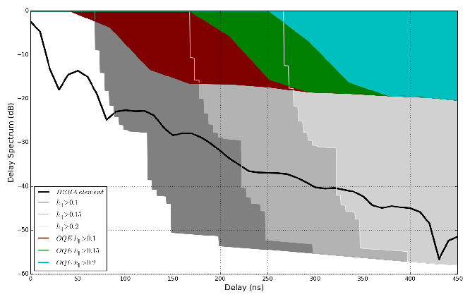
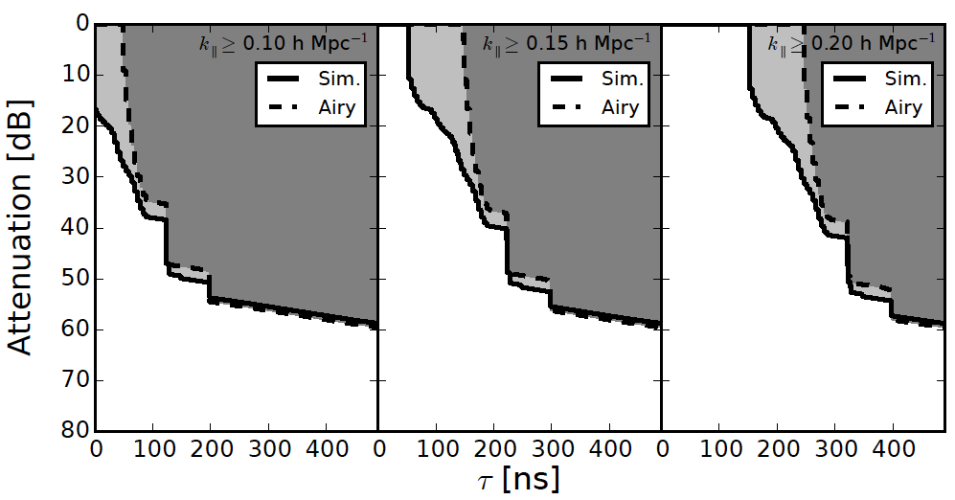
Design Specs on Reflections in Instrument
Dish-Feed Reflections
Antenna-to-Antenna Reflections
Reflections inevitable in electrical systems
Reflections extend foregrounds and contamination in delay spectrum
Require reflected foregrounds to be below HI signal levels
HERA will aim for these specs
Similar study is ongoing for SKA (with de Lera Acedo et al., Cambridge)
Thyagarajan et al. (2016)
Ewall-Wice et al. (2016)
Neben et al. (2016)
Patra et al. (2016)
DeBeor et al. (2016)

Slide 17
Summary
Systematics are the biggest challenge to EoR and low frequency experiments - HERA, SKA, MWA, PAPER, LOFAR
Best solutions are via robust instrument design
PRISim – high precision simulations for wide-field radio interferometry – publicly available: https://github.com/nithyanandan/PRISim
Discovery of new instrument + foreground physics:
Foregrounds + wide-field instruments leads to “pitchfork” contamination
Antenna beam chromaticity, reflections worsen contamination (thus requires careful design motivated cosmologically)
Control antenna position errors to preserve redundancy
HERA design based on these principles- offers great promise for EoR detection
SKA design also under study

