Slide 1
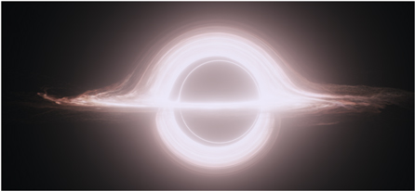
James et al. (2015)
Probing the First Black Holes with the MWA
Science At Low Frequencies III
Nick Seymour – Pasadena – 8th Dec 2016
Notes:
MWA image: false colour Vela SNR

Slide 2
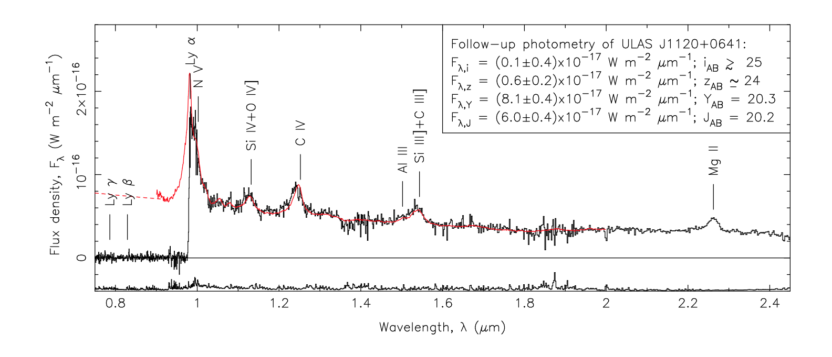
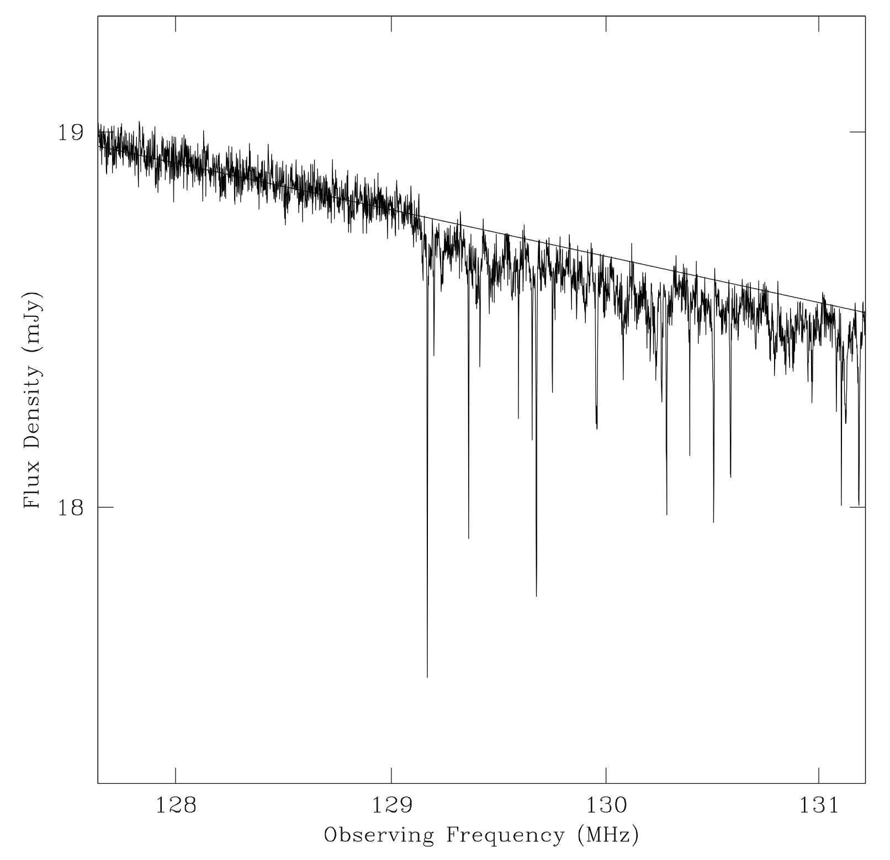
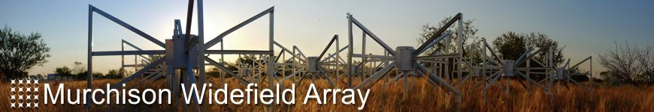
The early formation of massive black holes
HI absorption in EoR
QSO @z=7.1
M_{BH} ~ 2 x10⁹ M
Mortlock et al. (2011)
Carilli, et al. (2004)

Slide 3

MWA: The First Black Holes
Ionising Source in EoR
Low Frequency Radio Telescope

Slide 4
MWA: The First Black Holes
Bubble of neutral hydrogen

Slide 5
MWA: The First Black Holes

Slide 6
MWA: The First Black Holes
Active Very high-z Nuclear Galaxies at Epoch of Reionisation
(AVeNGER)

Slide 7
MWA: Radio SEDs of HzRGs
Drouart, Seymour, et al. (in prep)
HeRGÉ sample:
70 HzRGs
z > 1
L_{3GHz} > 10²⁷ W/Hz
Measured
  Stellar masses
  SFRs
  BHARs
  environments

Slide 8
GLEAM: The First Black Holes
Size of symbol = redshift (range 1<z<5.2)

Slide 9
GLEAM: The First Black Holes
Size of symbol = redshift (range 1<z<5.2)

Slide 10
Model Assumptions
Radio jet lifetime = 10 Myr (exponential rise over 0.1 Myr and decline over 1 Myr)
Same luminosity at 1.4 GHz as TNJ0924 (most distant known HzRG at z=5.2)
Simple power-law (α=-0.75)
IGM and ISM densities scale as (1+z)³
H₀=70km/s/Mpc, Ω_{M}=0.3, Ω_{Λ}=0.7
Host galaxy analogous to GN-z11 (Oesch+16)
SFR~20 M/yr at z~11 and other parameters from Mutch+16
Size of radio jet < size of galaxy

Slide 11
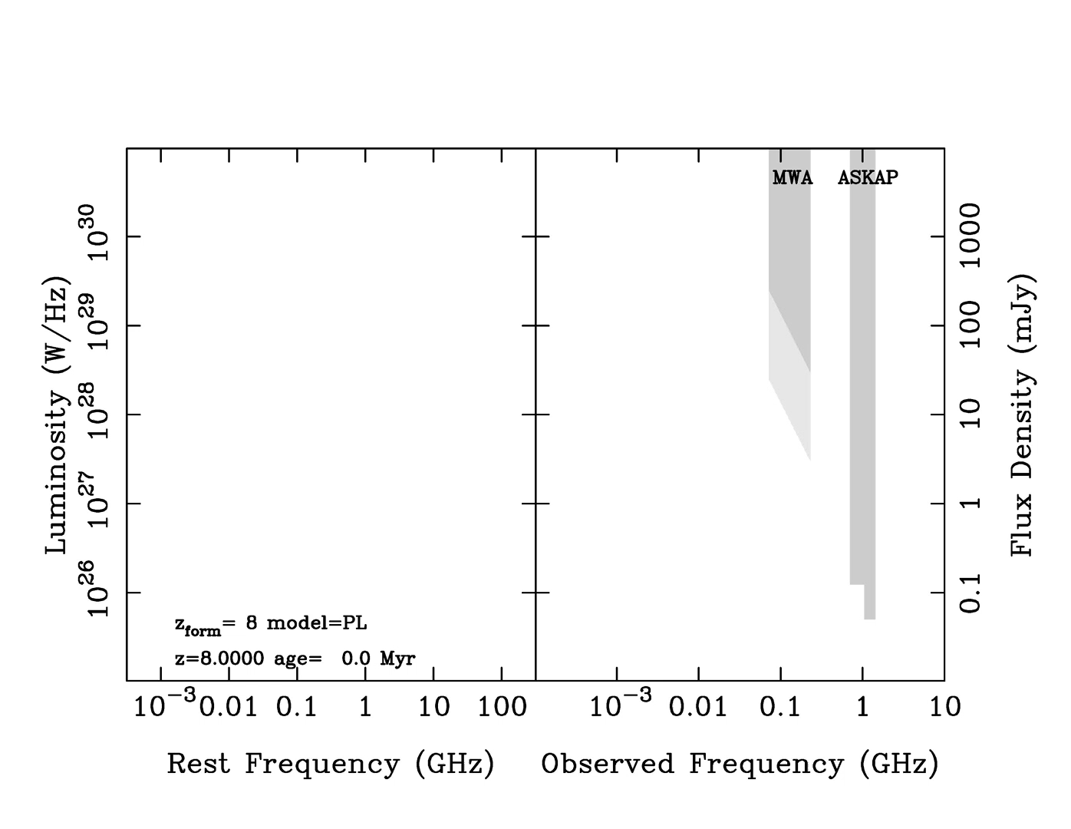
Vanilla Power-Law Model @z=8

Slide 12
Free-free absorption geometry
Ionised bubble
FFA from:
Host galaxy
EoR Strömgren Sphere

Slide 13
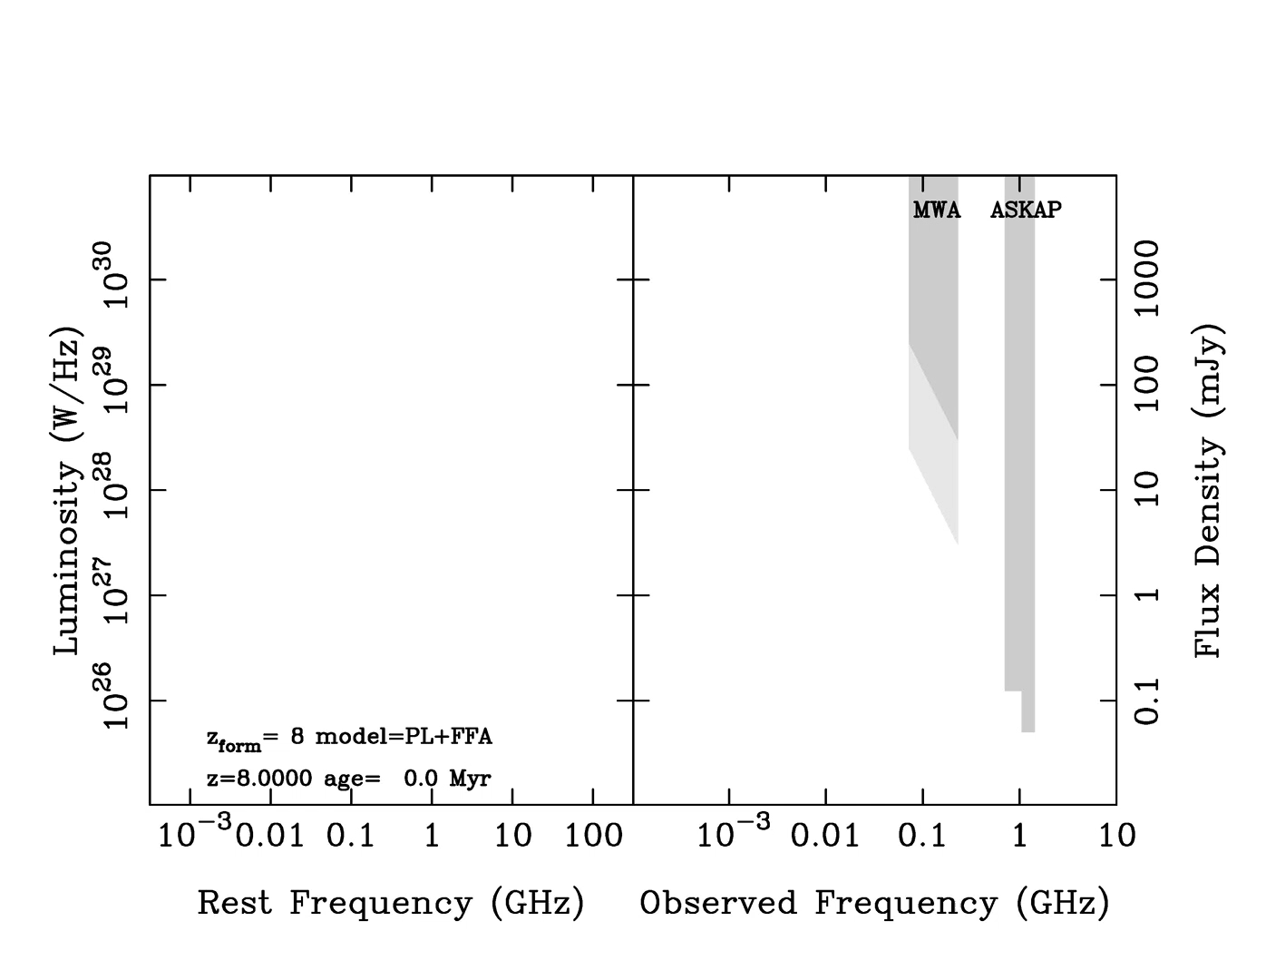
FFA model

Slide 14
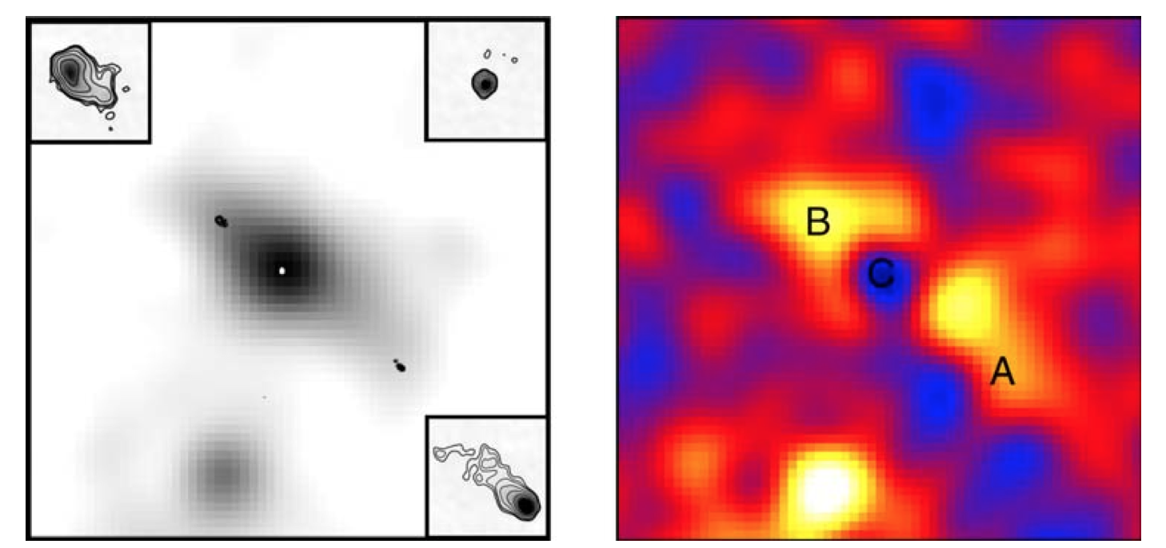
Inverse Compton Losses off CMB
Radio contours over smoothed X-ray image Soft (yellow) to hard (blue) X-ray ratio
4C23.56 @z=2.48 Johnson et al. (2007)

Slide 15

Inverse Compton + FFA Model

Slide 16

Full Model at z=11

Slide 17
Conclusions
HzRG within EoR is detectable with ASKAP and future, deeper MWA surveys
Unique(?) broad-band SED
Improved models:
    Integrated EMs for FFA
    Analytical rather than phenomenological models for IC
    Shift SEDs of known sources to higher redshift

Slide 18
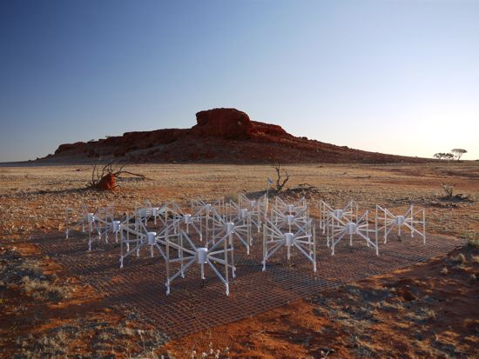
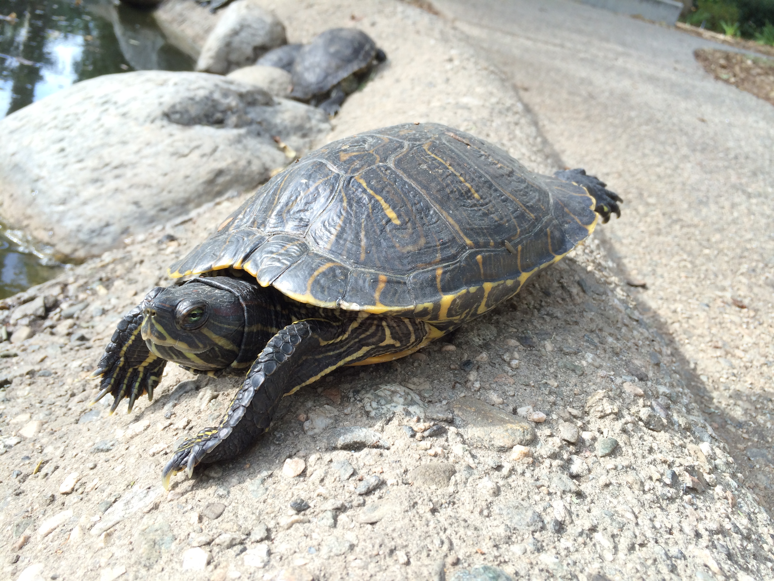
We acknowledge the Wajarri Yamatji people as the traditional owners of the observatory site.
Notes:
In fact we have precursors covering a wide frequency range

