Slide 1
MWA/GLEAM
Searching for Molecular Building Blocks at Low Frequency with MWA
Chenoa Tremblay
Supervisors: Andrew Walsh, Chris Jordan and Natasha Hurley-Walker
ICRAR-Curtin University
Dec 2016

Slide 2

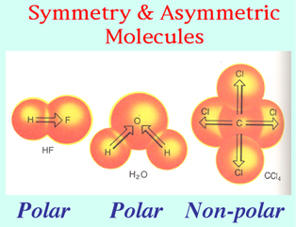
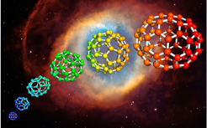
What are we looking for?
In the radio, we are detecting polar molecules
Molecules with uneven charge distribution
Notes:
Townes and Schklovski were first to realize in the mid 1950s the potential for radio observations for discovering molecules.

Slide 3
Molecules in Space
AlCl
AlF
AlO
ArH⁺
C₂
CF⁺
CH
CN
CO
CP
CS
FeO
H₂
HCl
HF
HO
KCl
NH
N₂
NO
NS
NaCl
MgH⁺
NaI
O₂
PN
PO
SH
SO
SiC
SiN
SiO
SiS
TiO
AlNC
AlOH
C₃
C₂H
C₂O
C₂S
C₂P
CO₂
FeCN
H₃⁺
H₂C
H₂Cl⁺
H₂O
HO₂
H₂S
HCN
HNC
HCO
HCP
HCS⁺
HNC
HNO
HOC⁺
KCN
MgCN
MgNC
NH₂
N₂H⁺
N₂O
NaCN
NaOH
OCS
O₃
SO₂
c-SiC₂
SiCN
SiNC
TiO₂
CH₃
l-C₃H
c-C₃H
C₃N
C₃O
C₃S
H₃O⁺
C₂H₂
H₂CN
H₂CO
H₂CS
HCCN
HCNH⁺
HOCO⁺
HCNO
HOCN
HOOH
HNCO
HNCS
NH₃
HSCN
SiC₃
HMgNC
C₅
NH₄⁺
CH₄
CH₃O
c-C₃H₂
l-H₂C₃
H₂CCN
H₂C₂O
H₂CNH
HNCNH
H₂COH⁺
C₄H
HC₃N
HCC-NC
HCOOH
NH₂CN
HCOCN
SiC₄
SiH₄
c-H₂C₃O
HNCHCN
C₂H₄
CH₃CN
CH₃NC
CH₃OH
CH₃SH
l-H₂C₄
HC₃NH⁺
HCONH₂
C₅H
C₅N
HC₂CHO
HC₄N
CH₂CNH
c-C₂H₄O
CH₃C₂H
H₃CNH₂
CH₂CHCN
H₂CHCOH
C₆H
HC₅N
CH₃CHO
H₃CC₂CN
H₂COHCHO
HCOOCH₃
CH₃COOH
H₂C₆
CH₂CHCHO
CH₂CCHCN
CH₃CHNH
C₇H
NH₂CH₂CN
CH₃C₄H
CH₃OCH₃
CH₃CH₂CN
CH₃CONH₂
CH₃CH₂OH
C₈H
HC₇N
CH₃CHCH₂
HCCCCH
HC₅H₃
HC₉N
CH₃COCH₃
(CH₂OH)₂
CH₃CH₂CHO
CH₃C₅N
CH₃CH₂OCHO
CH₃COOCH₃
CH₃C₆H
H₃COC₂H₅
C₆H₆
C₃H₇CN
HC₁₁N
C₁₄H₁₀
C₁₆H₁₀
C₆₀
C₇₀
Over 180 interstellar molecules have been detected with many of them organic and quite complex
Molecular Transitions at Low Frequency – December 2016
Notes:
The majority of molecules discovered have been from milli-metre wave radio telescopes.
In this regime observed spectral features of fine structure atoms or rotational transitions of polar molecules (non-symmetric)
McGuire et al 2016 first Chiral Molecule recently.

Slide 4
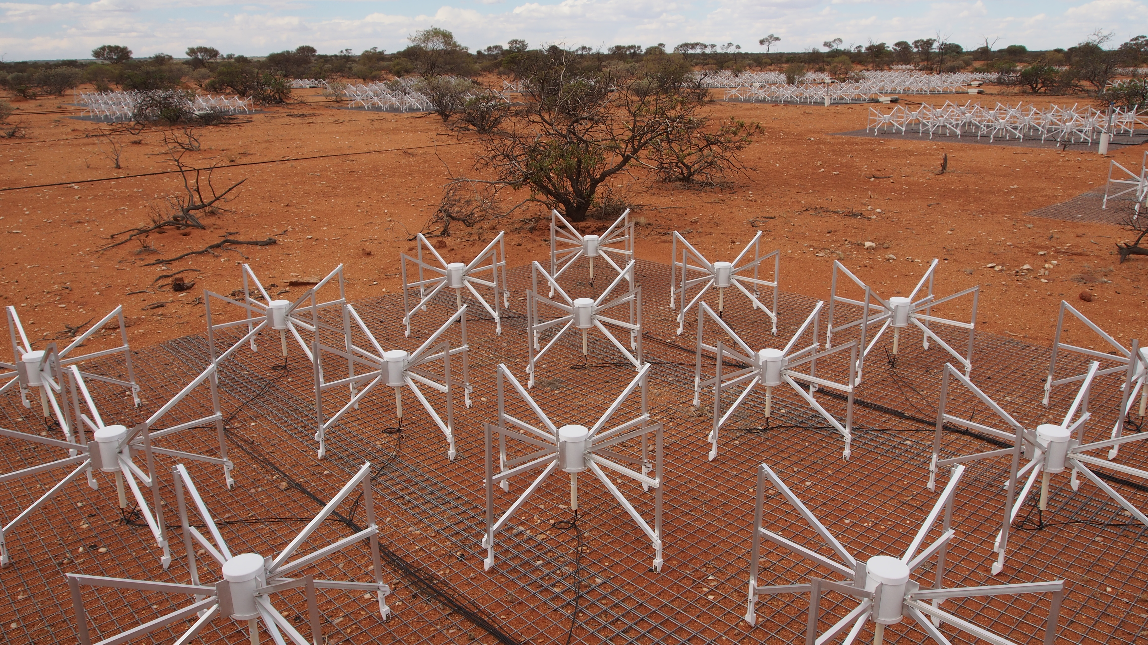
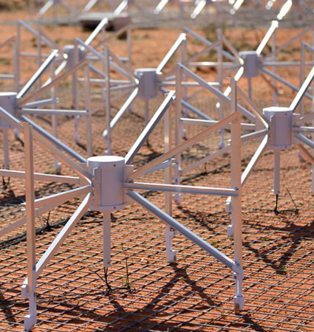
Murchison Widefield Array (MWA)
MWA Low Frequency Instrument
    128 dipole antennas with 3km baselines
    70-300MHz
    30.72 MHz bandwidth
    10kHz frequency resolution (26km/s at 114MHz)
    30 degree primary beam

Slide 5
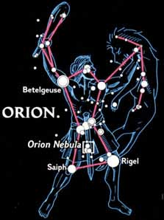
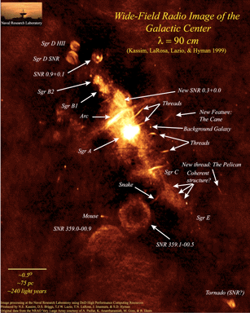
MWA Survey Fields
99-300MHz
103-133MHz
Molecular Transitions at Low Frequency – December 2016

Slide 6
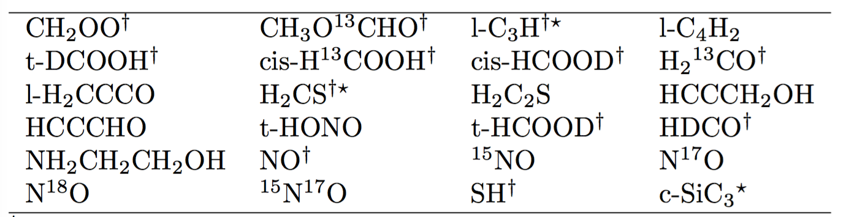
Galactic Centre Survey
Galactic Plane Survey (Imaging Mode)
    ~4 hours integration time
    103-133 MHz
    400 square degrees
Notes:
Some of the largest molecules we have ever detected are in the Sgr B star, so that is the motivation for starting here.
Other labroatory experiments and models would be helpful to find additional transitions and better calculate sensitivities.

Slide 7
Galactic Centre Survey
Galactic Plane Survey (VCS Mode)
    80 minutes integration time
    99-129 MHz
    400 square degrees
    0.3kHz frequency resolutions (<1km/s)
Notes:
Voltage Capture system: raw voltages with 100 us resolution.
NO: Large amount of known transitions, low energy transitions,
Perssson et al 2010 suggest a most likely low frequency molecule to be detected is NO.

Slide 8
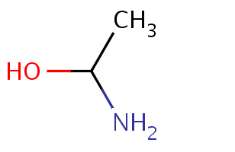

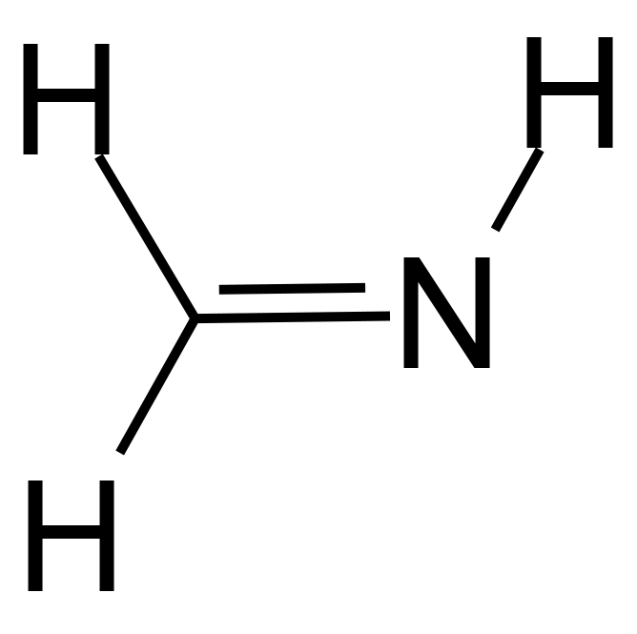
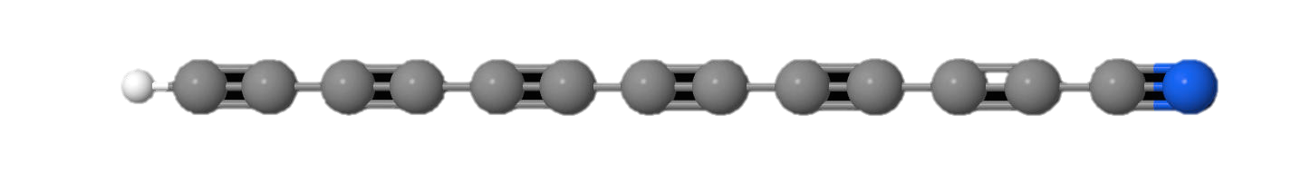

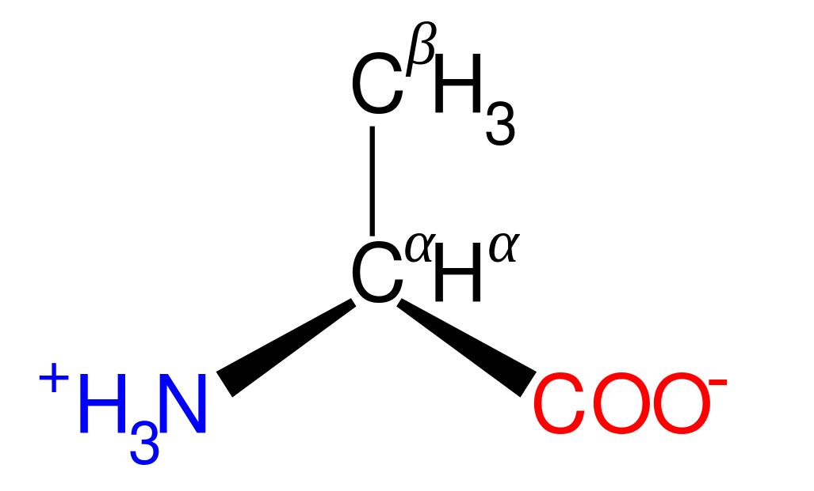
Orion Region Survey
Orion Region Survey (Imaging Mode)
    180 minutes integration time
    99-300 MHz
    400 square degrees
Aminoethanol
Formic Acid
Methanamine
HC₁₃N
Glycine
α-Alanine
Notes:
Primary transitions of several large molecules important for star formation, life, ….

Slide 9

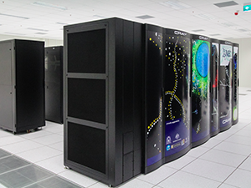

Data Analysis
Using the Supercomputer: Galaxy
Make ~1.5 Million images
  Calibrated
  Flux Scale Corrected
  Corrected for Ionosphere
Make ~144 data cubes to search for spectral lines
All of this requires a new sophisticated pipeline for the MWA

Slide 10
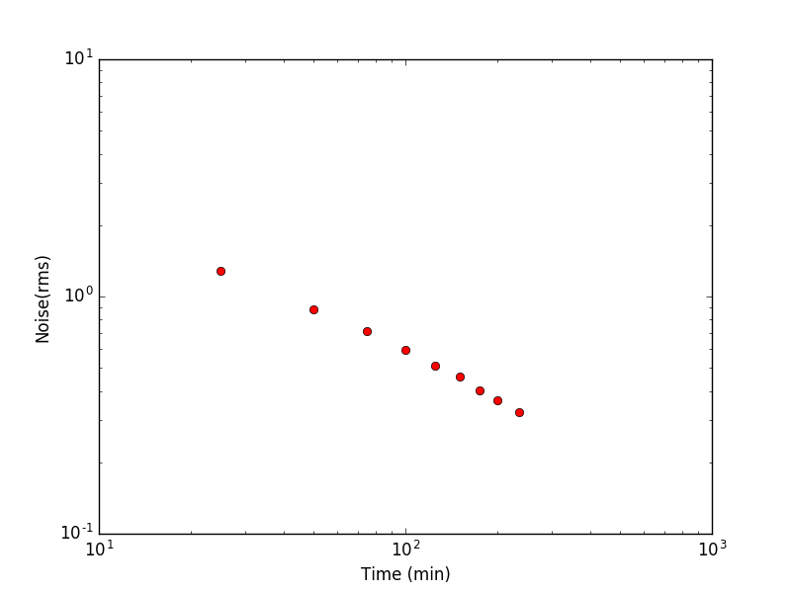
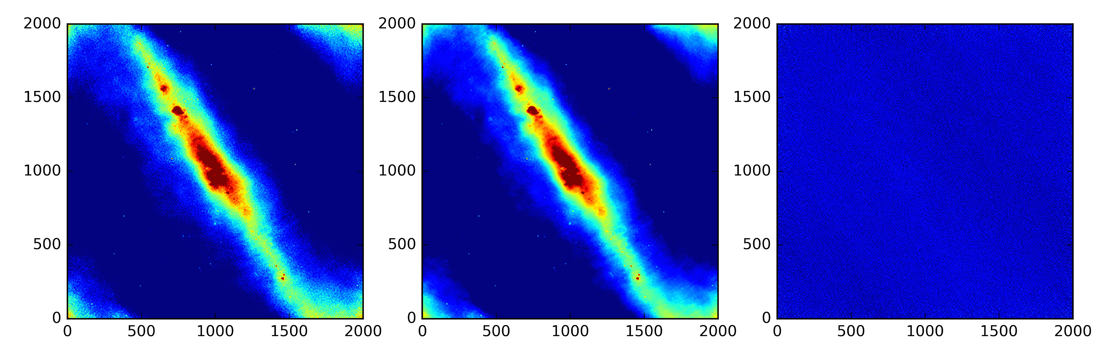
Results
Noise (mJy)
√t
Created continuum subtracted cubes to search for spectral lines
Time (min)
Continuum Image
Single Channel Image
Subtracted Image
Min -2Jy Max 12Jy
Notes:
The noise goes down as a function of square root of t.

Slide 11
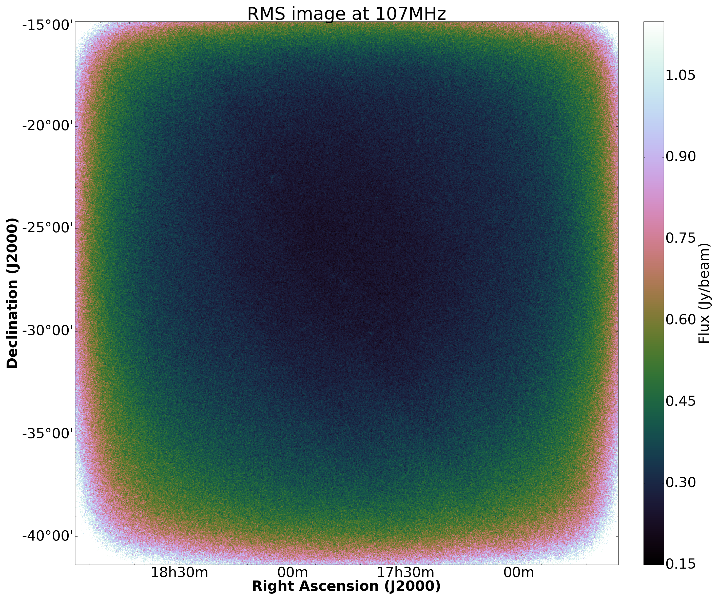
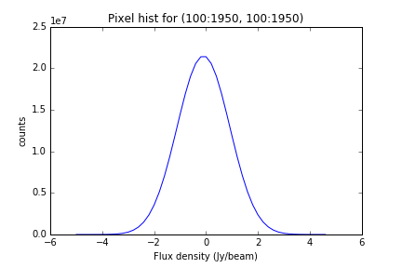
Results
Imaged 2400 (10kHz) channels (115,200 images)
    Noise appears to be Gaussian
    After ~4hrs have a RMS of 150mJy

Slide 12
Results
Some signals are popping out of the background in which we are investigating.
Preliminary

Slide 13

Data Cube at 107MHz: Preliminary Results
Molecular Transitions at Low Frequency – December 2016

Slide 14
Summary
Using the MWA Wide field of view to perform large area surveys
    Galactic Centre Region
    Orion Region
  Using both
    Imaging mode (10kHz, 26km/s)
    VCS mode (0.3kHz, <1km/s)
  Using these surveys to
    Find missing sulfur-bearing molecules like SH
    Look for long-chain molecules
    Target NO, SH, and c-SiC₃ at high frequency resolution.

