Slide 1
The Impact of Clark Lake Radio Observatory: Thirty Years Later
T. E. Gergely (ret) and
T.B.H. Kuiper (JPL)

Slide 2
An Element of the LPA

Slide 3
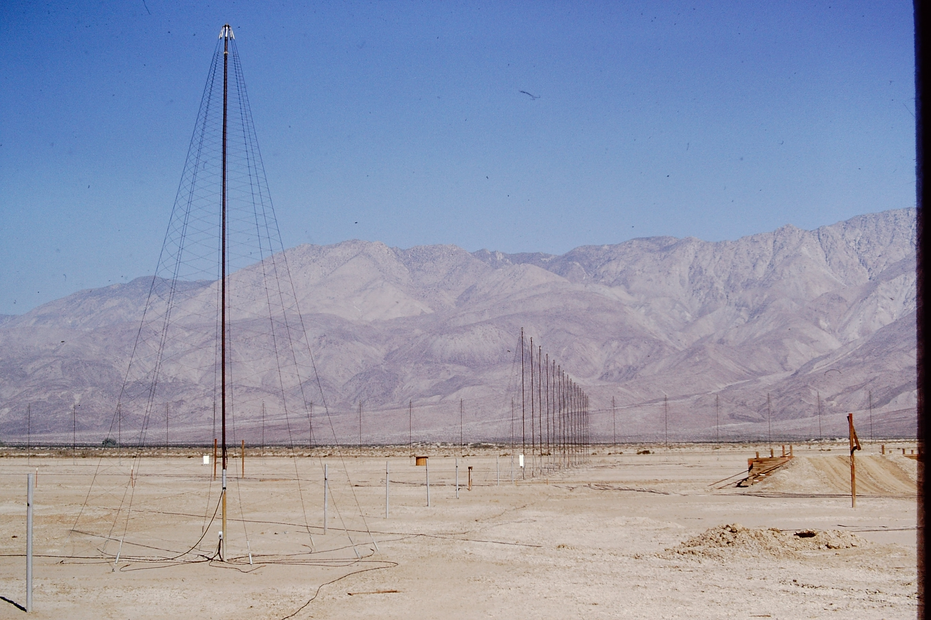
The TPT in 1972

Slide 4
…. and when finished, in 1982

Slide 5
CLRO Issues – Common to Low Frequency RA
Spatial resolution
Even relatively modest spatial resolution requires large arrays, and consequently large, flat (and cheap) extensions of land. Multi-station arrays, that extend over about 2-3 km, the maximum ionospheric coherence length in this frequency range, have become possible only after phase closure has become available in the early to mid-eighties.
Man-made interference.
an enormous number of radio systems work in this range, that encompasses what is commonly known as the High Frequency (3-30 MHz - HF) and Very High Frequency (VHF) ranges. Man-made interference is difficult to avoid, and to be successful, observatories require elaborate interference excision schemes. Even so, most of them avoid the 88.5-108 MHz FM band.
Ionospheric effects,
Tend to smear and displace images and that must be accounted for, even when dealing with relatively

Slide 6
Solutions
Solving these issues satisfactorily requires:
Far more computing power than available in the 80s
Some techniques, such as Self-calibration, also computer intensive and just becoming available in the 80’s

Slide 7
The CLRO Legacy

Slide 8
FOSTERING INTEREST IN LOW FREQUENCY SCIENCE
HIGHLY REDSHIFTED HI
FAST TRANSIENTS AND THEIR CORRELATION WITH, E.G. GAMMA RAY BURSTS
SPECTRUM OF EXTRAGALACTIC RADIO SOURCES- STEEP SPECTRUM
RADIO RECOMBINATION LINES ( C )
SOLAR AND INTERPLANETARY TRANSIENT EVENTS

Slide 9
Imitation Is the Sincerest Form of Flattery- The Nançay Decametric Array and the U. of Florida Jupiter Observatory

Slide 10
From CLRO to the LWA
CLRO also gave origin to the LWA
The 74 MHz Array was developed in the early 90’s and showed that self calibration worked at low frequencies
The LWA concept grew out of the 74 MHz Array
Bill Erickson designed the Bow-Tie Dipoles used in both

Slide 11
Comparison of the Specs of the TPT and the LWA1

Slide 12
The Correlator

Slide 13
…ended up in the Mauritius Telescope

Slide 14
Space Based Low Frequency Arrays

Slide 15
CLRO Ph. D.s

Slide 16
CLRO’S (URO’S) DEMISE
FUNDING AGENCY INTEREST- MOSTLY in SCIENCE OUTPUT
LOW BUDGET OPERATION ⇒
LOW LEVEL OF STAFFING
LOW LEVEL OF DOCUMENTATION
LOW LEVEL OF SUPPORT FOR USERS ⇒
FEW PAPERS AND LOW PRODUCTIVITY
TRAINING OF SCIENTISTS
LOW BUDGET OPERATION ⇒
FIGURE/DO IT YOURSELF
CREATIVE PROBLEM SOLVING
HANDS ON ATTITUDE ⇒
WELL ROUNDED, LEADING AND CREATIVE INSTRUMENTALISTS

Slide 17
Bill Erickson, checking the fuel on a transcontinental flight from the U MD to CLRO

Slide 18
A Clark Lake Gathering
Left to Right
Foreground: Tom Kuiper and
“M.J.” Mahoney
Back Row:
Stig Johansson, Rick Perley,
Iva Johansson, Eva Rodriguez,
Hilary Cane, Bill Erickson, Pat Resch,
George Resch, Tom Matthews

