Slide 1
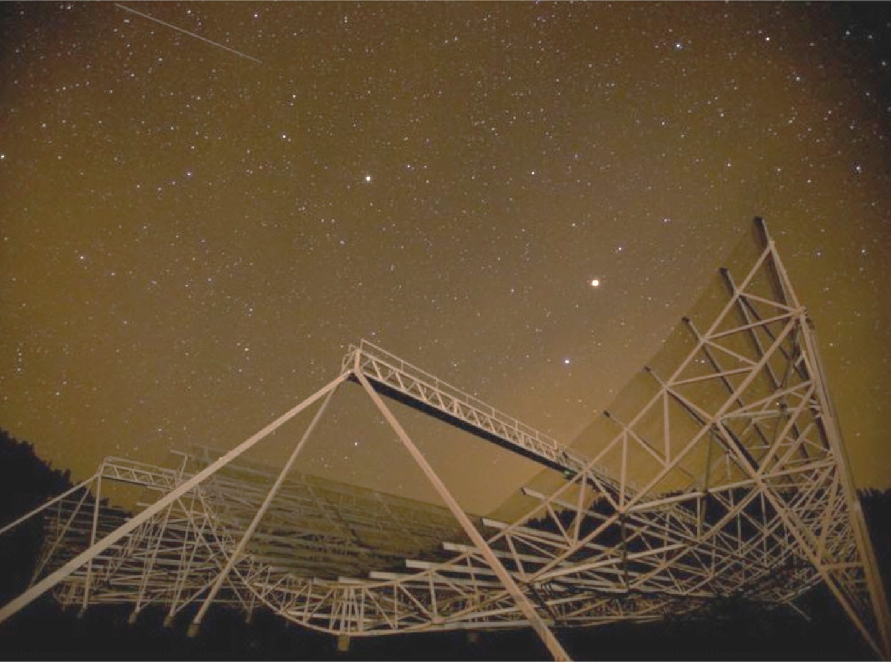
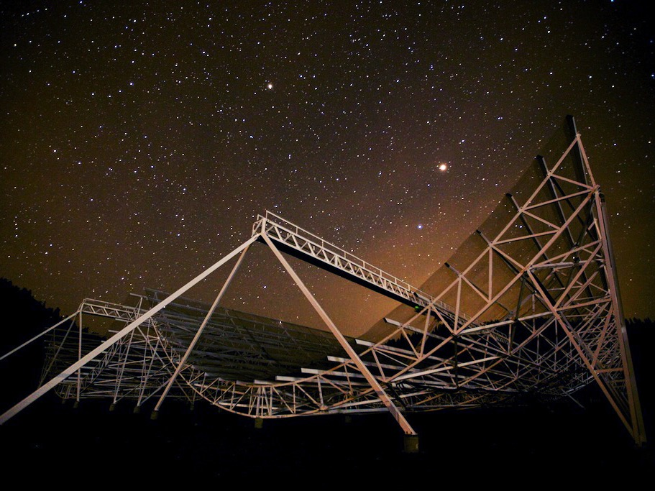
Canadian Hydrogen Intensity Mapping Experiment
Status Update 2016
Keith Vanderlinde
Dunlap Institute @ UofT
Dec 7, 2016
SLFIII

Slide 2
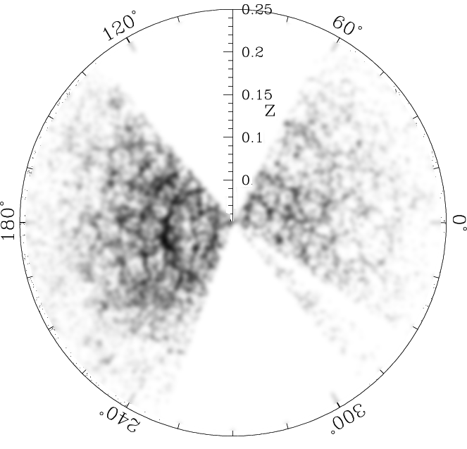
Tracing Structure through 21cm
Redshifted 21cm intensity is a tracer for matter.
BAO
Scale
0.8<z<2.5 =
400-800MHz is relatively clean window, prime for measuring Dark Energy
Unresolved galaxies, resolved BAO.

Slide 3
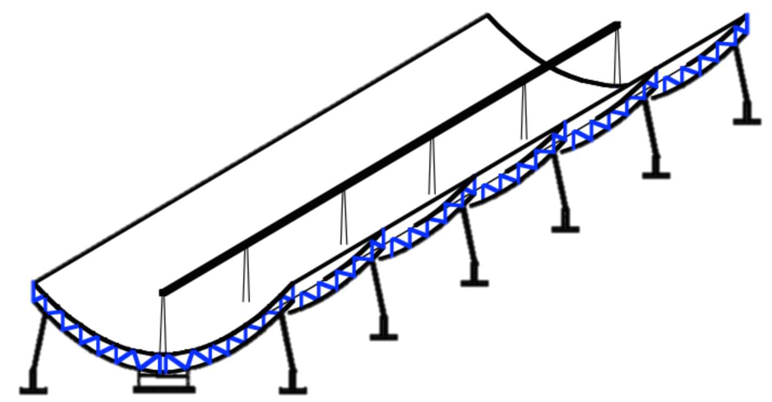




CHIME
An experiment to measure BAO and constrain DE eq of state
400-800MHz
Resolution 1/3 – 2/3 deg
Drift scan w/ 1024 dual-pol feeds
~200 deg² instantaneous FoV
>20,000 deg² daily survey
~μJy noise floor (50μJy / day)

Slide 6
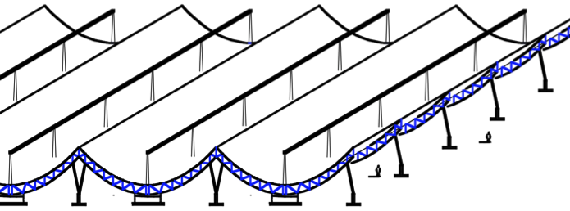
The CHIME Pathfinder
64 dual-pol antennas per cylinder (256 total channels)
36m
Details in
Bandura et al., 2014
40m

Slide 7
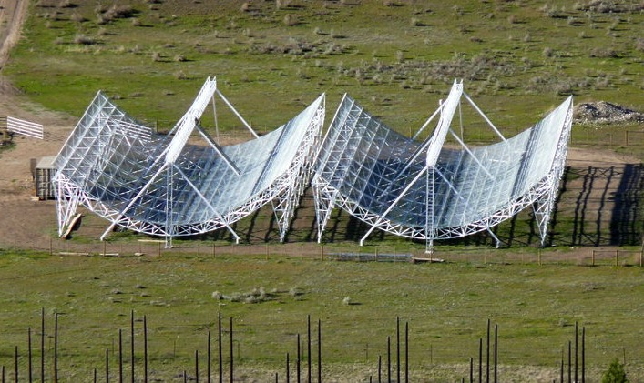
Pathfinder Cylinders
N
36m
S
20m

Slide 8
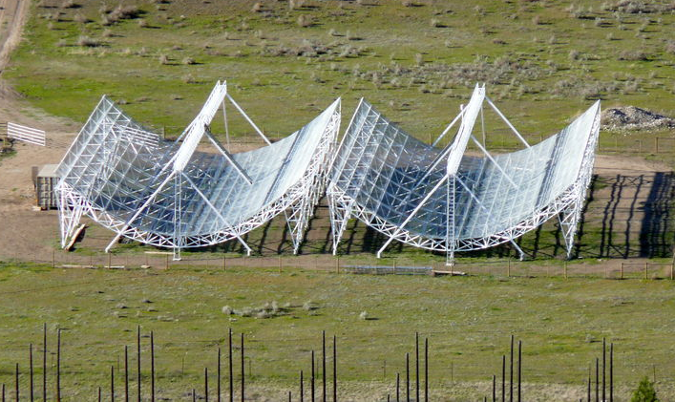
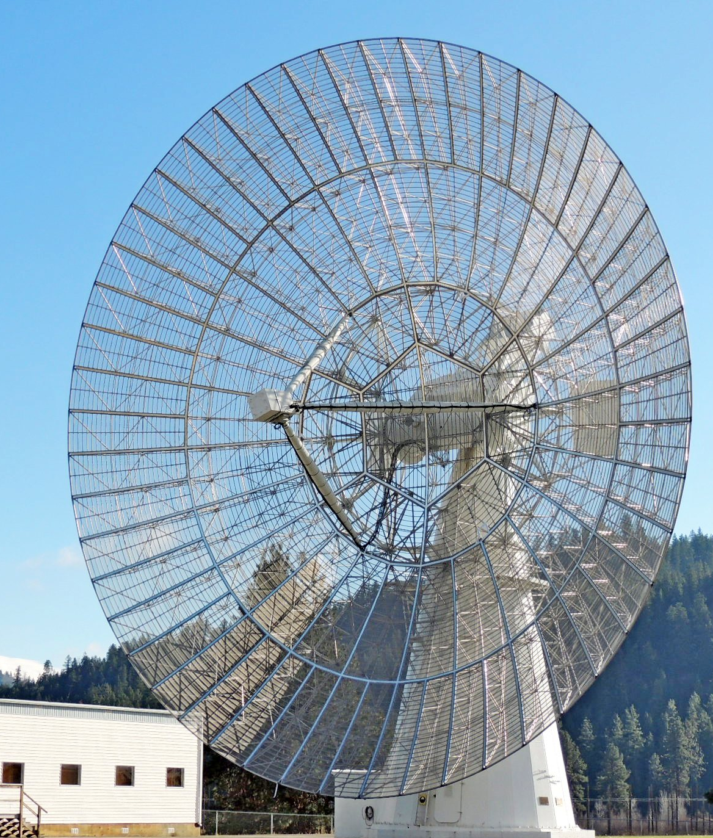
Calibration: Beam Holography
Berger et al., 2016
DRAO 26m Galt Telescope
Track sources with steerable dish as they drift overhead.
Correlate with CHIME to measure primary beams.

Slide 9
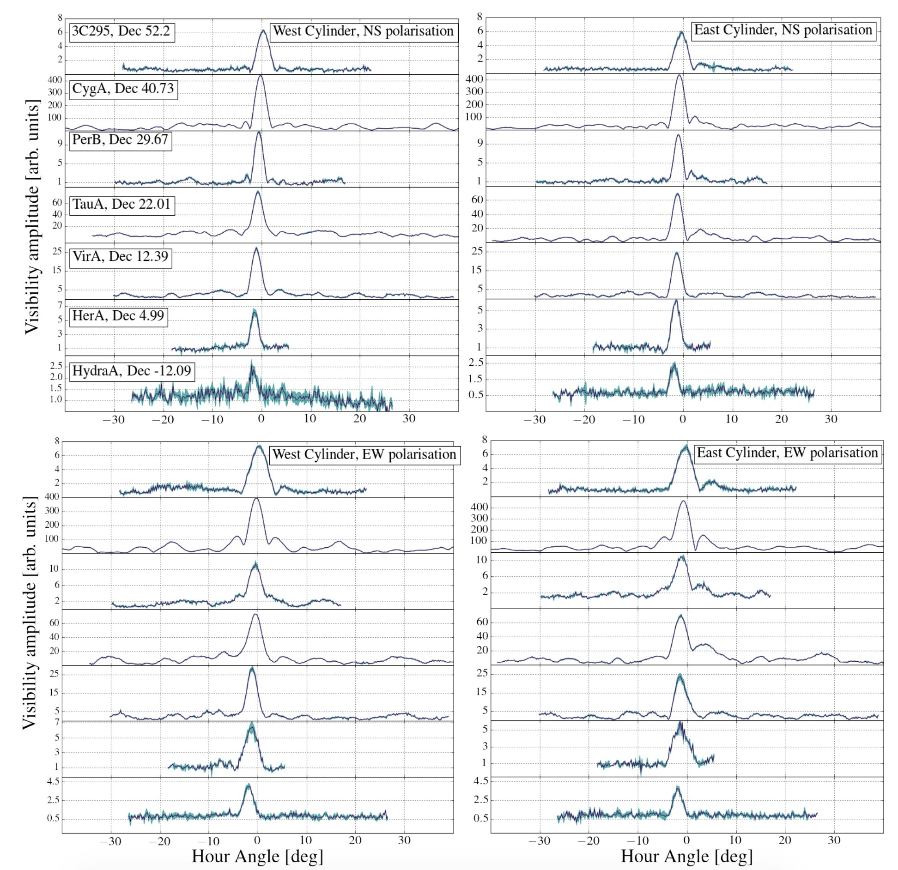
Berger et al., 2016

Slide 10
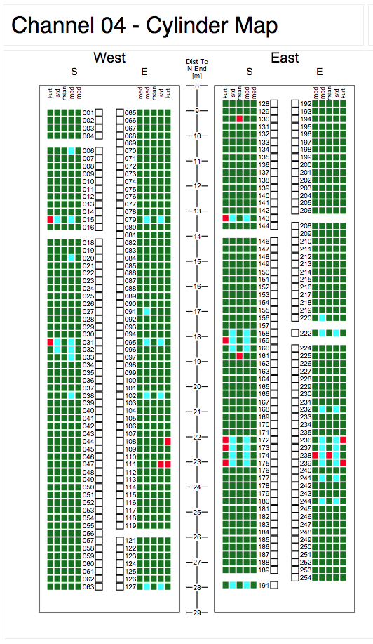
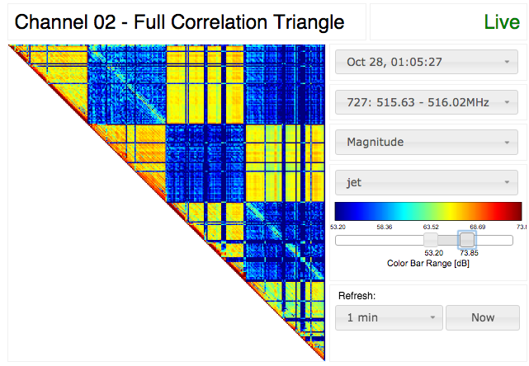
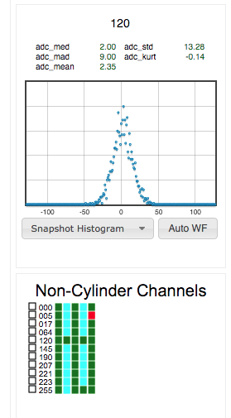
Large-N Interferometry
Monitoring with CHIME TV

Slide 11
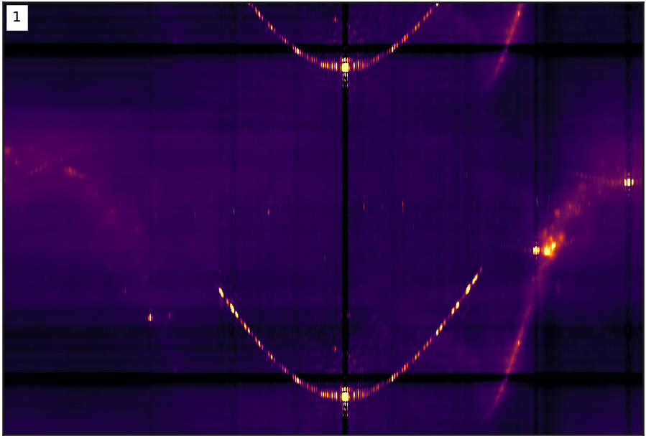
VERY
PRELIMINARY!

Slide 12
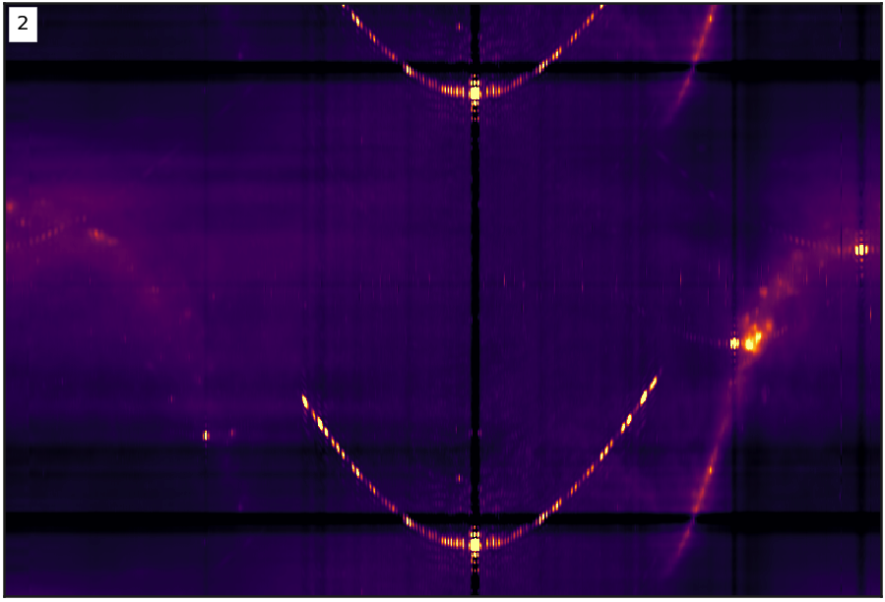
VERY
PRELIMINARY!

Slide 13
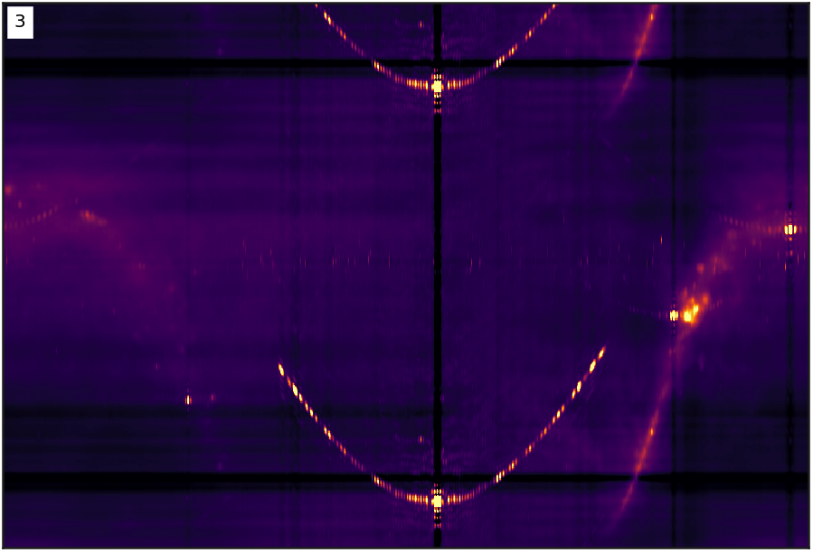
VERY
PRELIMINARY!

Slide 14
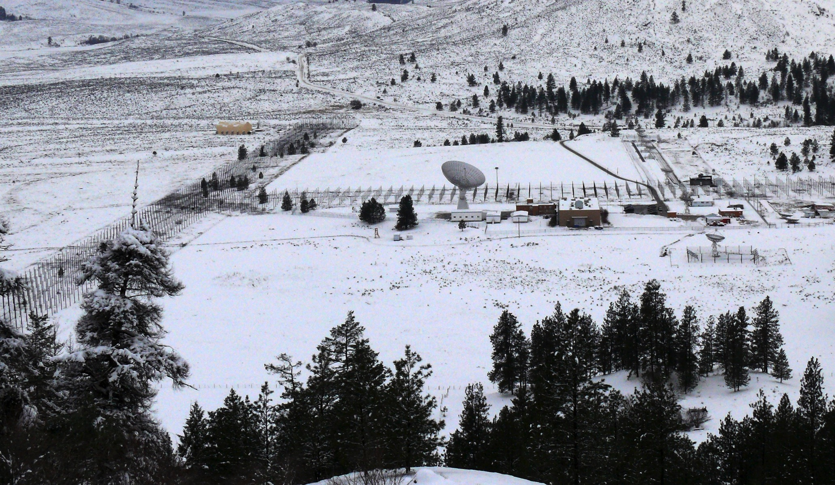
CHIME Site: DRAO

Slide 15
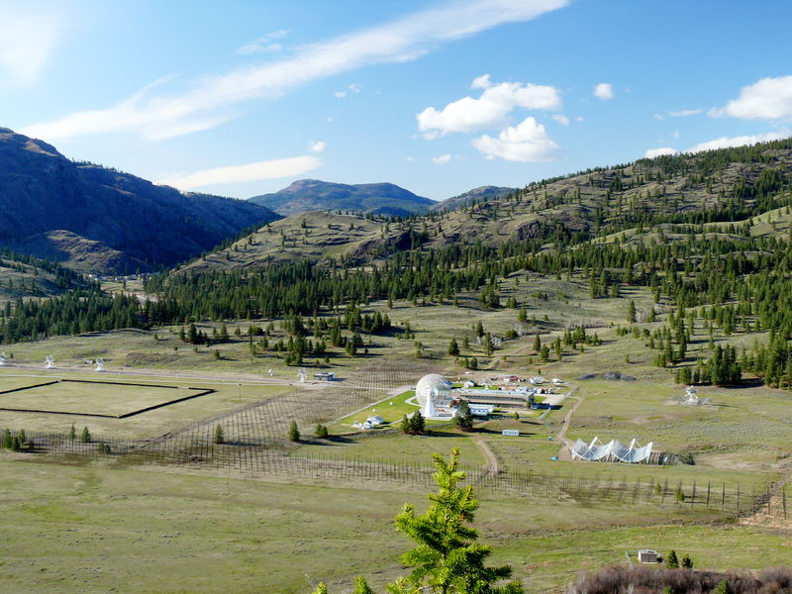
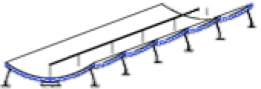
CHIME Site: DRAO

Slide 16
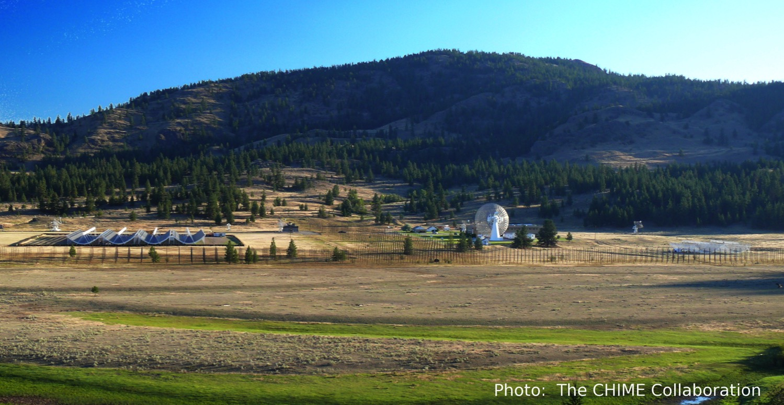
DRAO - Summer 2016

Slide 17
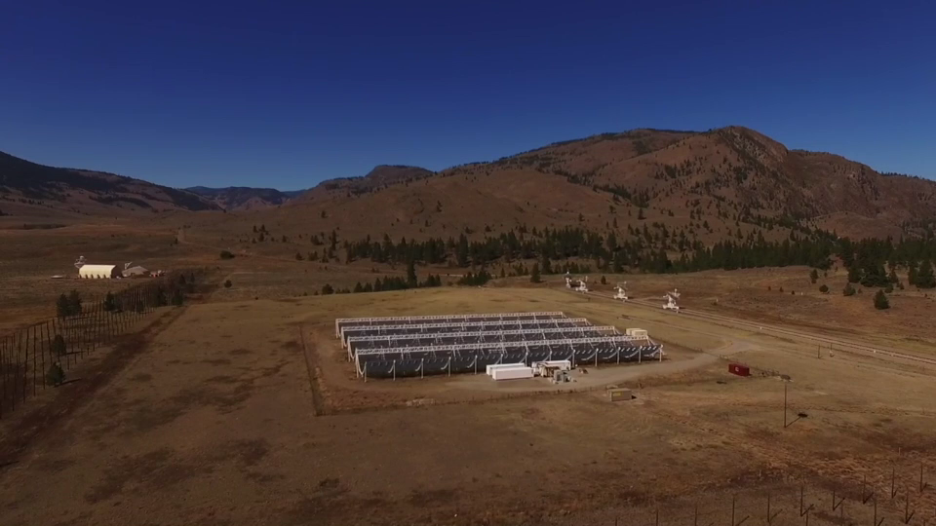
CHIME

Slide 18
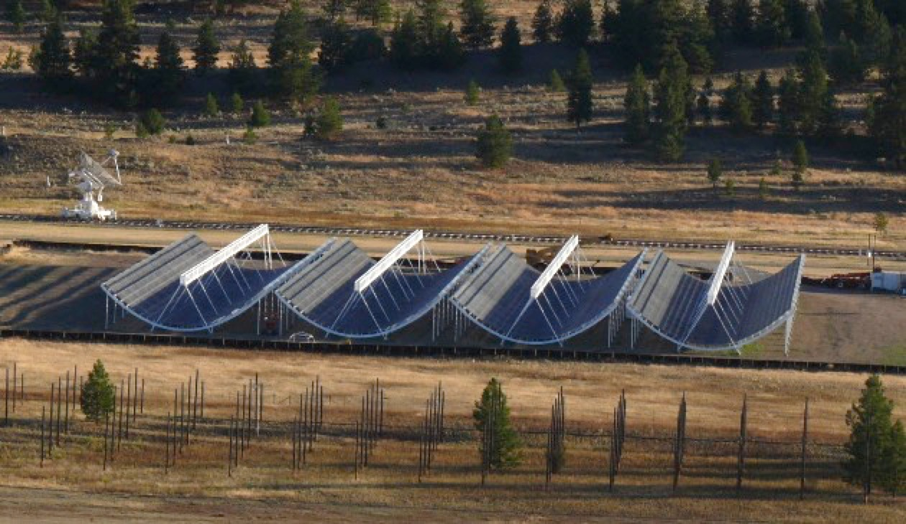
N
S
20m
100m

Slide 19
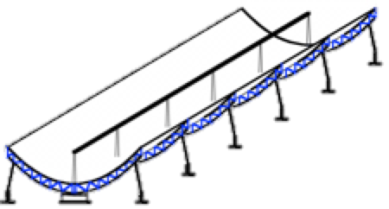
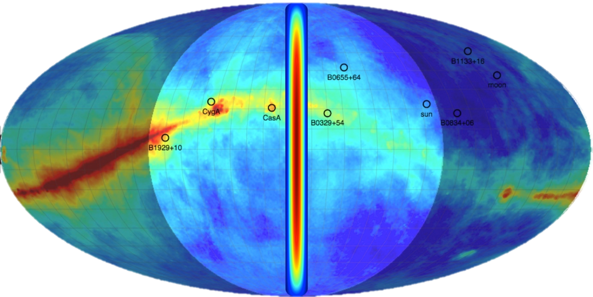
System Overview
Reflectors
Analog Frontend
Amps, filters, etc
FPGA Digitizer /
Channelizer
GPU Correlator
1024 dual-polarization feeds
each sees a broad N-S band
Realtime
Backend(s)
Disk

Slide 20
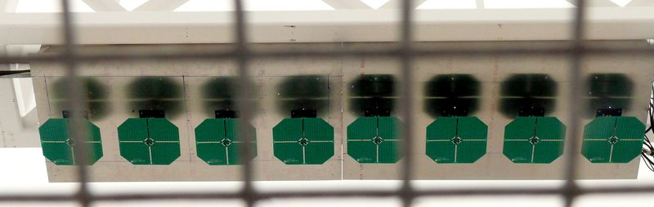
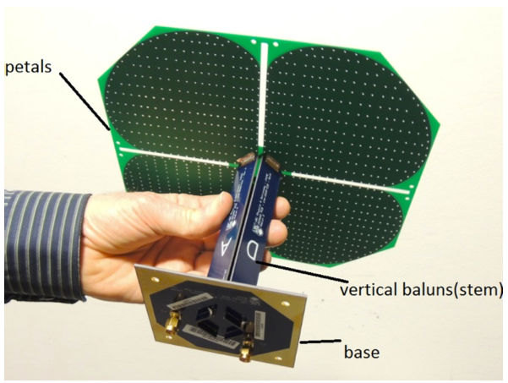
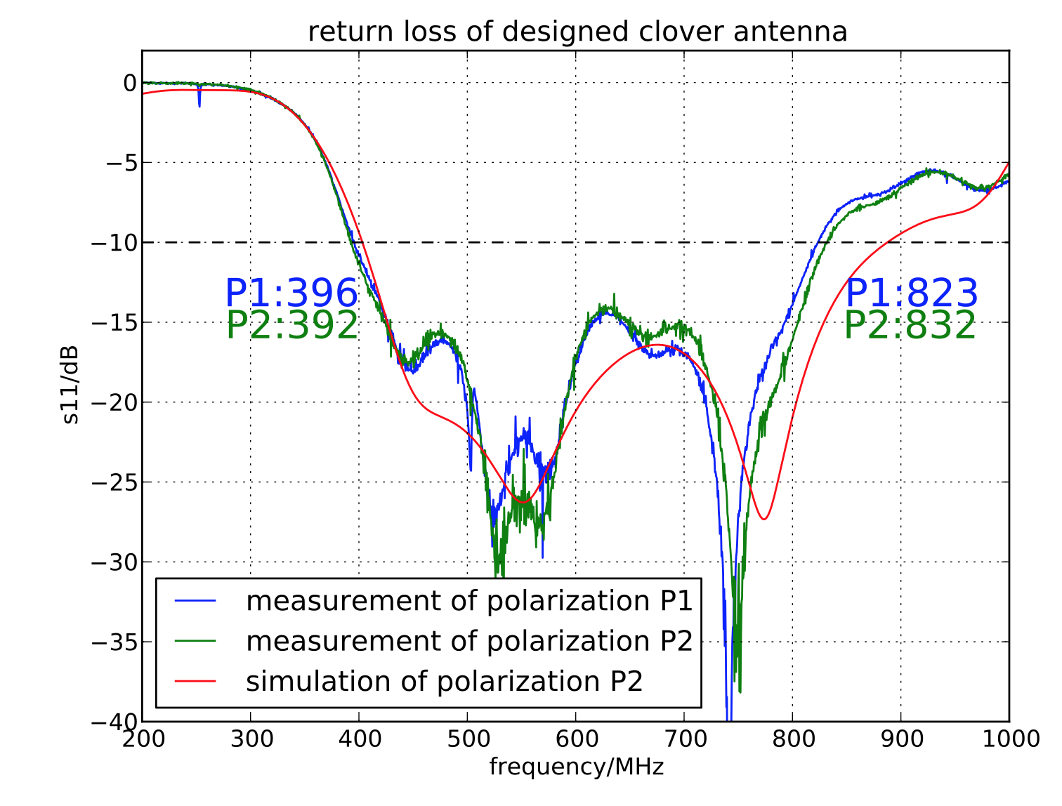
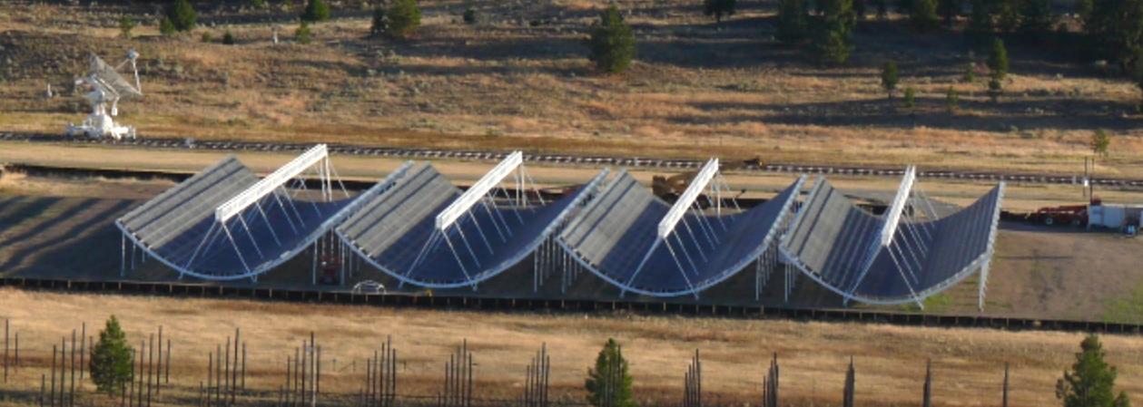

Slide 21
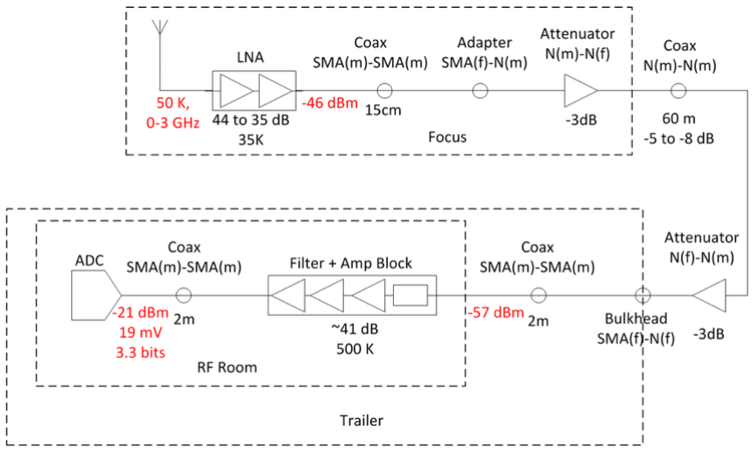
System Overview
Reflectors
Analog Frontend
Amps, filters, etc
FPGA Digitizer /
Channelizer
GPU Correlator
Custom analog frontend:
2048 signal chains
50K system temperature
>40dB out-of-band rejection
Realtime
Backend(s)
Disk

Slide 22
Analog System Overview

Slide 23
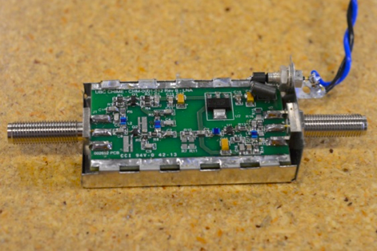
Analog System Overview

Slide 24
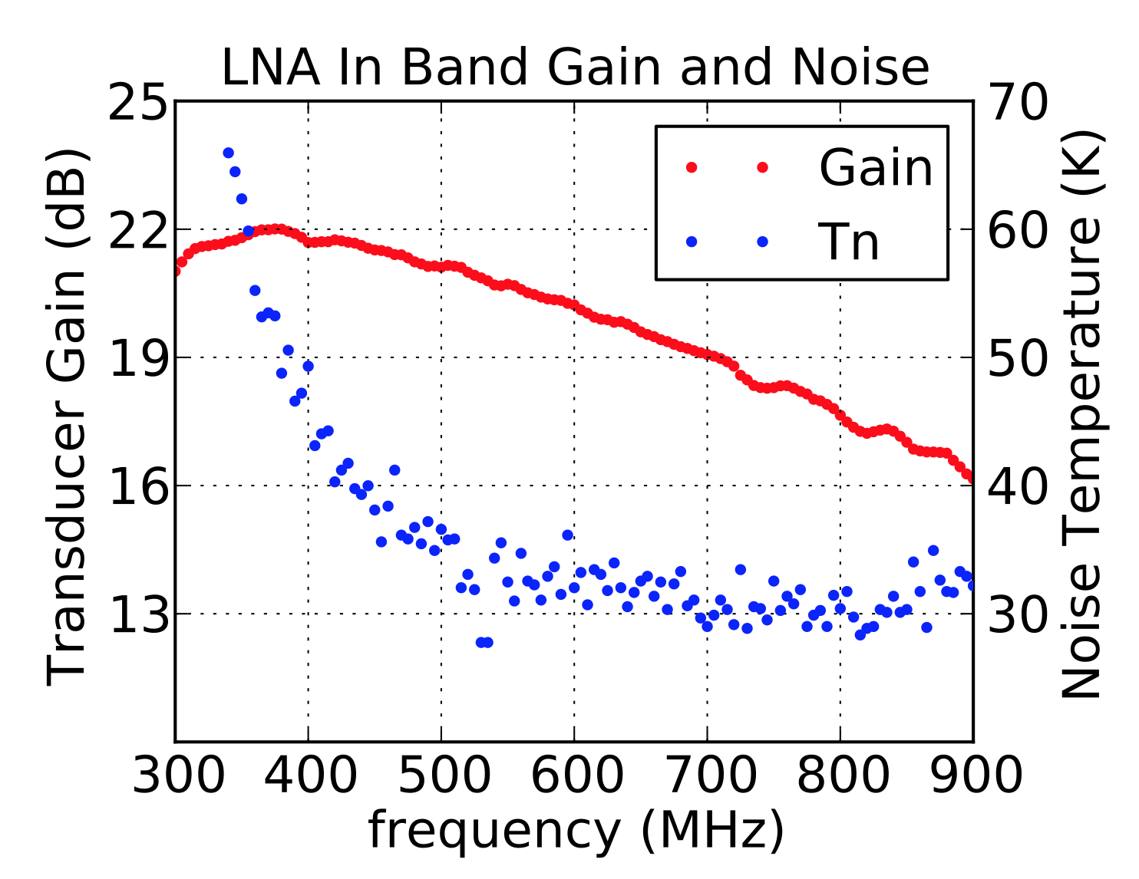
Analog System Overview

Slide 25
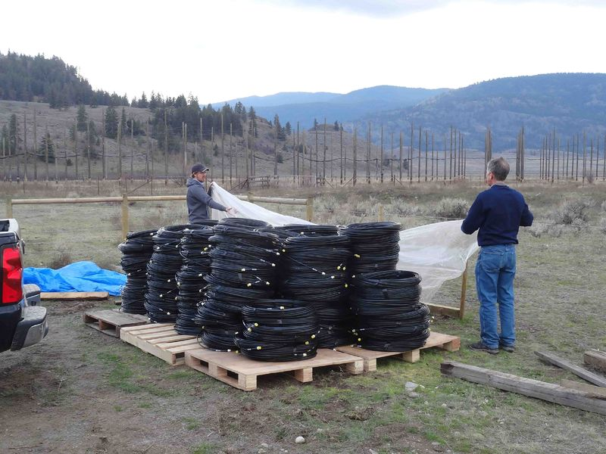
Analog System Overview

Slide 26
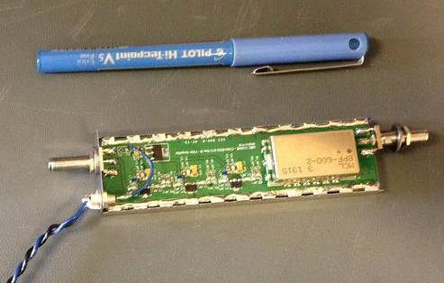
Analog System Overview

Slide 27
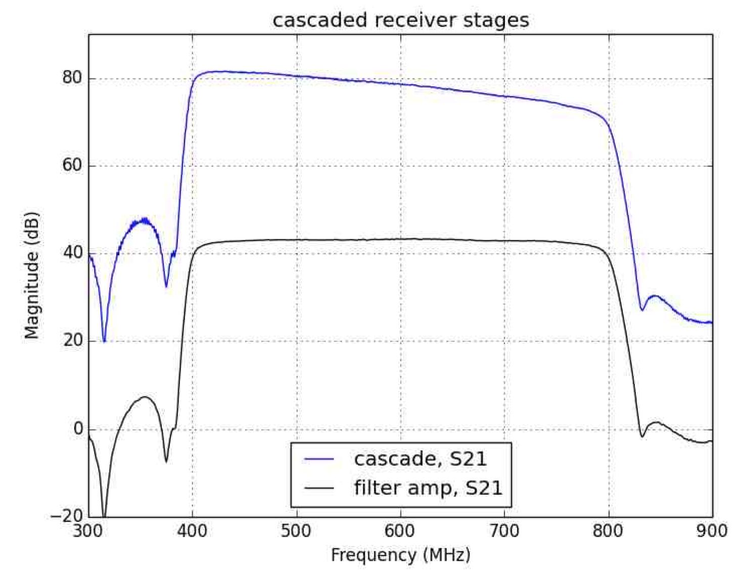
Analog System Overview

Slide 28
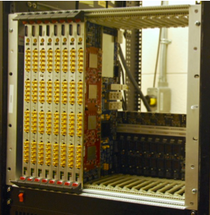
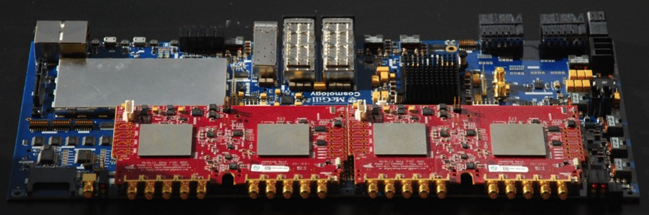
System Overview
Reflectors
Digitizes at 800MHz
Splits into 1024 freqs
via 4-tap PFB
Analog Frontend
Amps, filters, etc
FPGA Digitizer /
Channelizer
GPU Correlator
HDD
16 / crate, 8 crates
Bandura et al, 2016

Slide 29
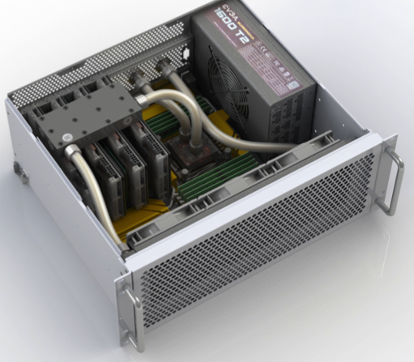
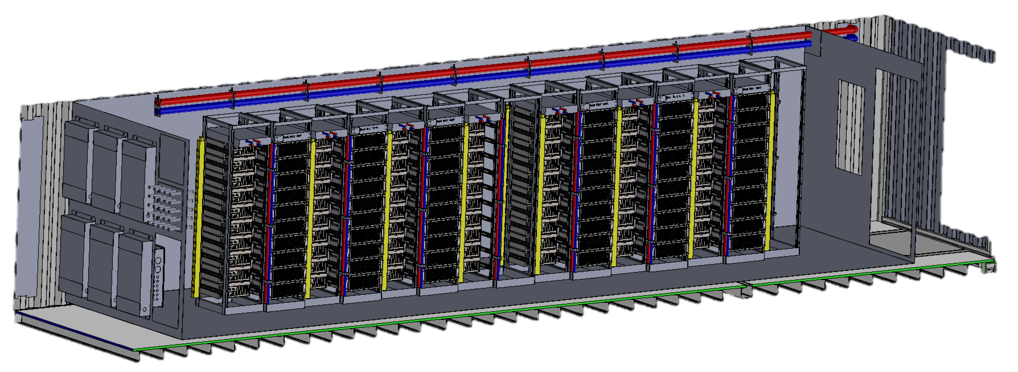
System Overview
Reflectors
AMD GPU-based X-Engine
Full N² corr (!)
Fits in a SeaCan
Analog Frontend
Amps, filters, etc
FPGA Digitizer /
Channelizer
≈TBps
GPU Correlator
≈GBps
HDD
Full N² ≈10¹⁵ cMAC/s ≈ 8 PFLOP/s

Slide 30
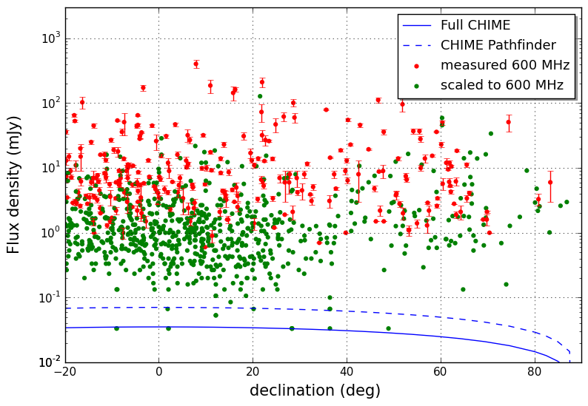
Extra Capabilites
Reflectors
ATNF Pulsar Catalog
Analog Frontend
Amps, filters, etc
FPGA Digitizer /
Channelizer
GPU Correlator
Cherry Ng
Realtime
Backend(s)
CHIME can monitor every known northern pulsar, near-daily cadence.
Disk

Slide 31
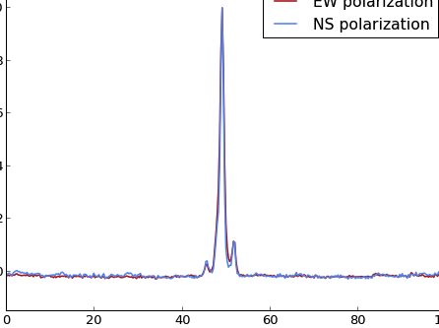
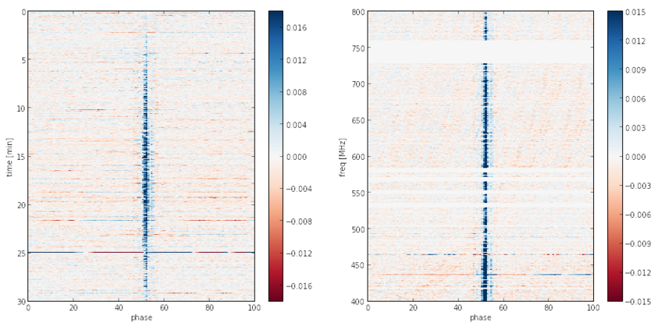
CHIME/Pulsar
Tied-array Beam
Commissioning
(b0329+54)
0
800
Time (min)
Freq (MHz)
30
phase
400
phase

Slide 32
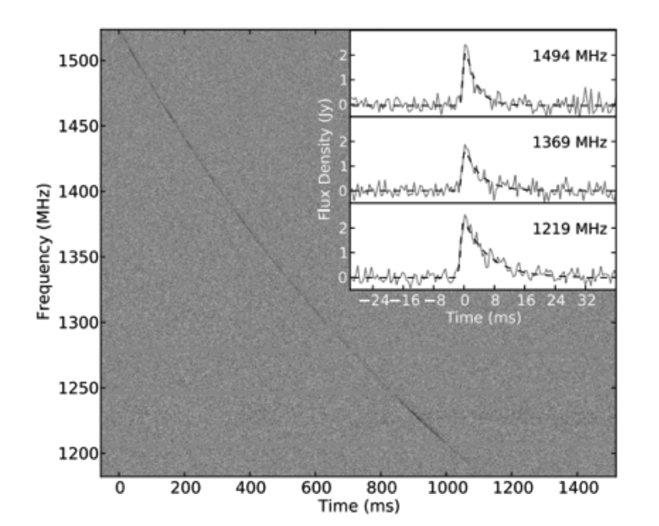
Fast Radio Bursts!
Reflectors
Analog Frontend
Amps, filters, etc
FPGA Digitizer /
Channelizer
GPU Correlator
Realtime
Backend(s)
Disk

Slide 33
FRB Search
1024 “Fan” Beams
Δν=24kHz, Δτ=1ms
1024
Stokes-I beams
1024 dual-pol feeds
FFT / Beamforming
Correlator

Slide 34


CHIME/FRB
Siphon off data stream of:
1024 FFT/Fan Beams
Stokes-I, Δτ=1ms, Δν=24kHz
8,000m² collecting area
400-800MHz bandwidth
Feed into search cluster, search everywhere in CHIME, always.
→ Should see dozens / day.
1024
Stokes-I beams

Slide 35
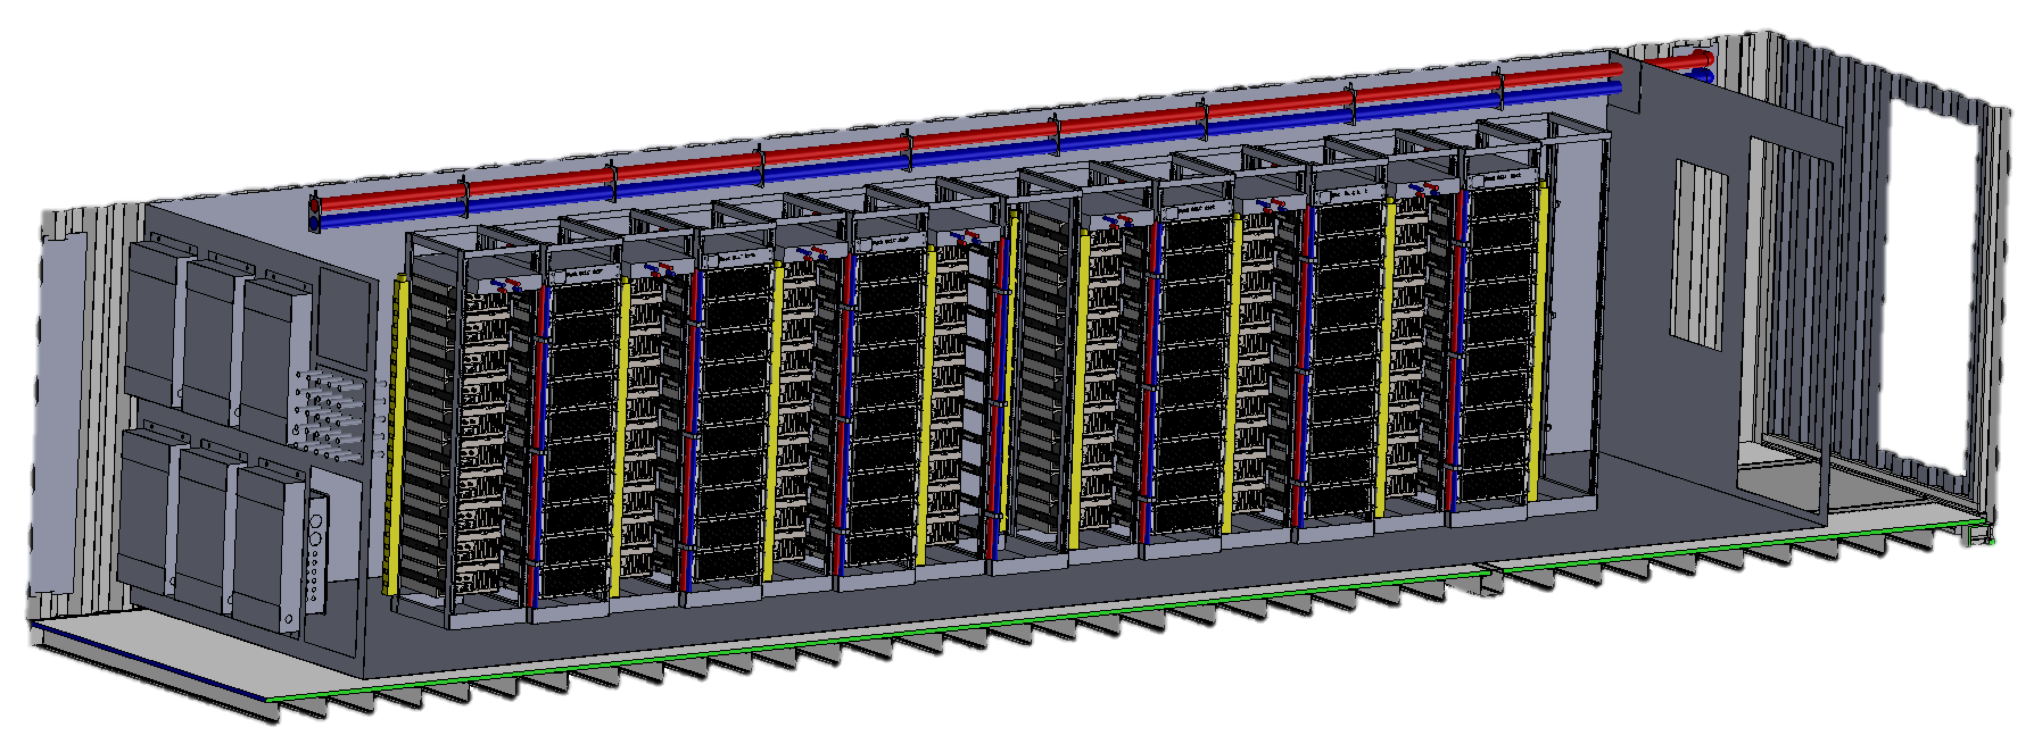
Growing CHIME
Reflectors
Analog Frontend
Amps, filters, etc
8 PFLOP GPU Backend
16
X
FPGA Digitizer /
Chanelizer
≈TBps
GPU Correlator
≈GBps
≈16GBps
Full N² (≈10¹⁵ cMAC/s = 8 PFLOP/s)
+ 10 Tied-array Coherent Beams
+ 1024 Fan beams @ 24kHz, 1ms
Realtime
Backend(s)
Disk

Slide 36
CHIME Status
← Complete
Reflectors
Analog Frontend
Amps, filters, etc
← Installing Now, all @ DRAO/UBC
FPGA Digitizer /
Channelizer
← ¼ Installed, ¾ ready at McGill
GPU Correlator
← 80% Assembled, all at Toronto
← CHIME/Pulsar: Built, at McGill
Realtime
Backend(s)
Disk
← CHIME/FRB: Finalizing design, deployment in spring/summer 2017

Slide 37
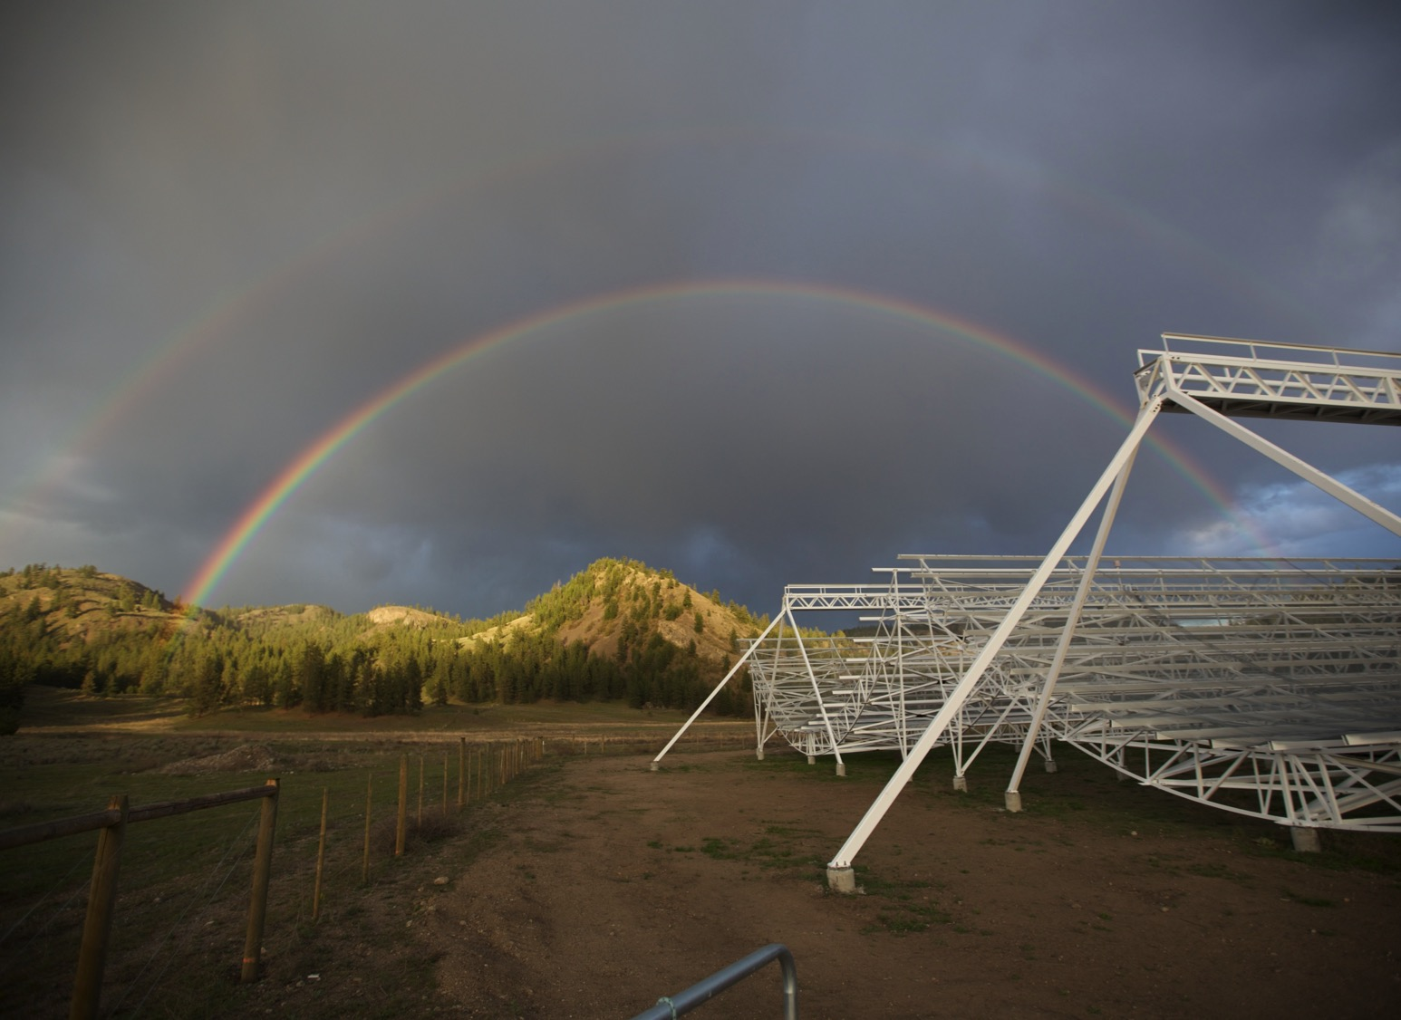
Stay tuned…

