Slide 1
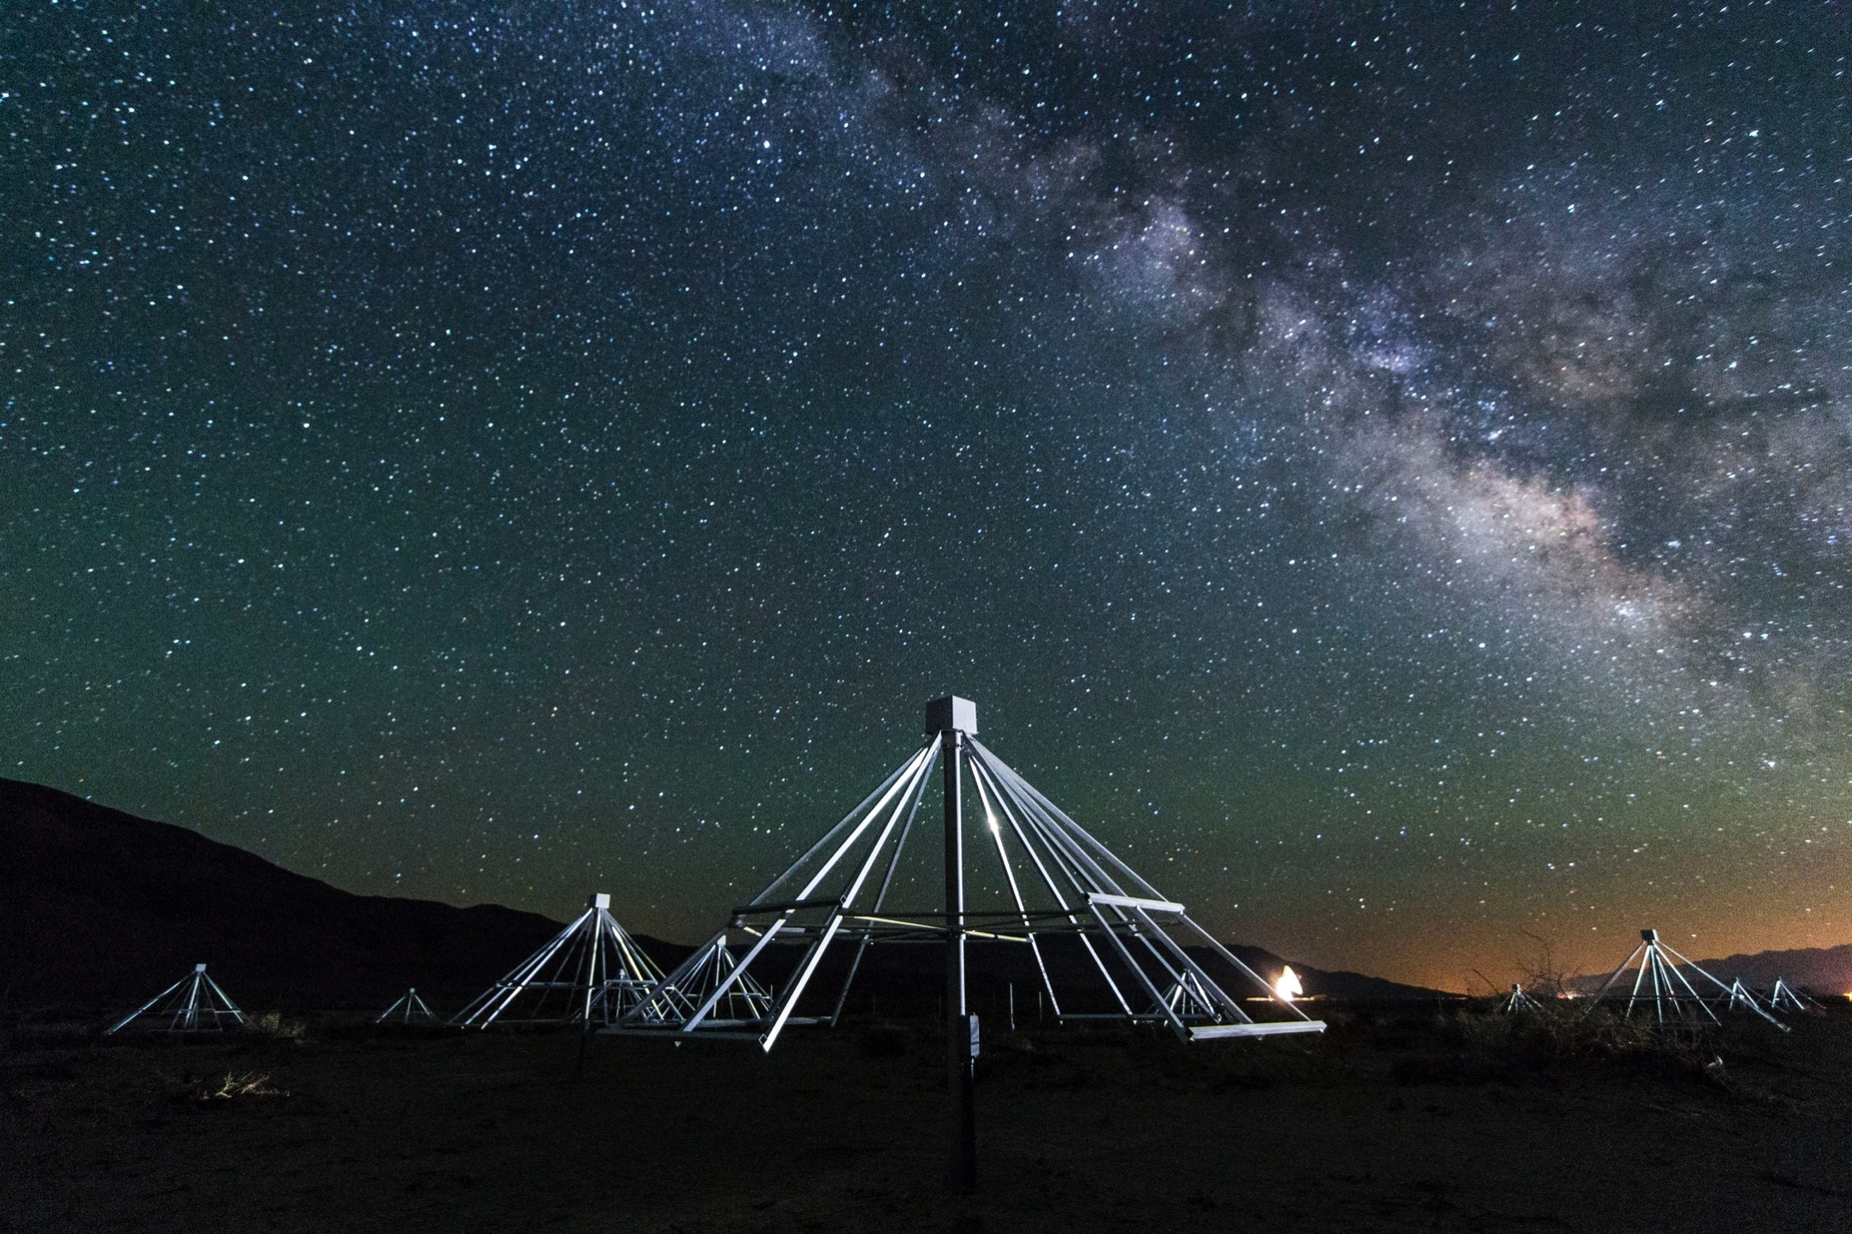
The Owens Valley LWA:
Status & Future Plans
Gregg Hallinan: Caltech
E-mail: gh@astro.caltech.edu

Slide 2
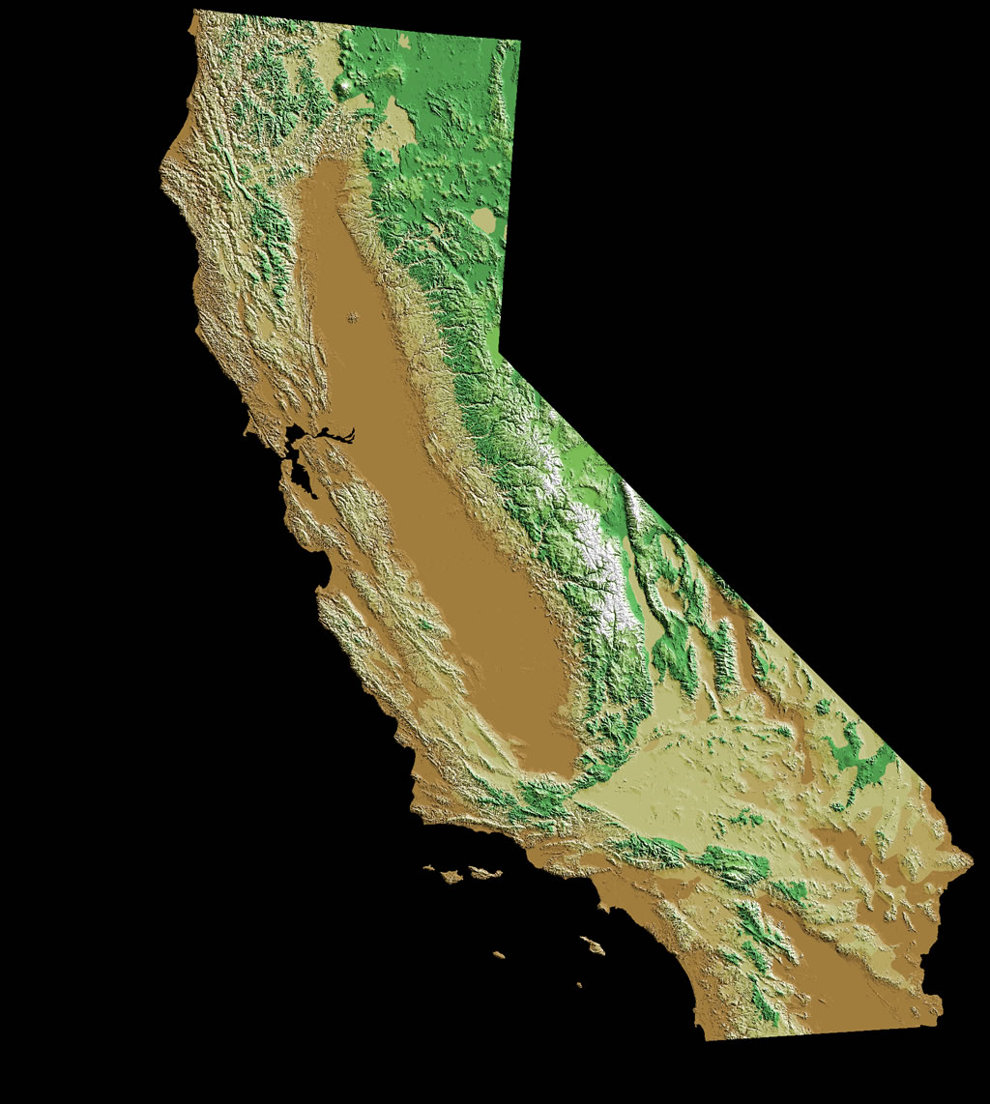
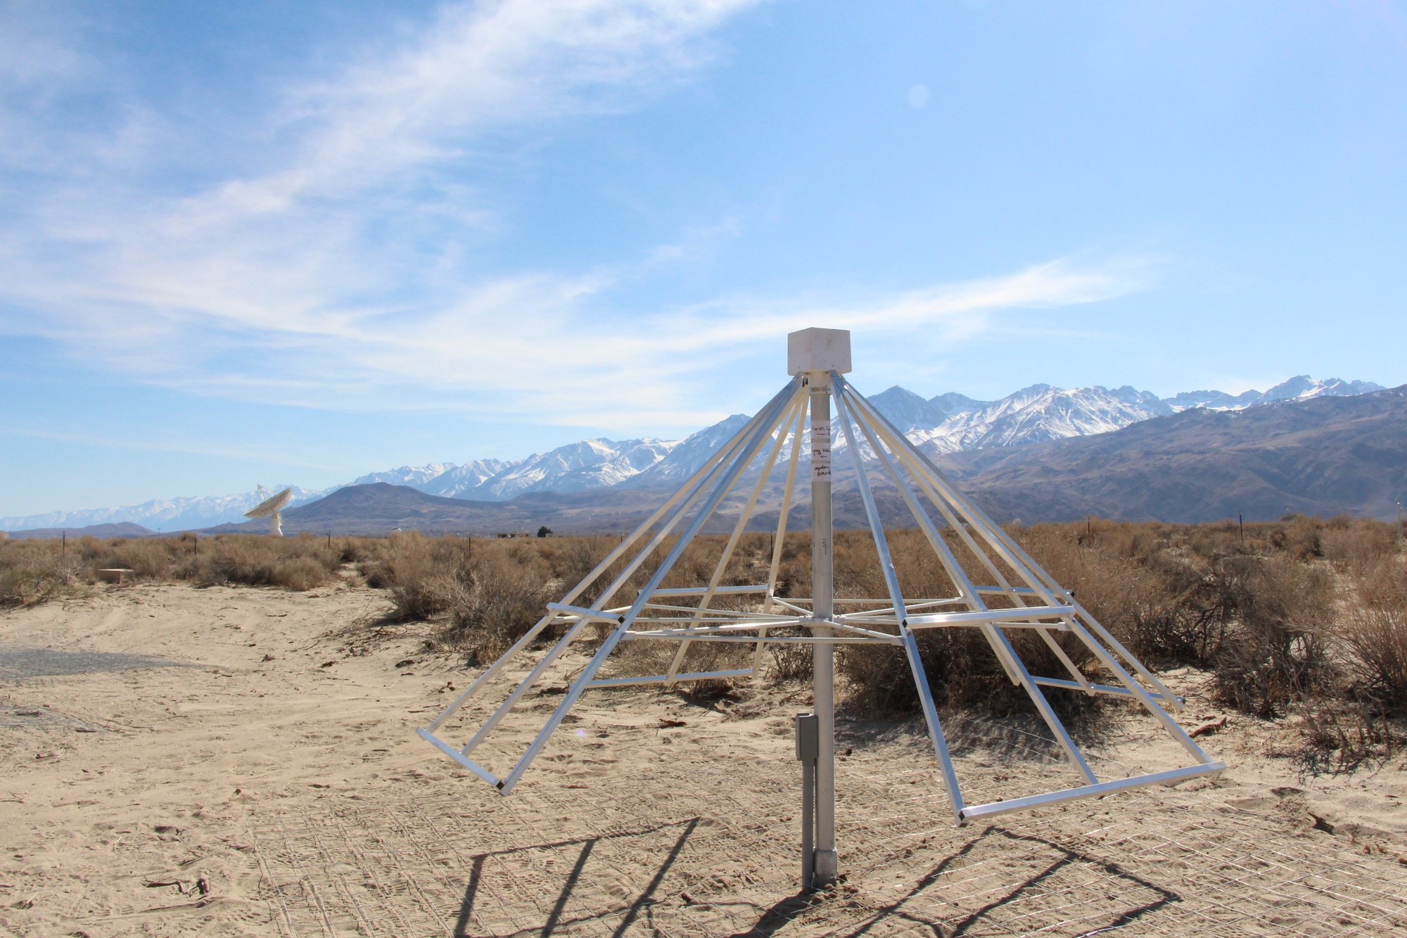
Concept
352 antennas spaced over ~2.6 km
Full cross-correlation = All-sky FOV
25-85 MHz (2400 channels)
5 arcminute resolution
Unmatched survey speed below 100 MHz

Slide 3
Collaboration
Caltech, OVRO & JPL:
Gregg Hallinan, Michael Eastwood, Marin Anderson, Ryan Monroe, Sandy Weinreb, Harish Vedantham, David Wang, Michael Huynh, Esayas Shume, Kate Clark, Larry D’Addario, Jonathon Kocz
David Woody, James Lamb + OVRO staff
Joe Lazio, Dave Hawkins, Attila Komjathy, Melissa Soriano, Andrew Romero-Wolf, Paul Ries
LEDA Collaboration: Lincoln Greenhill, Danny Price, Ben Barsdell, Hugh Garsden, Frank Schinzel, Greg Taylor, Dan Werthimer, Steve Ellingson et al.
LWA Collaboration: Greg Taylor, Joe Craig, Namir Kassim, Brian Hicks, Frank Schinzel, Steve Ellingson et al.
NJIT Solar: Dale Gary, Bin Chen, Sherry Chhabra, Sijie Yu

Slide 4
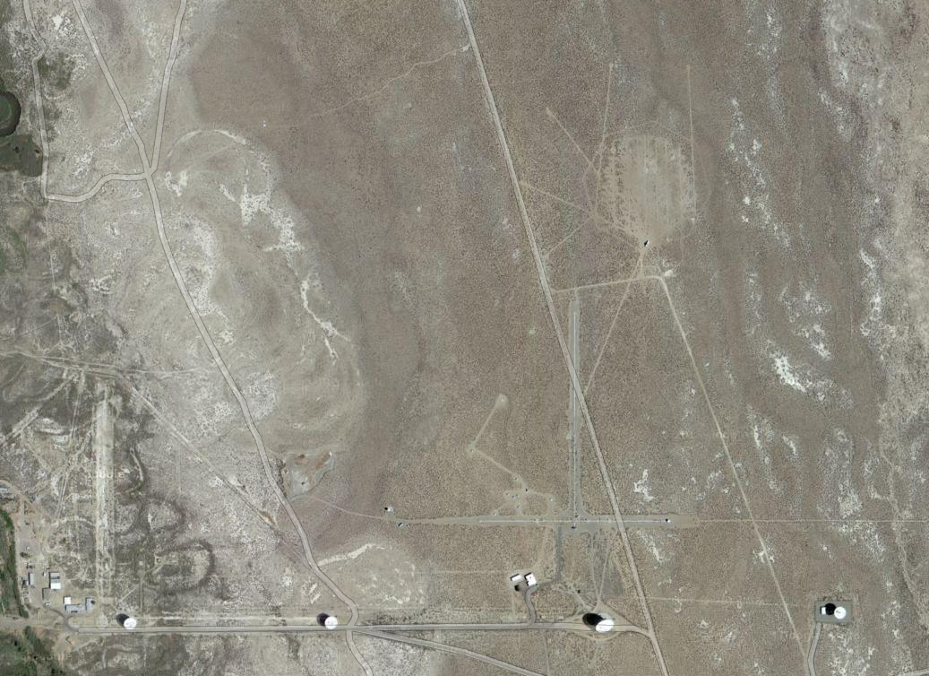
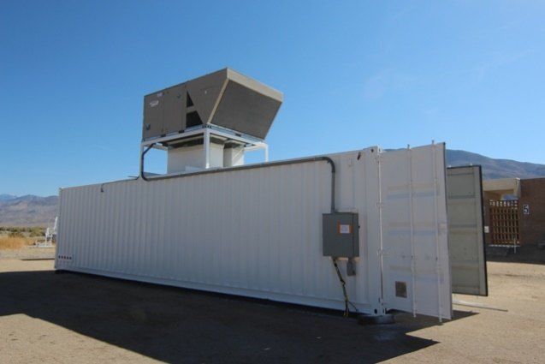
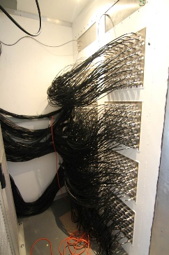
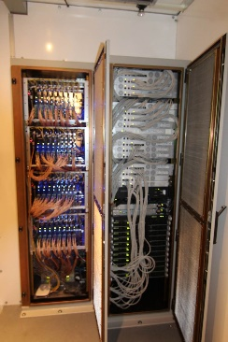
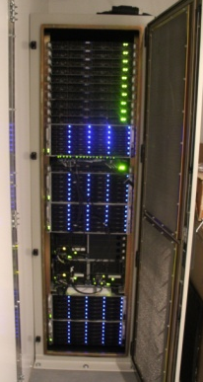
Phase 1: 2013-2014
Custom built array for all-sky imaging
256 antennas
88 km of buried coaxial cable
1 km of fencing
200m
Two powerful back-ends:
1) LEDA correlator
2) All-sky Transient Monitor

Slide 6
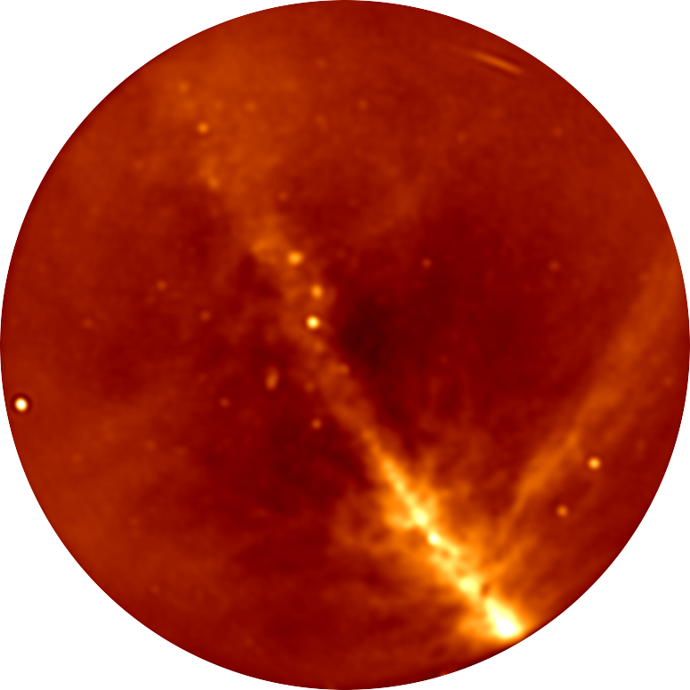
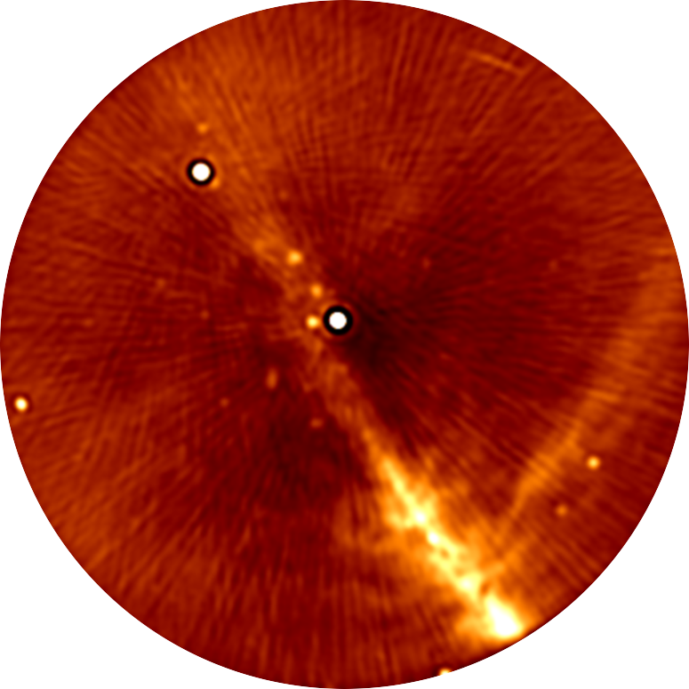
Core Image (200m baselines)
30 second snapshot with ~40 MHz bandwidth
Confusion limit is ~few Jy
Thermal noise is ~ 200 mJy
Reach confusion noise in <0.1 seconds!

Slide 7
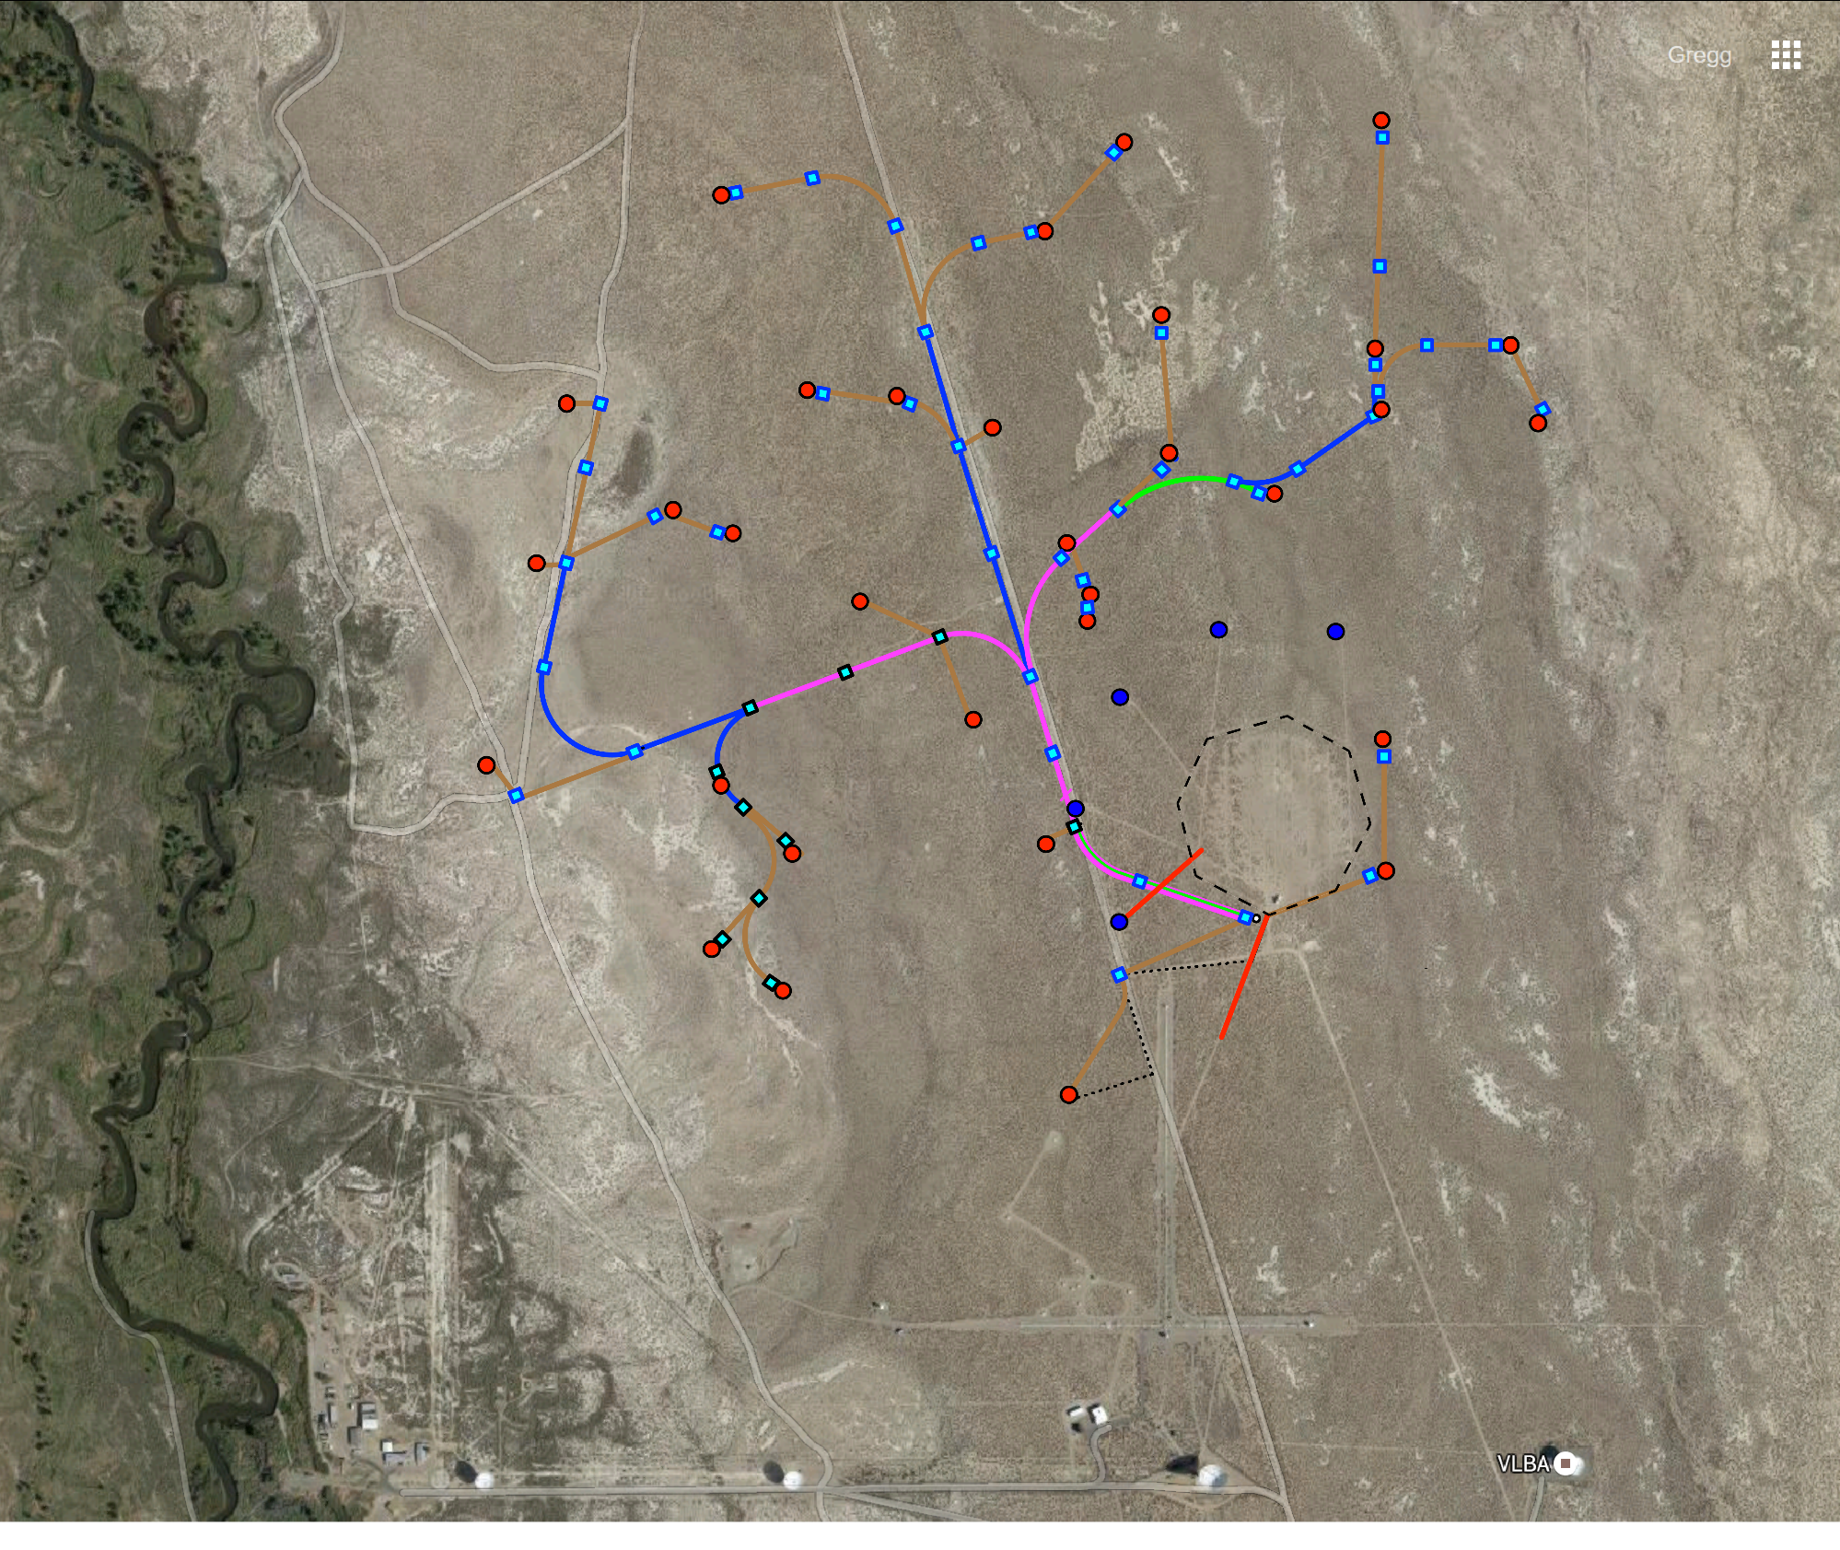
Phase 2: 2015-2016
Max baseline ~1.6 km

Slide 8
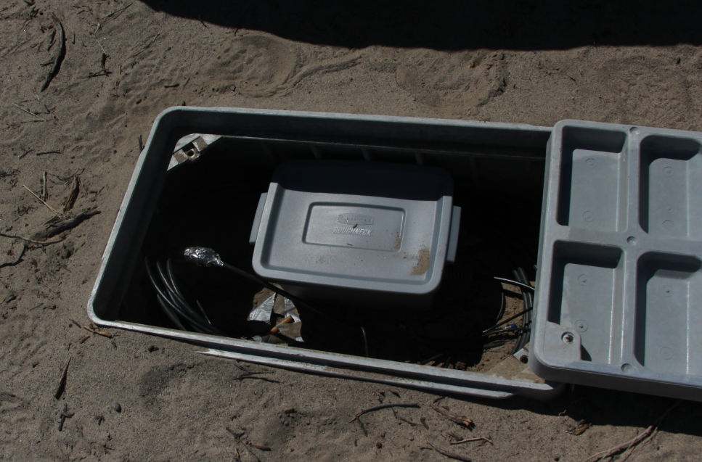
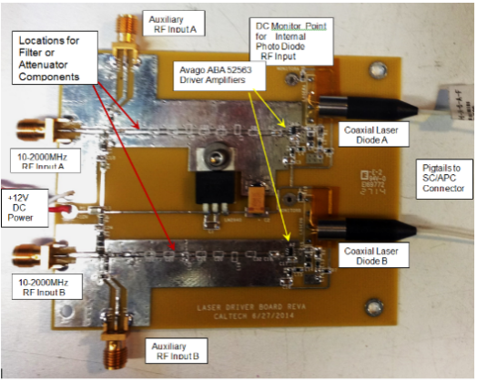
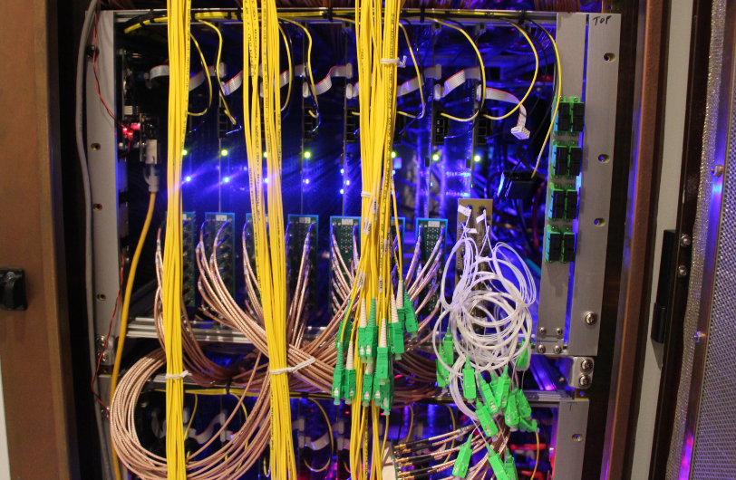
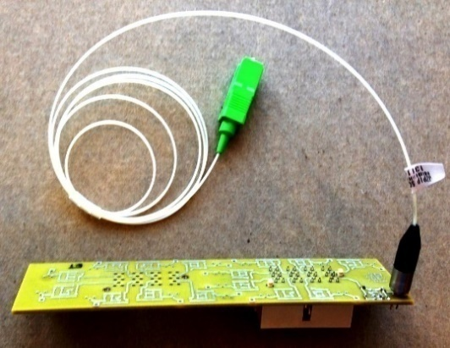
Longer baselines – 2015
Custom fiber links designed by Sandy Weinreb
– cost per antenna now <$100 (vs $2000 for commercial hardware)

Slide 9
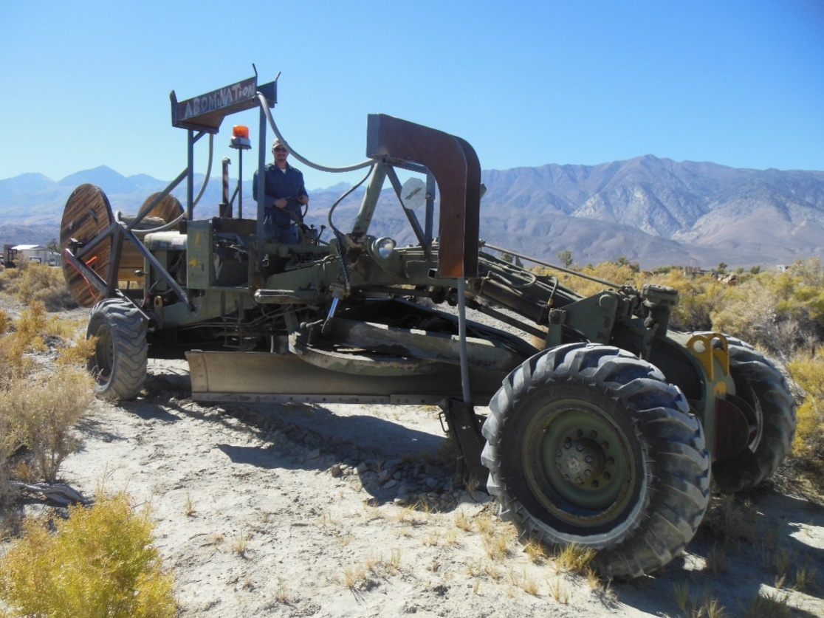
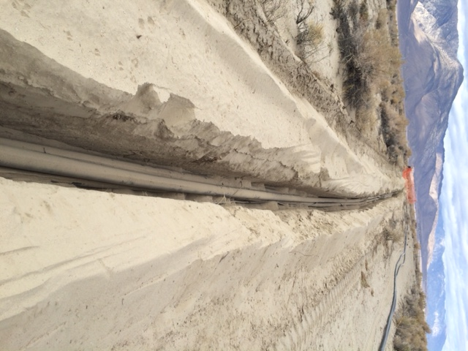
Longer baselines – 2015
Large network of conduit holding 43 km of optical fiber
6 fibers at each “station”

Slide 10
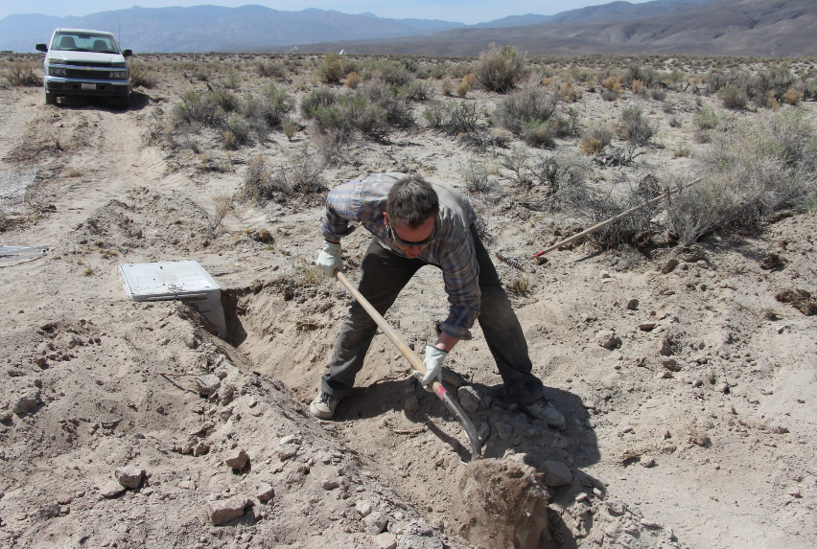
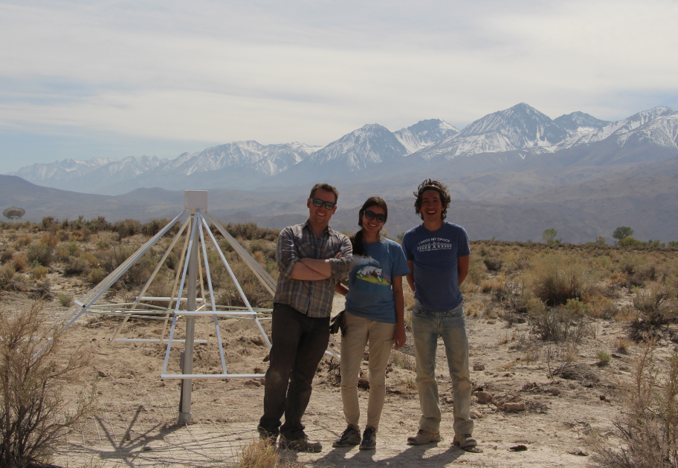
Longer baselines – 2015

Slide 11
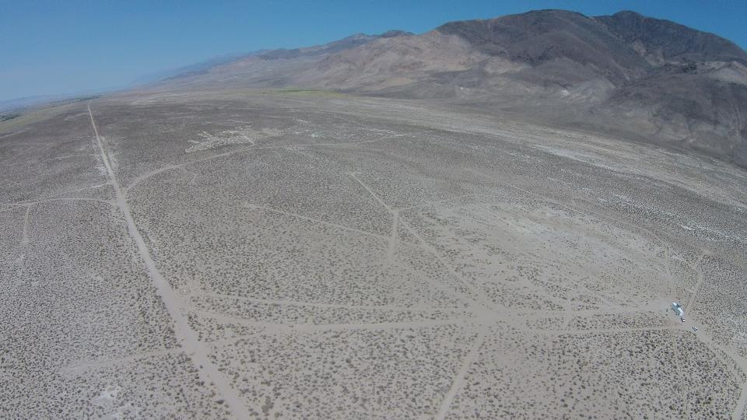
Phase 3 - NSF ATI
i) Complete remaining 64 antennas on long baselines
ii) Install new correlator with double the existing capacity
iii) Install a 1.35 PB system to allow 3000 hour integrations
iv) Replace all receiver boards with next-gen models

Slide 12
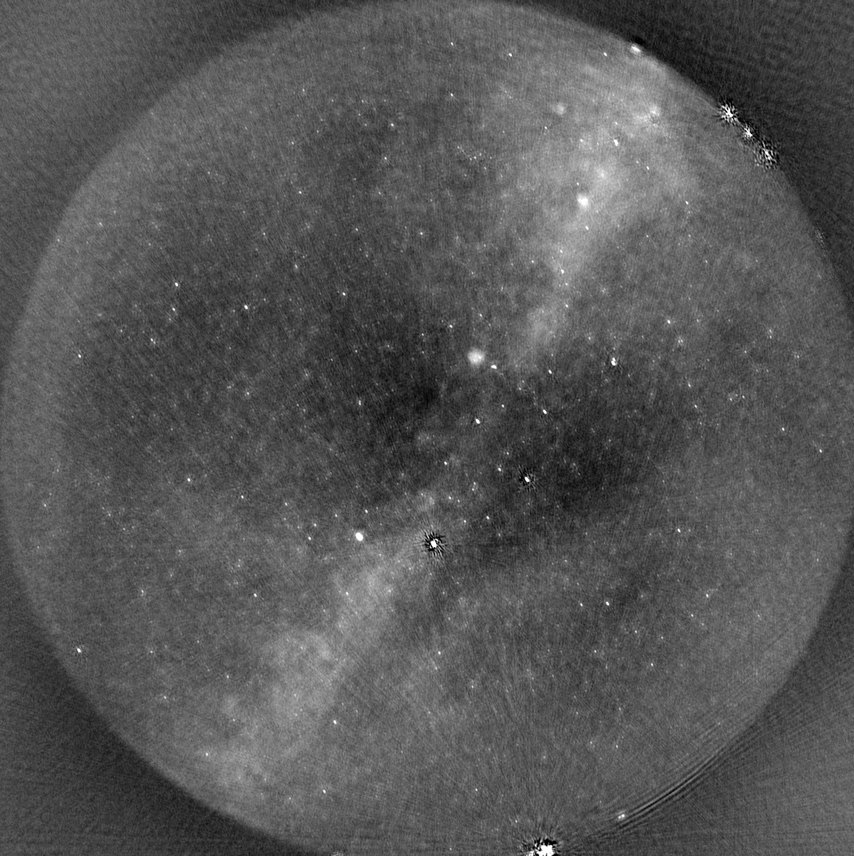

Slide 13
First 100 hour survey
completed in March/April 2016
Continuous (buffered) observing underway
Advanced LIGO-VIRGO O2 run
GCN triggers for GRBs

Slide 14
Science with All-sky FoV
Transients
(Stellar CMES and Extrasolar Planets)
Cosmic Dawn
Monitoring of the Sun and Jovian System
Ionospheric Monitoring

Slide 15
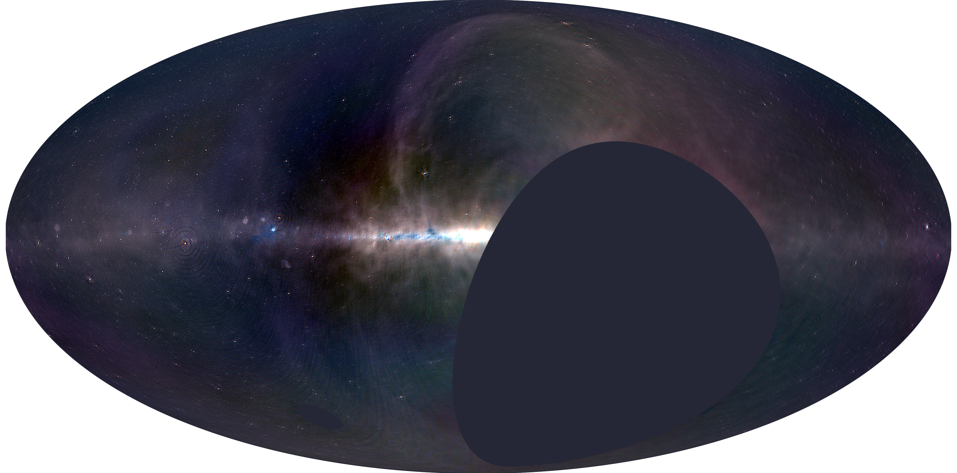
21-cm science: Cosmic Dawn (z ~15-20)
i) Foreground maps
ii) Foreground separation
iii) Power spectrum Estimation
Makes use of m-mode analysis – Shaw et al. 2014, 2015
Michael Eastwood talk today

Slide 16
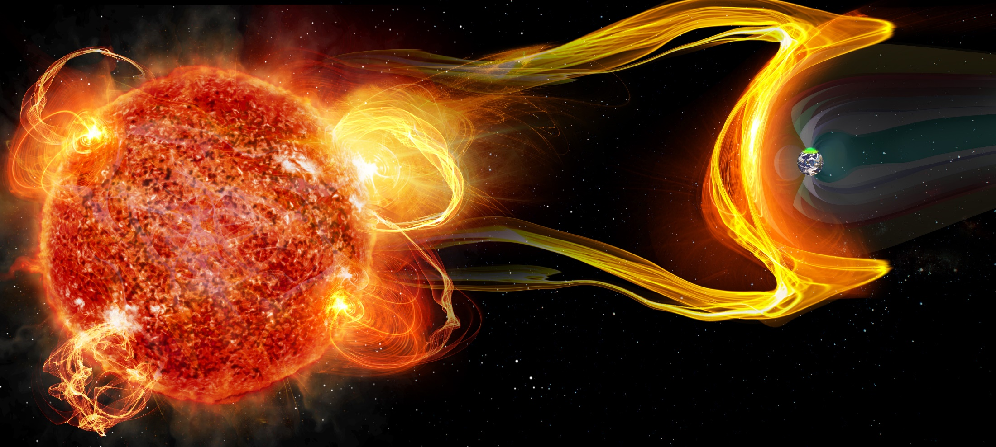
Extrasolar Space Weather
Is magnetic activity important for defining habitability?
Can we directly detect CMEs, planetary aurorae?
Notes:
Radio Blackouts
Solar Flares send out x-rays
Arrive at Earth in 8 minutes
Modify the ionosphere
Disrupt HF radio communication
Impacts:
Airline communication
HF radio operators
DoD Communications
Satellite Communications
Radiation Storms
Solar Flares and Coronal Mass Ejections (CMEs) send out Energetic Particles
Arrive at Earth in 15 minutes to 24 hours
Modify the high latitude ionosphere
Disrupt HF radio communication
Impacts:
Airline communication
HF radio operators
DoD Communications
Ionizing radiation penetrates into the atmosphere
Impacts:
Astronauts (radiation)
Satellite failures
Geomagnetic Storms
Coronal Mass Ejections (CMEs) send out Magnetic Clouds
Arrive at Earth in 1-4 days
Accelerate particles within the magnetosphere and into the ionosphere
Impacts:
HF radio communication
Radio Navigation (GPS)
Electric Power Grids
Increased Satellite Drag
Aurora

Slide 17
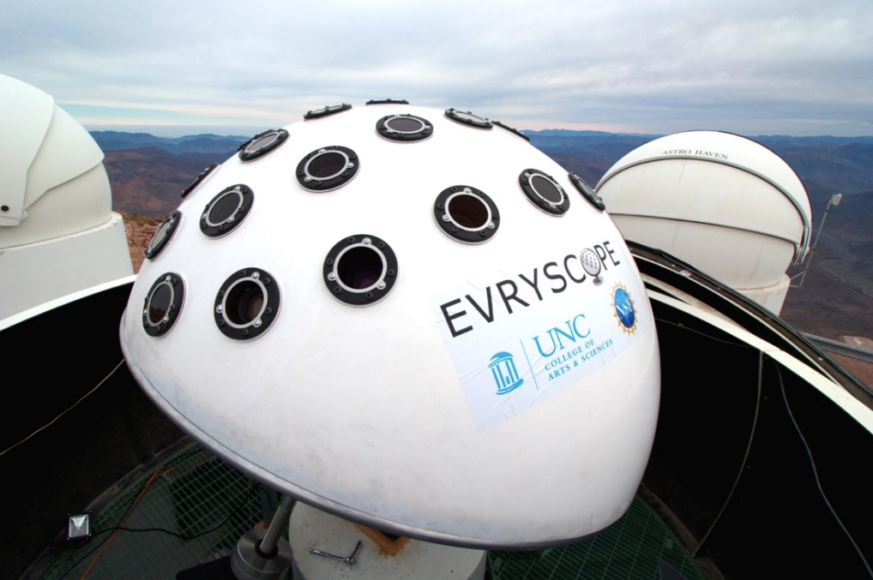
Extrasolar Space Weather
Evryscope: Nicholas Law et al.
OVRO-LWA: 352 antennas
Both telescopes will monitor 4000 stars out to 25 pc
Stokes V imaging essential!
Marin Anderson’s talk on Friday

Slide 18
Solar Coronal Mass Ejection
Sherry Chhabra talk on Friday

Slide 19
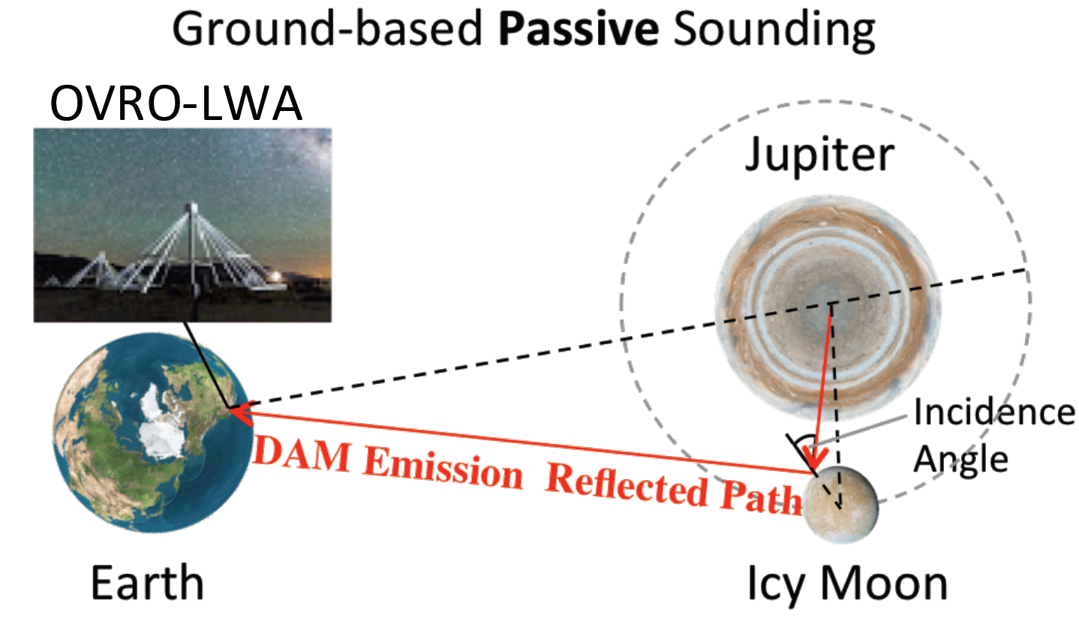
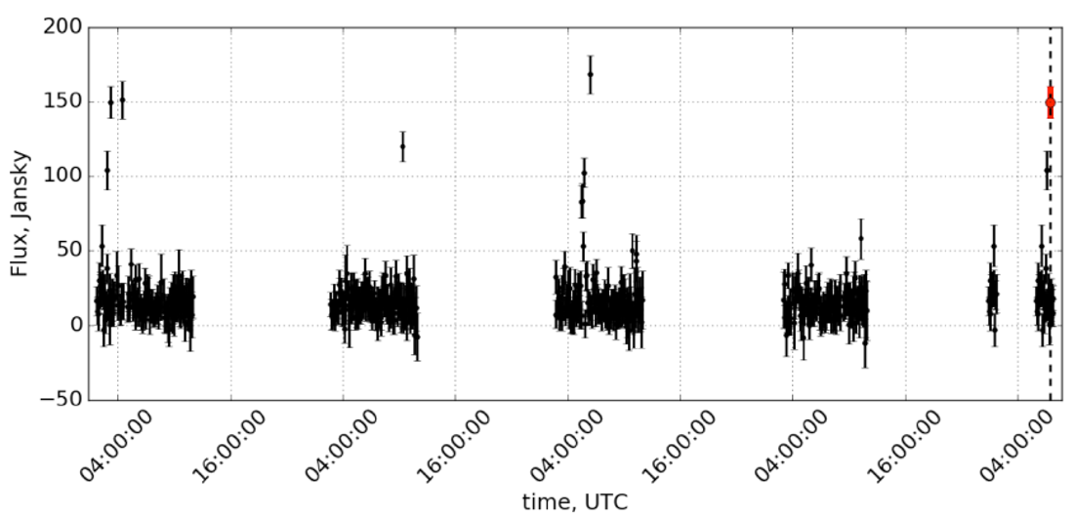
Probing the Subsurface of Galilean Moons
Initially funded though a President & Director’s Fund Award
PI: Andrew Romero Wolf & Dave Stevenson

Slide 20
OVRO-LWA Data Pipeline
LEDA Correlator
Output
Antenna gain patterns
Conversion to MS format
Generate 2-D ionospheric phase screens
Apply Calibration
Ryan Monroe talk: today
Flag Data
Michael Eastwood
talk: today
M-mode analysis
Fully Polarized All-sky Imaging
Marin Anderson
Talk: Friday

Slide 21
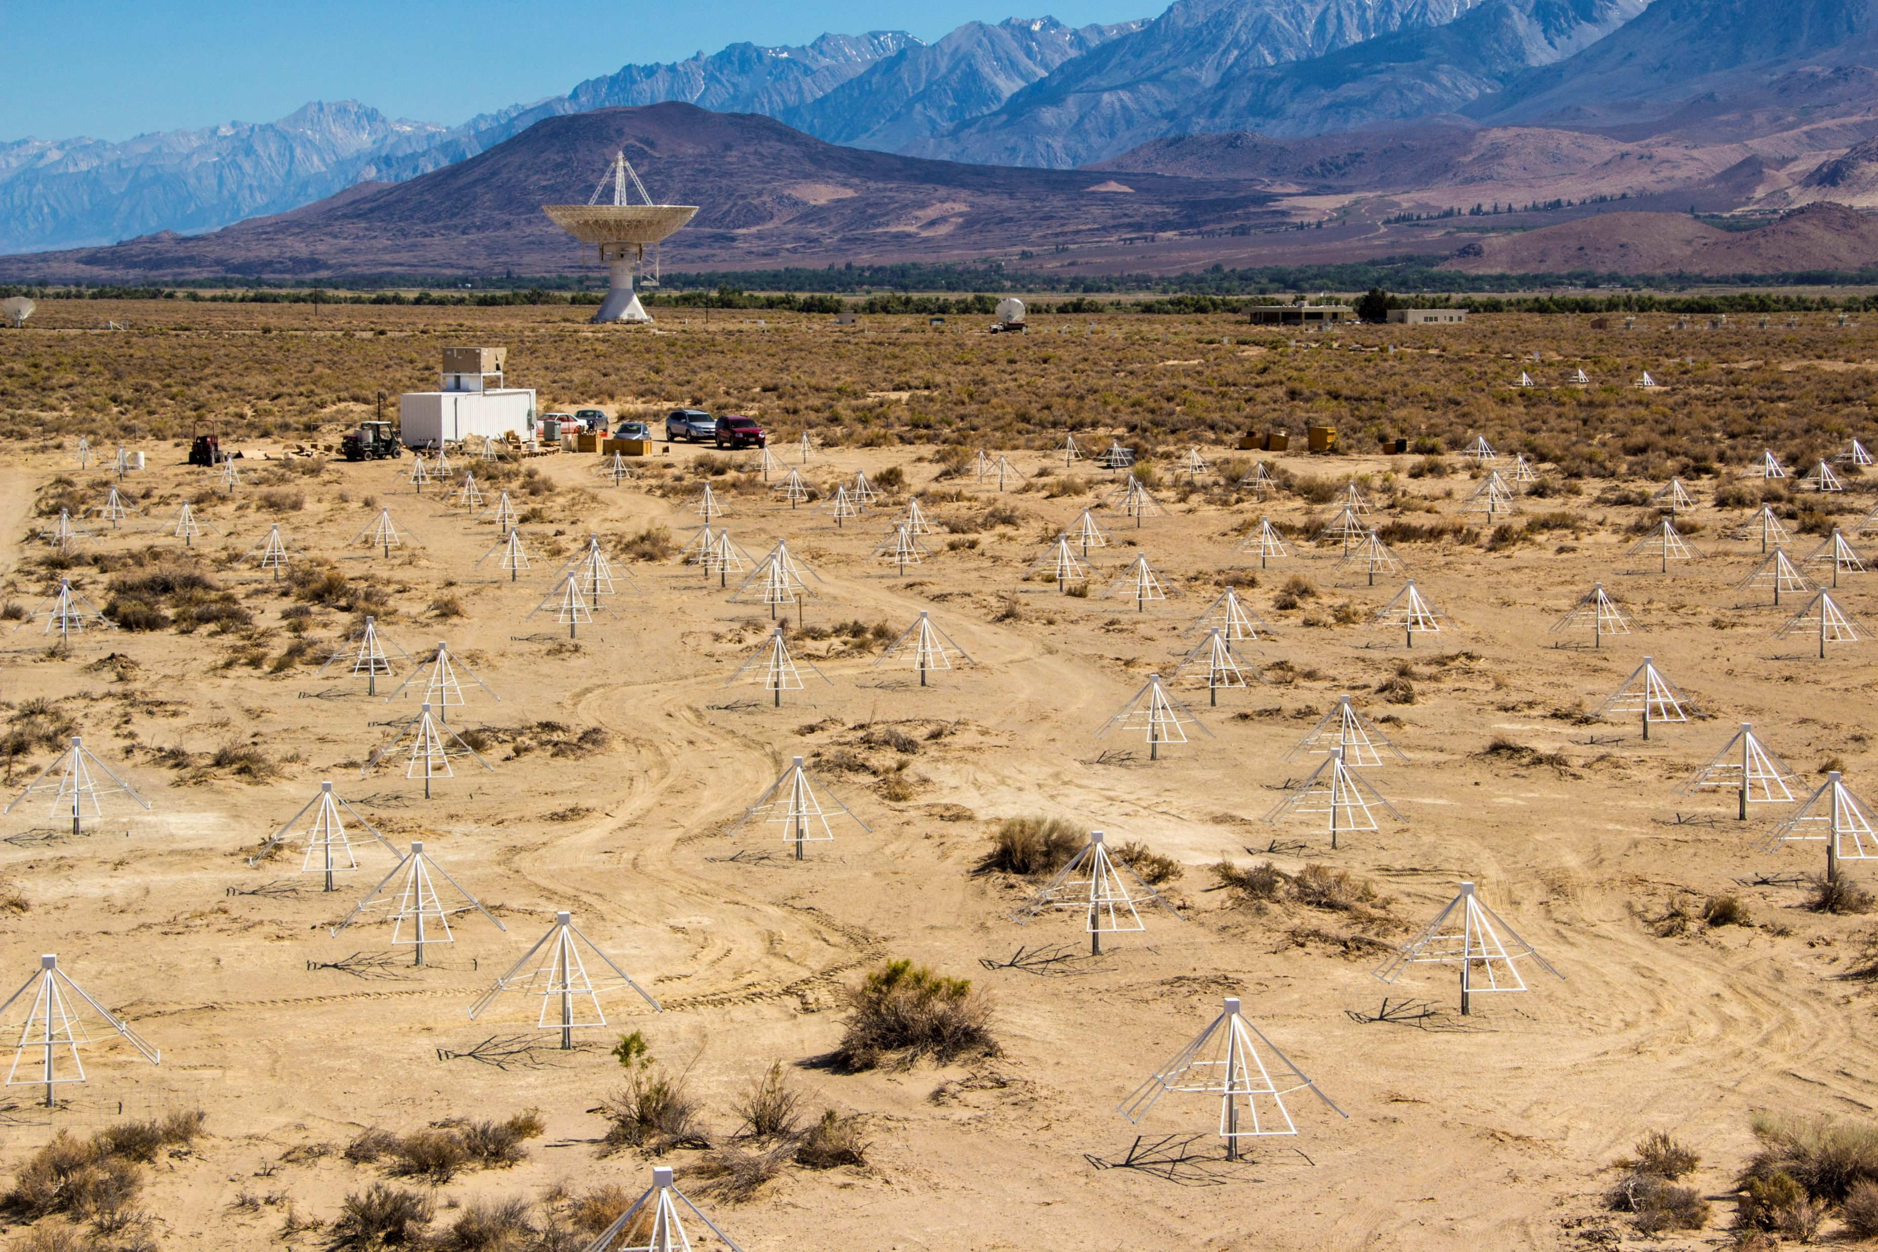
Dipole Beam Holography
Science requires exquisite knowledge of the polarized beam of each dipole
Holography of each dipole antenna with nearby 40 m antenna (goal <1% error)
Initially use bright sources – transition to gated pulsars
Goal: Stokes V all-sky map each day with 5 mJy rms noise in Stokes V
Combined all-sky map with 500 µJy rms noise in Stokes V

Slide 22
Summary
Stage 1: Core array built in 2013/2014
Stage 2: Long baseline demonstrator array built in 2015/2016
First 100 hour survey completed April 2016
Continuous (buffered) observing underway
- Advanced LIGO-VIRGO O2 run
- GCN triggers for GRBs (Swift, MAXI, etc.)
Stage 3 proposed via NSF ATI
Planned antenna beam holography project underway

